Slide 1
Please make a pocket on p. 137 –
Target: I can review for my final exam and practice the multiple choice format

Slide 2
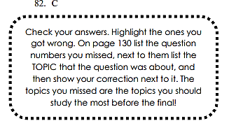
NOT PAGE 130! PLEASE UPDATE TO SAY P. 136

Slide 3
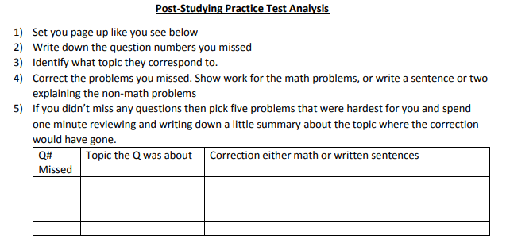
p. 136 - Corrections

Slide 4
http://tinyurl.com/jxy7rwh
Fill out the form so I know which questions to do tomorrow! Tomorrow is a short period!

