Slide 1
Mrs. Farmer’s Example Interactive Notebook Regular Chemistry
Please note
This is just an example of what your notebook should look like. Yours may have different assignments, different notes –depends on the year. Please use this as a general guide only. Read the reference sheets in Interactive Notebook for more specifics

Slide 2
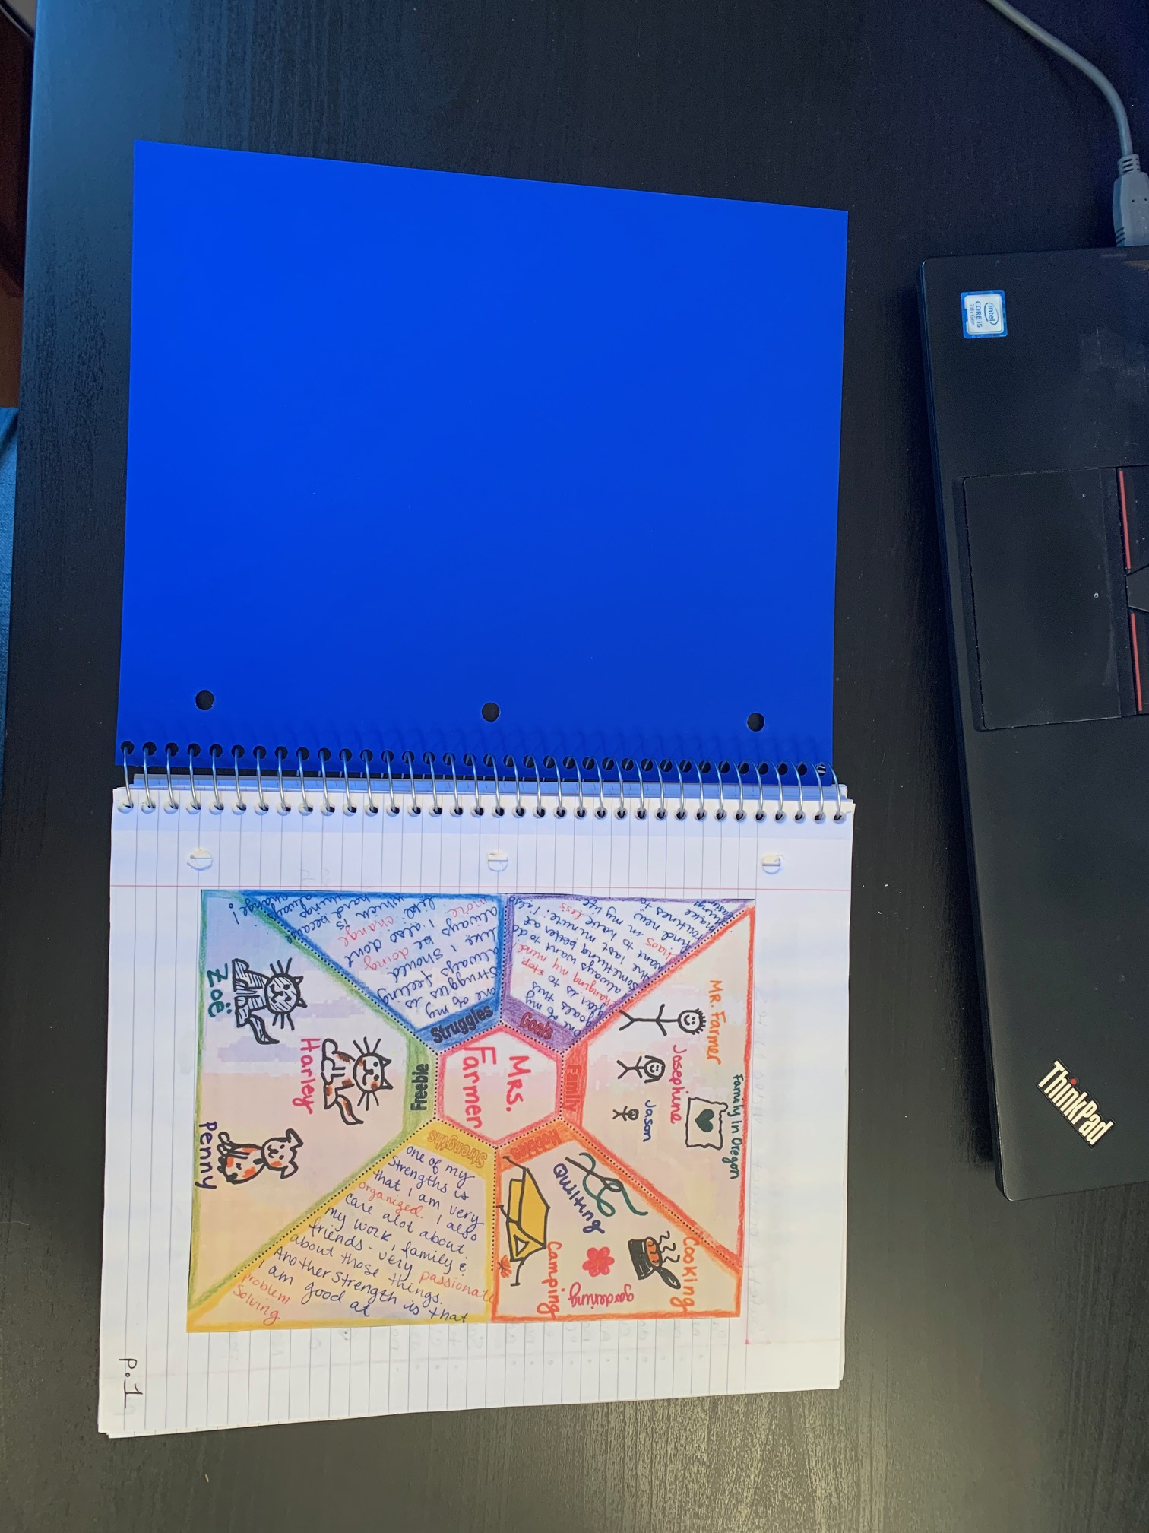
All About Me Page 1

Slide 3
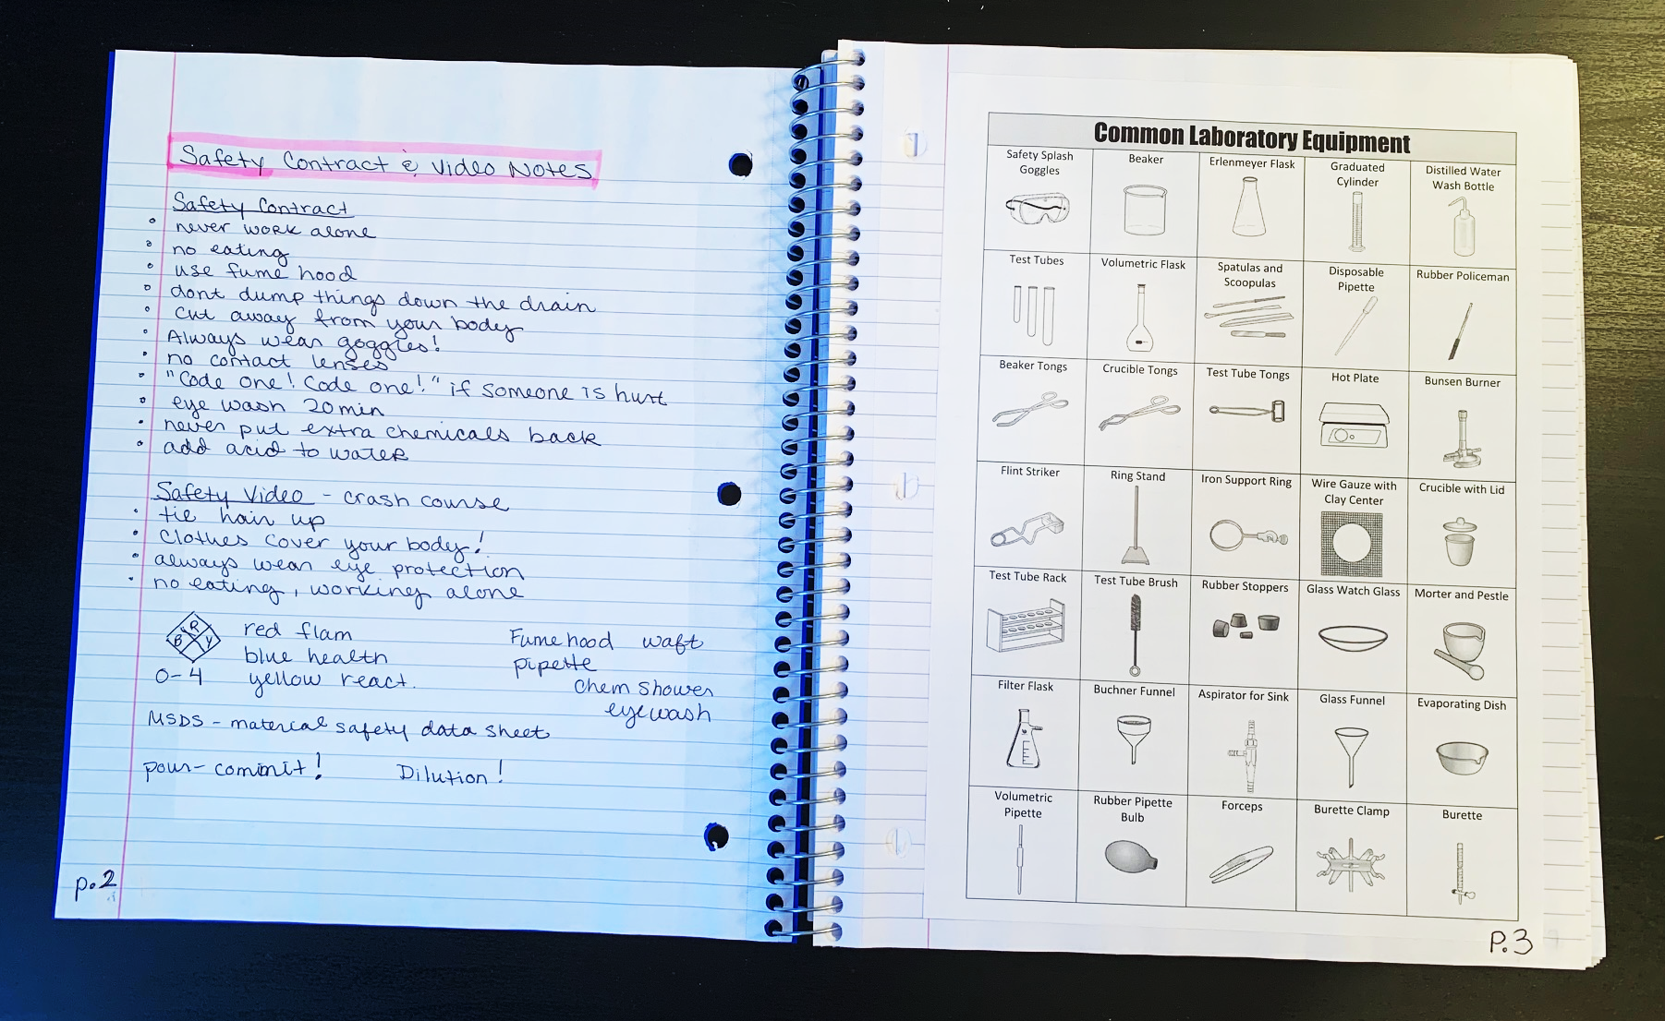
Safety Work Page 2 Common Lab Equipment Page 3

Slide 4
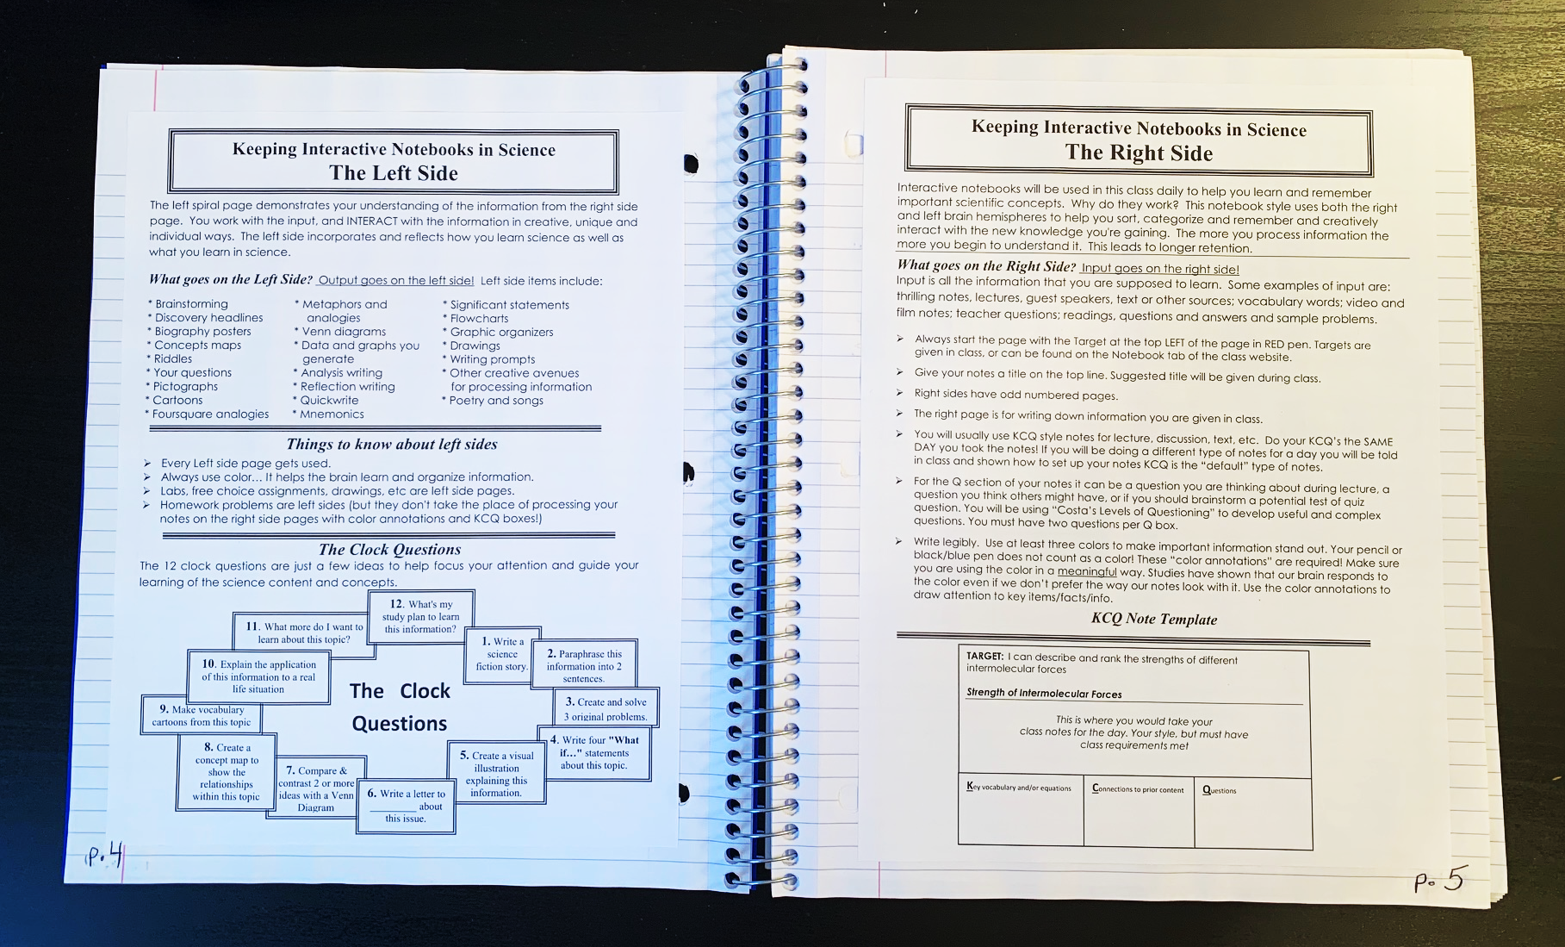
The Left Side Page 4 The Right Side Page 5

Slide 5
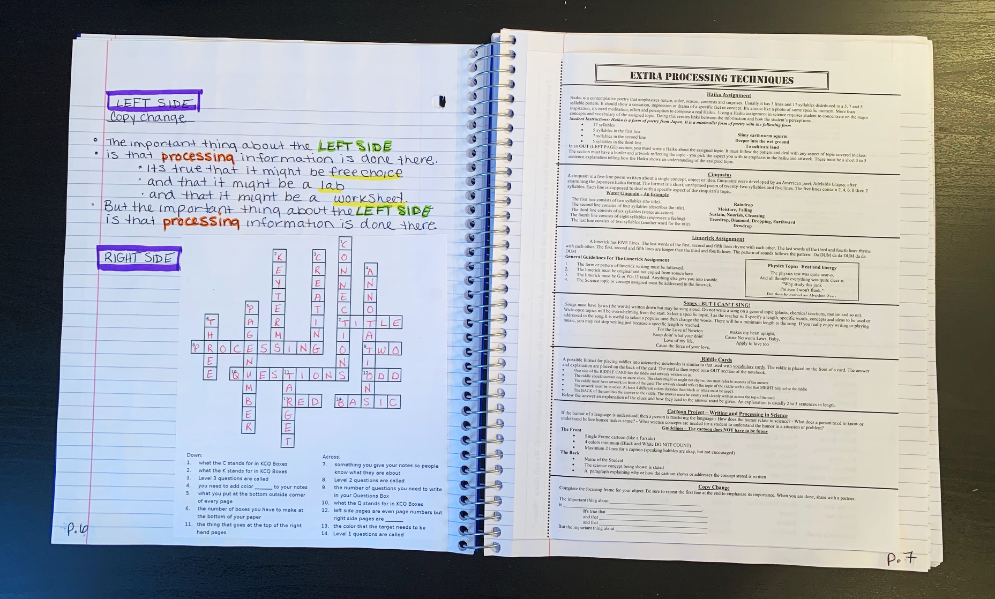
Free Choice Processing Page 6 Processing Techniques Page 7

Slide 6
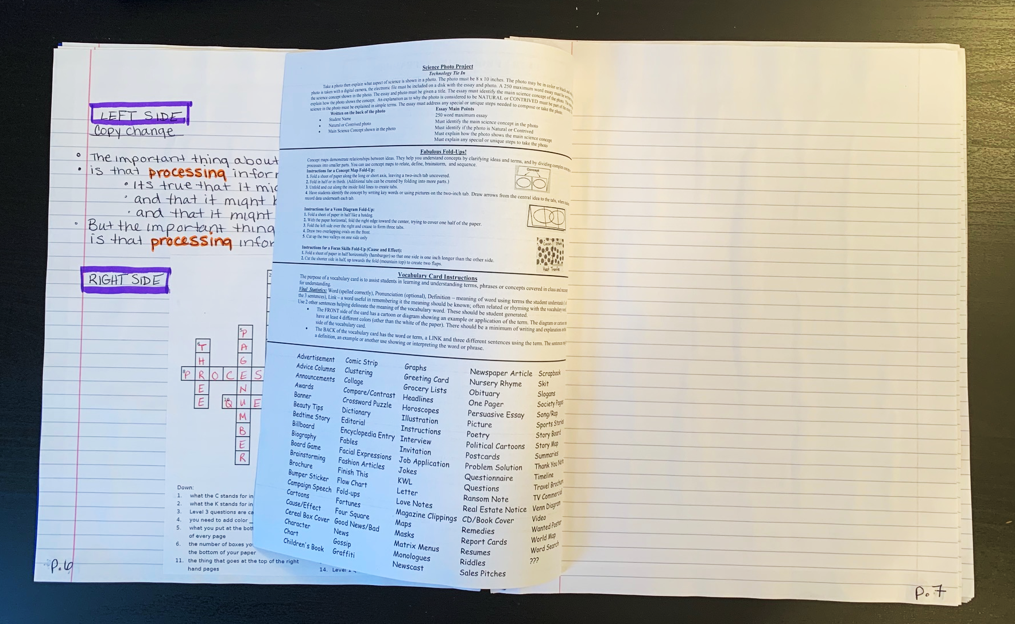
Some Pages are “Flippies” – you can glue just the edge down and then can flip to see the back side.

Slide 7
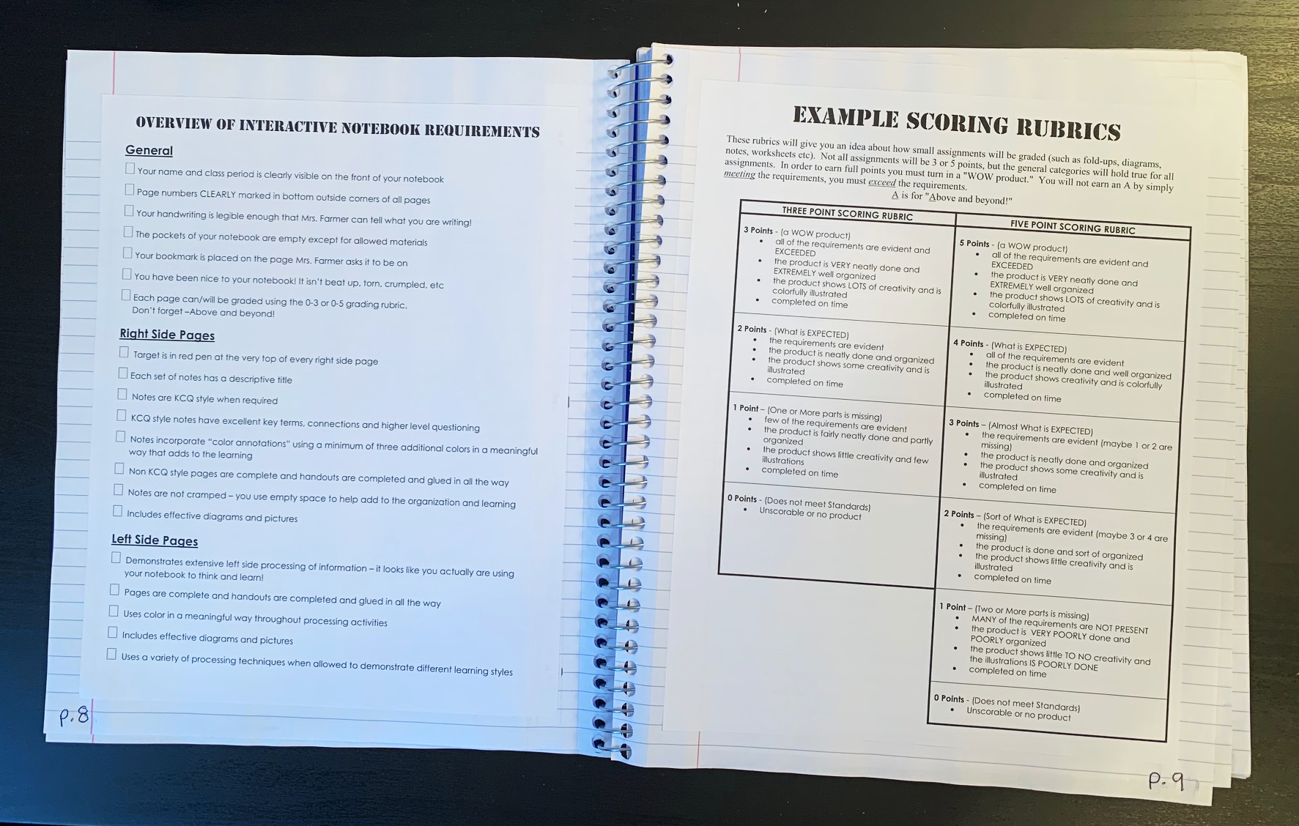
Notebook Requirements Page 8 Example Rubrics Page 9

Slide 8
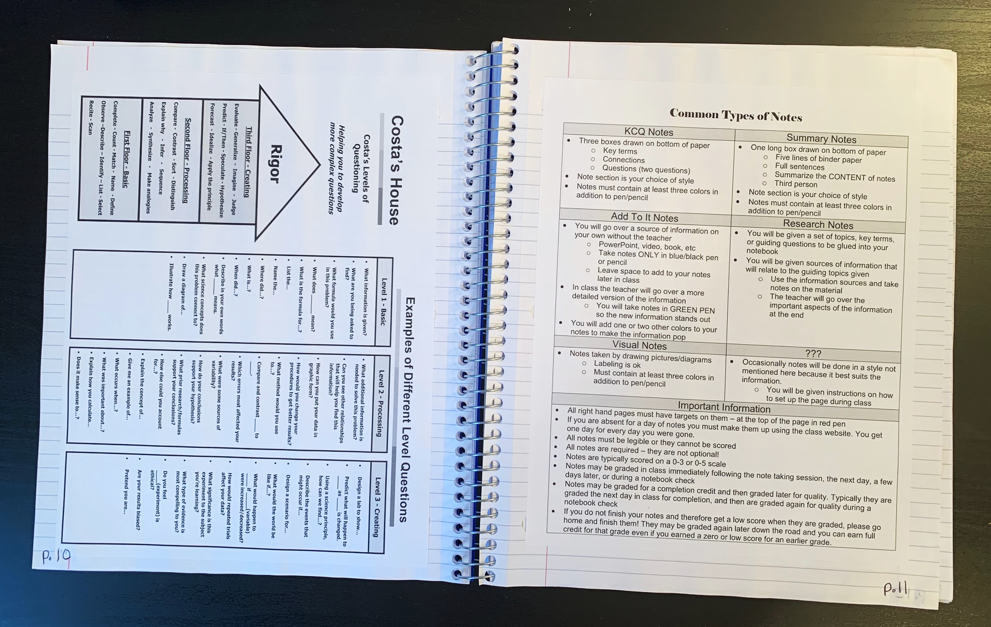
Levels of Questions Page 10 Types of Notes Page 11

Slide 9
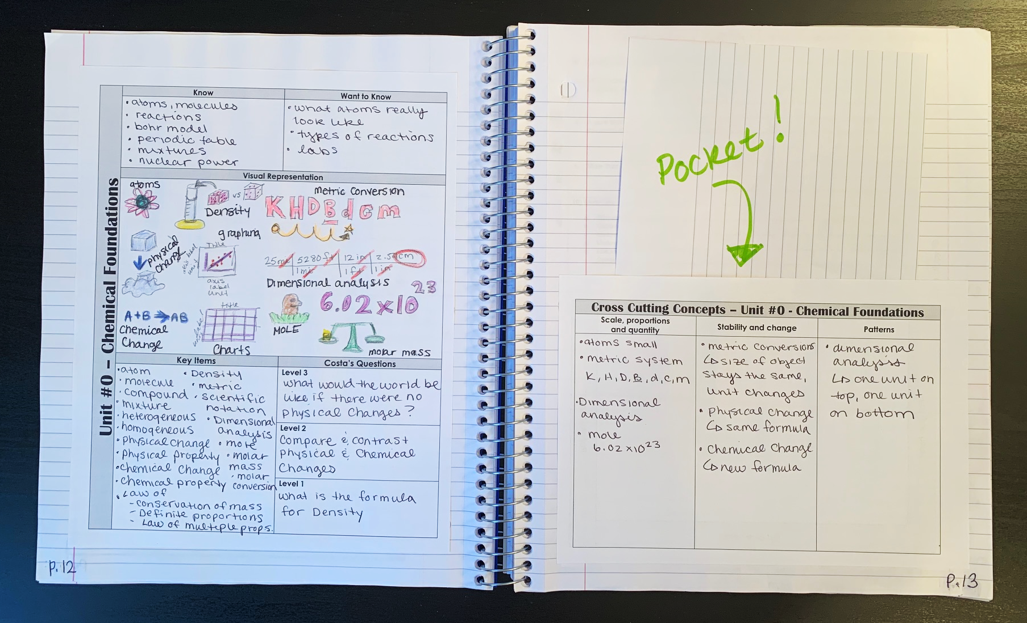
Unit Intro Page Page 12 Cross Cutting Concept Pocket Page 13

Slide 10
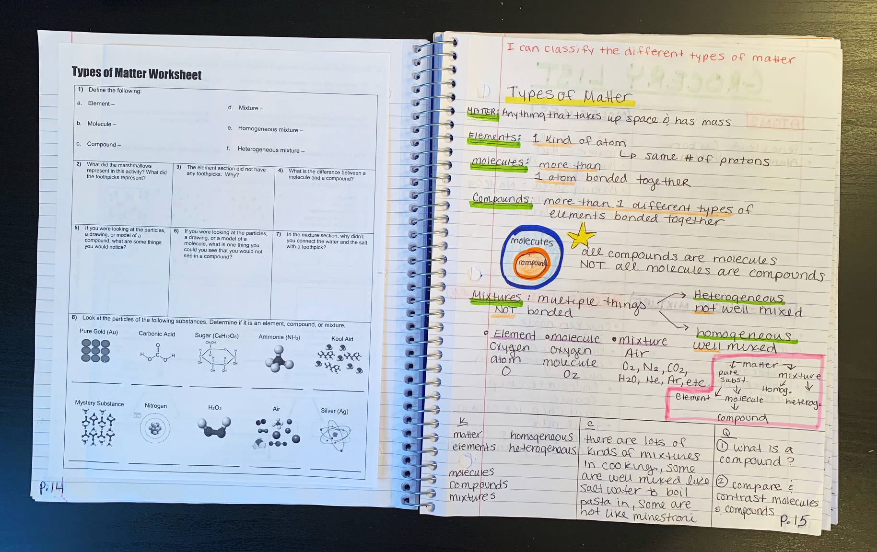
Worksheet Page 14 KCQ Notes Page 15

Slide 11
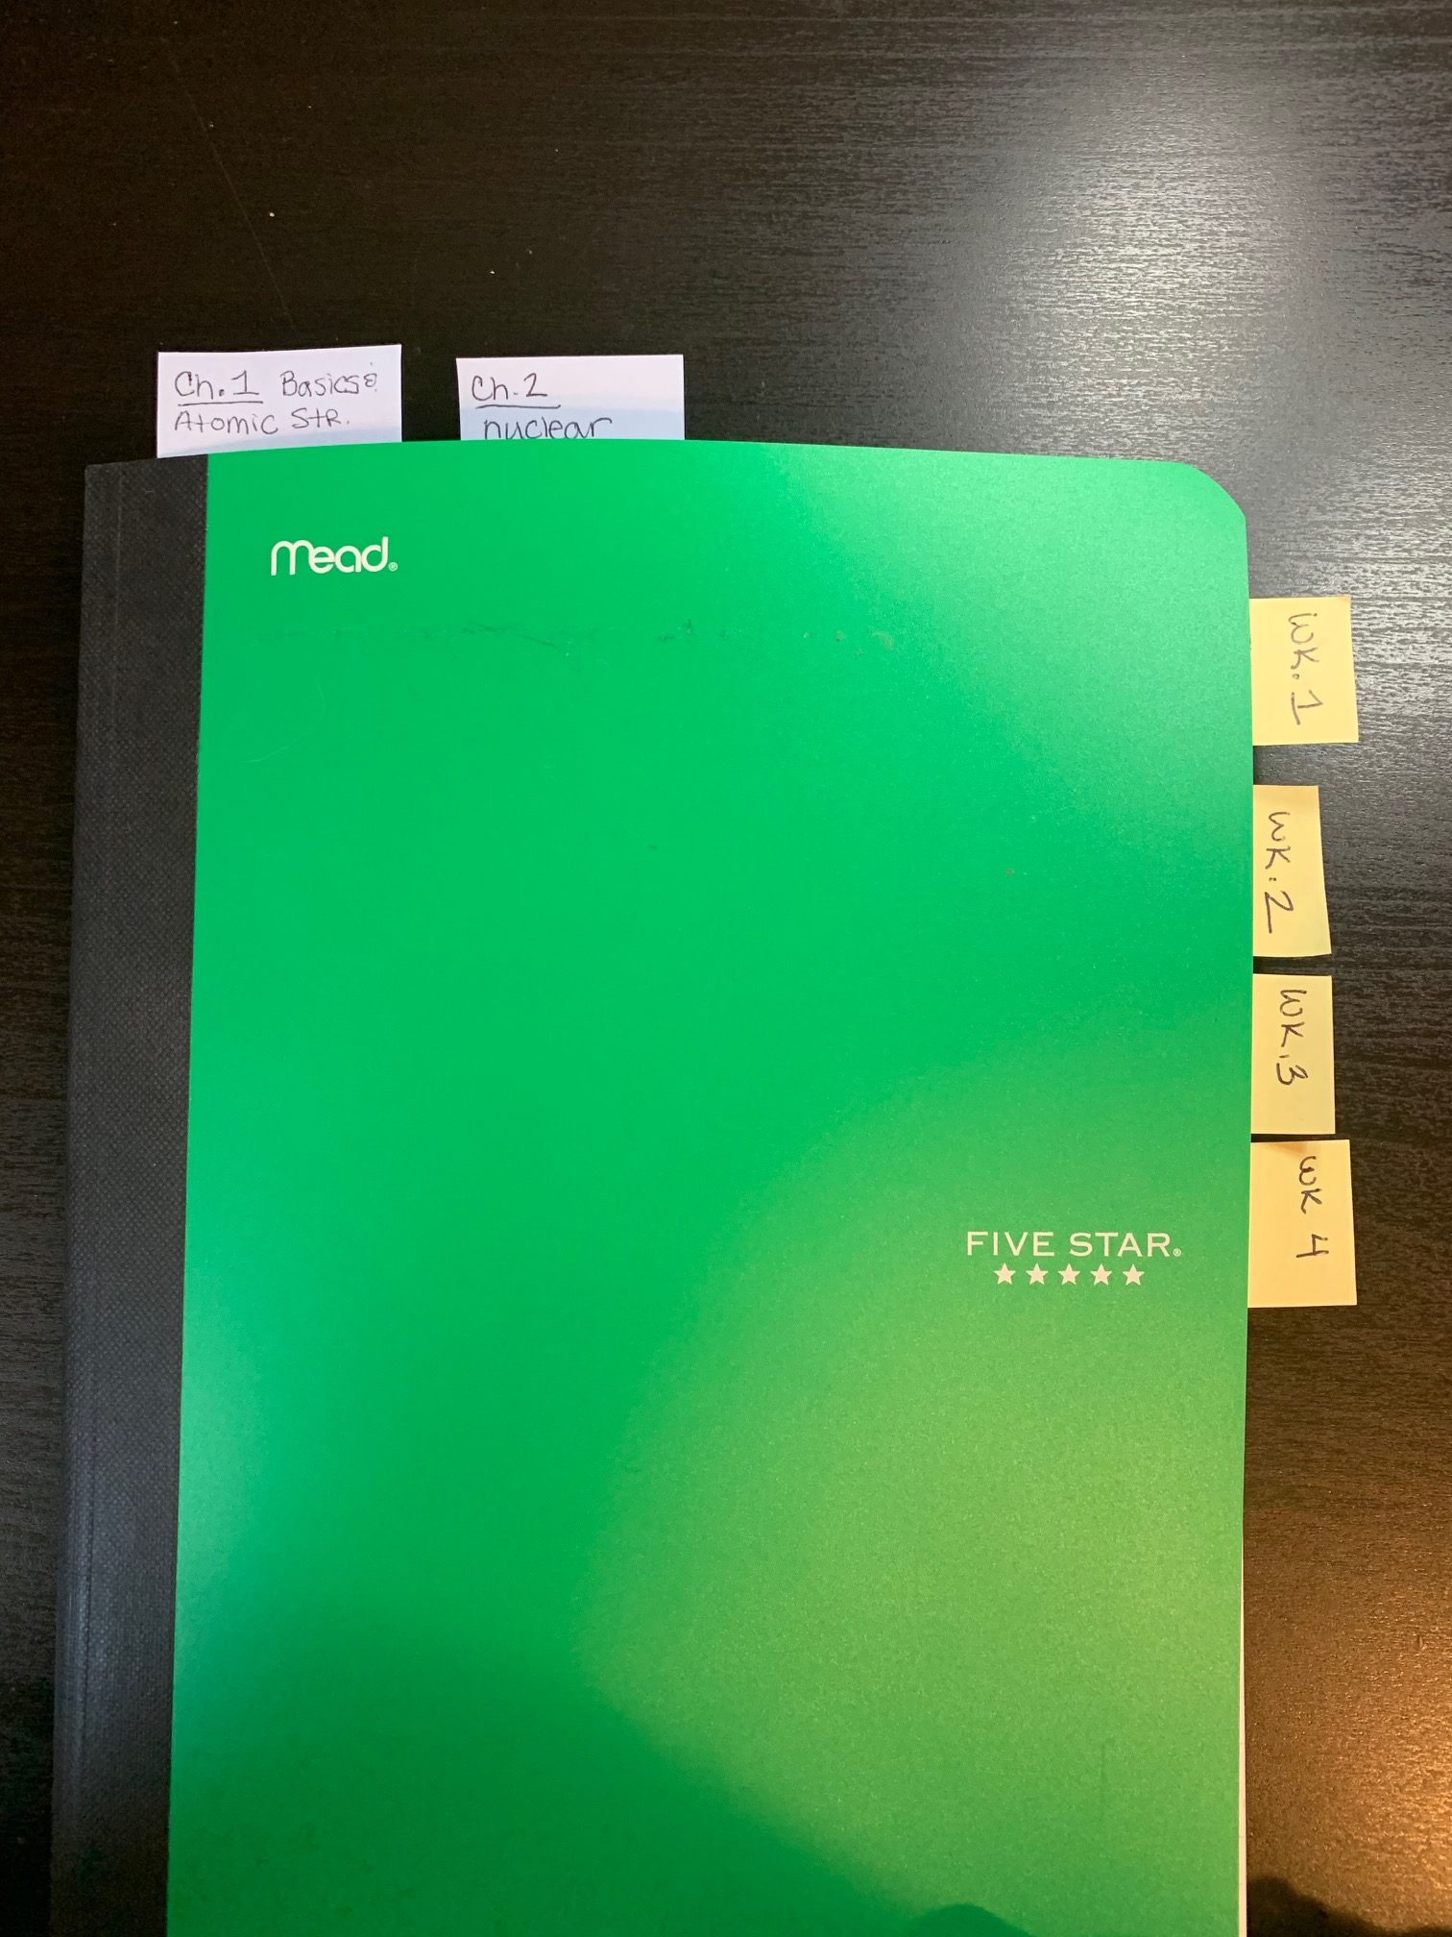
Feel Free to add tabs, bookmarks, etc to your notebook! Make it work for you!
*Yes, I know this is a composition book, this example photo is from my Honors class and they use Composition Notebooks instead of spiral ones. The idea still applies! ☺

Slide 12
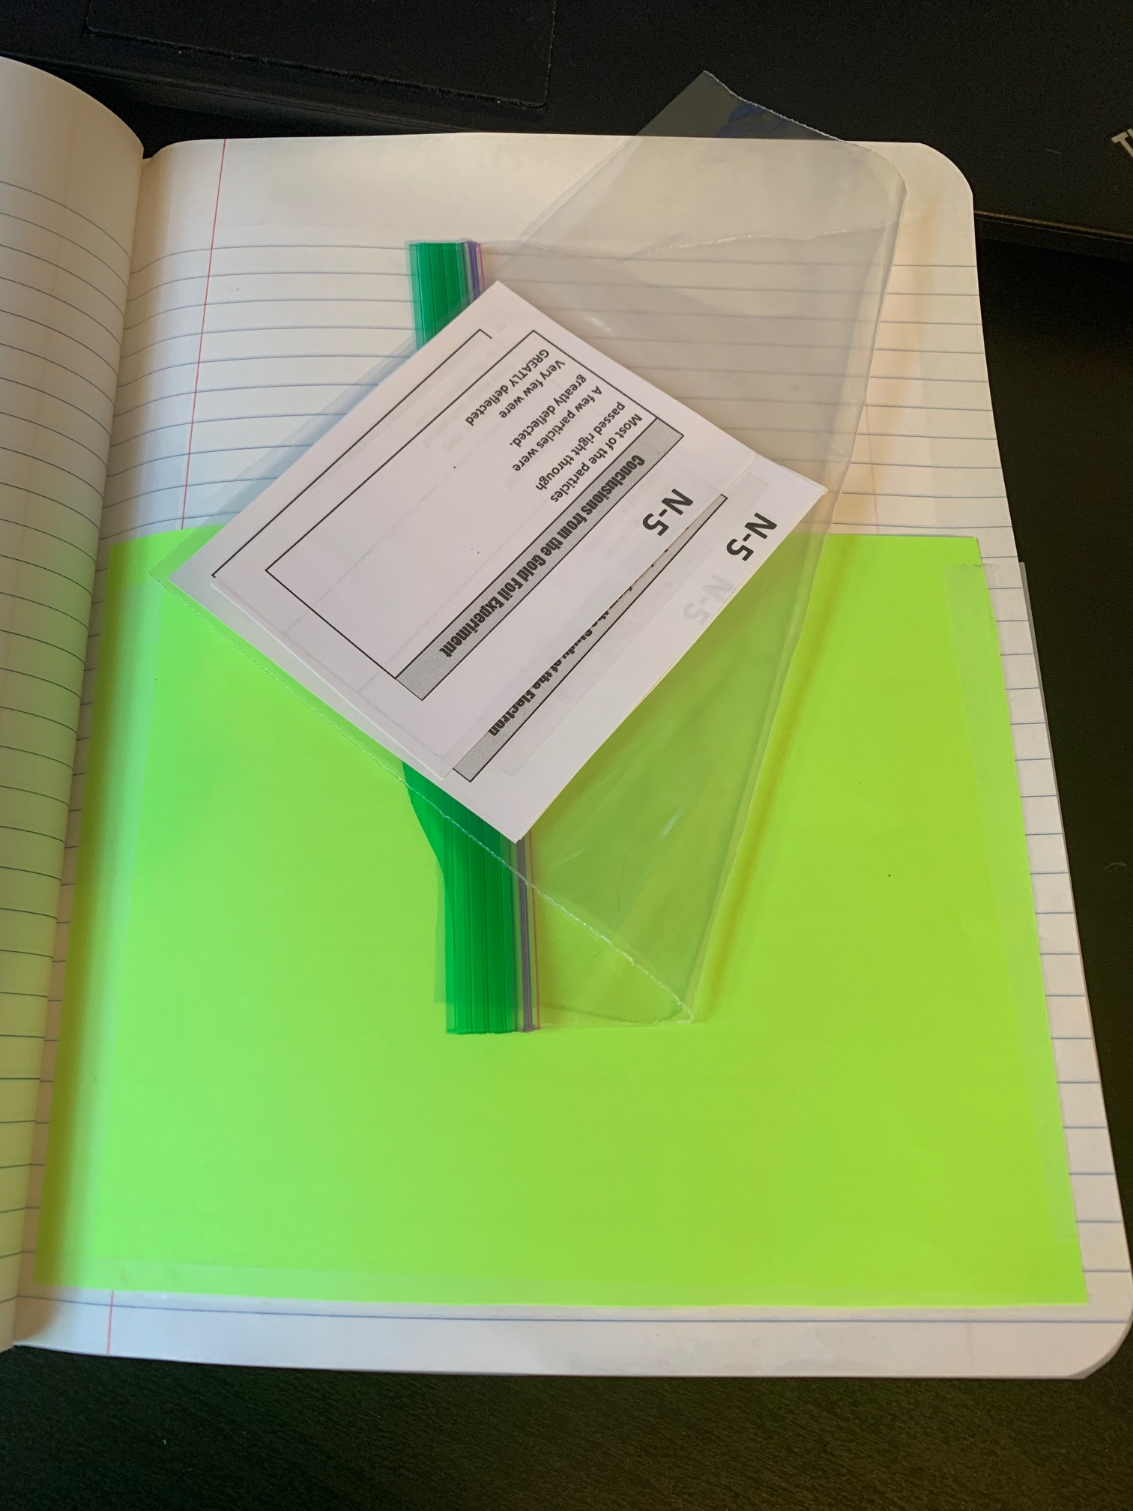
I like to make a pocket in the back to hold a little ziplock bag filled with my Glue Ins for my notes. That way I can print them all at once, cut them to size, and not lose them!
*Yes, I know this is a composition book, this example photo is from my Honors class and they use Composition Notebooks instead of spiral ones. The idea still applies! ☺

Slide 13
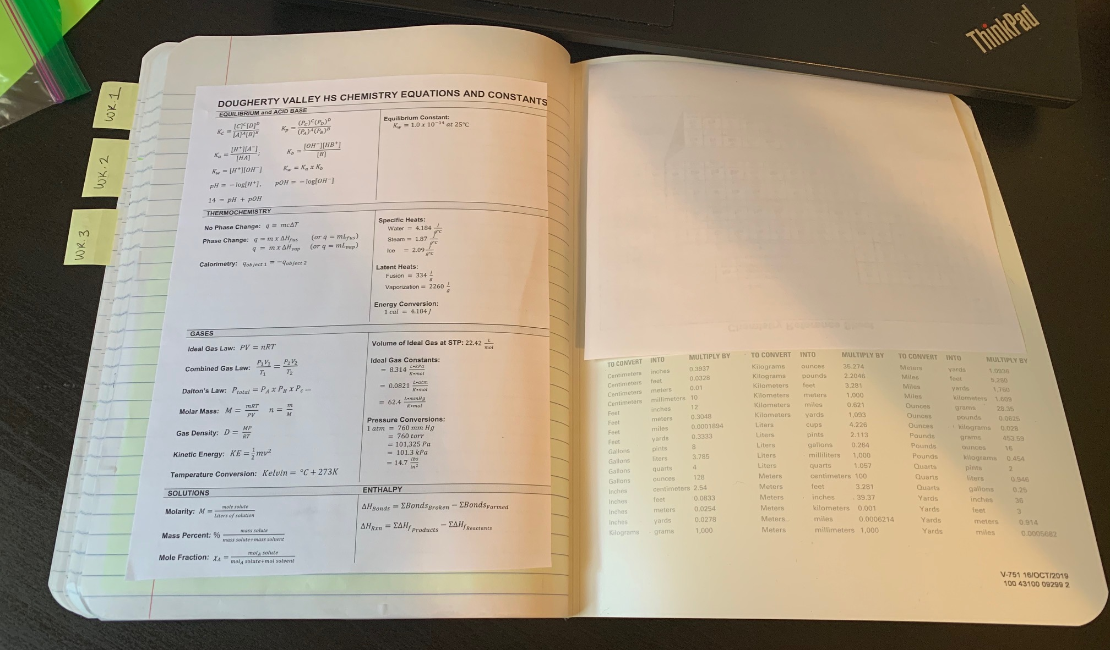
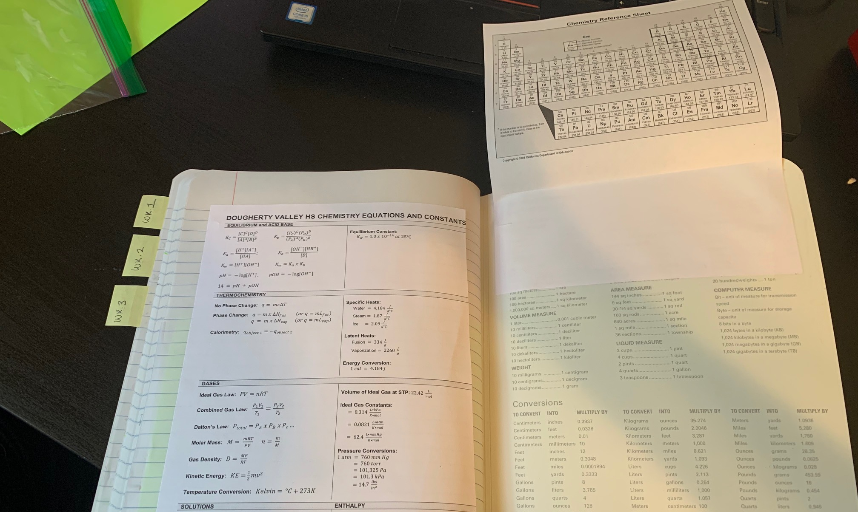
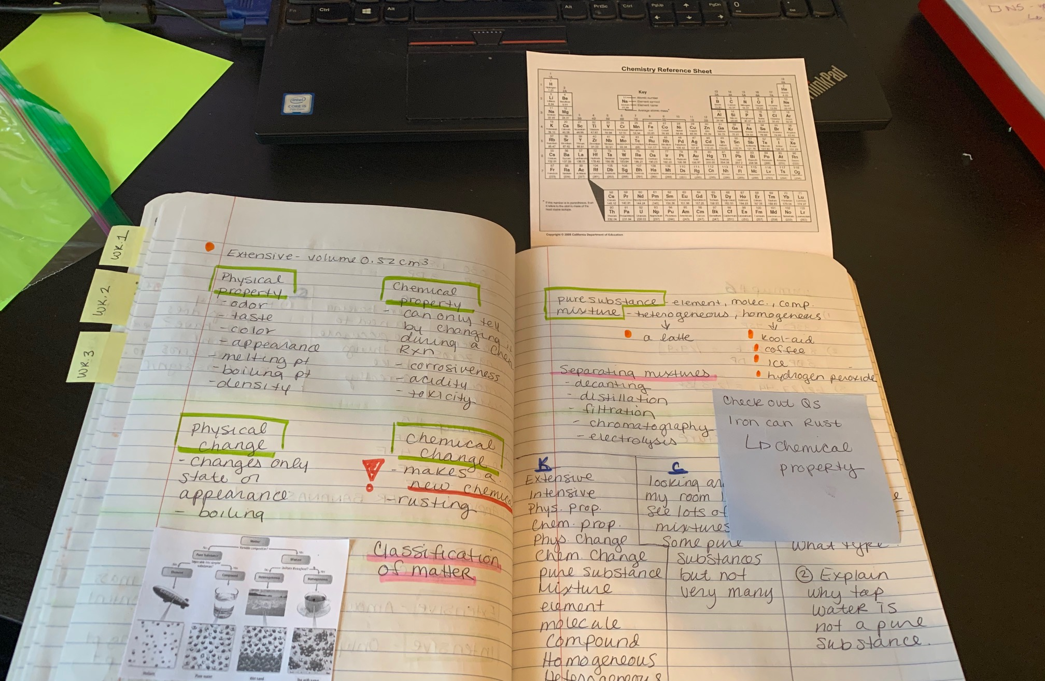
I like to print a small periodic table (you can shrink it down to 75% in the print menu) and then I glue/tape it onto the back inside cover so it flips out of my notebook! Very handy!
*Yes, I know this is a composition book, this example photo is from my Honors class and they use Composition Notebooks instead of spiral ones. The idea still applies! ☺

Slide 14
The next set of slides are just examples of the first few weeks of worksheets and notes. Try to look for the following things.
Large clear numbering on outside, bottom page corners
Large clear title for the notes
Target at the top in RED pen (our brain behaves differently when it sees red!)
Space left in the notes around important points – do not crowd your notes! We have lots of space in our notebooks, use it!
KCQ Boxes on the bottom
Practice problems done in the notes
Color annotations added

Slide 15
The next set of slides are just examples of the first few weeks of warmups and notes. Try to look for the following things.
Color Annotations adding a minimum of three additional colors to the notes.
Color Annotations done in a meaningful way – I didn’t just scribble the background or highlight every word a different color.
More is not always better!
Be careful to not focus on “decorating” or “coloring” your notes – you are supposed to be doing color “annotations.” Sometimes people have beautiful notes but they spent more time on what they look like than thinking about what the notes say!

Slide 16
The next set of slides are just examples of the first few weeks of warmups and notes. Try to look for the following things.
KCQ Boxes added to the end of each set of notes
Make the boxes fit the work that needs to be in them, don’t draw the boxes and then squeeze in the information! Use as much space as needed. You can always make little flippies if you need to
All key terms, not just words that’re new to you!
Connections can be to previous classes, things you saw on TV etc – but they should be specific. Don’t just write “7th grade”
Questions – two questions, one lower level, one higher level. You do not have to answer them!

Slide 17
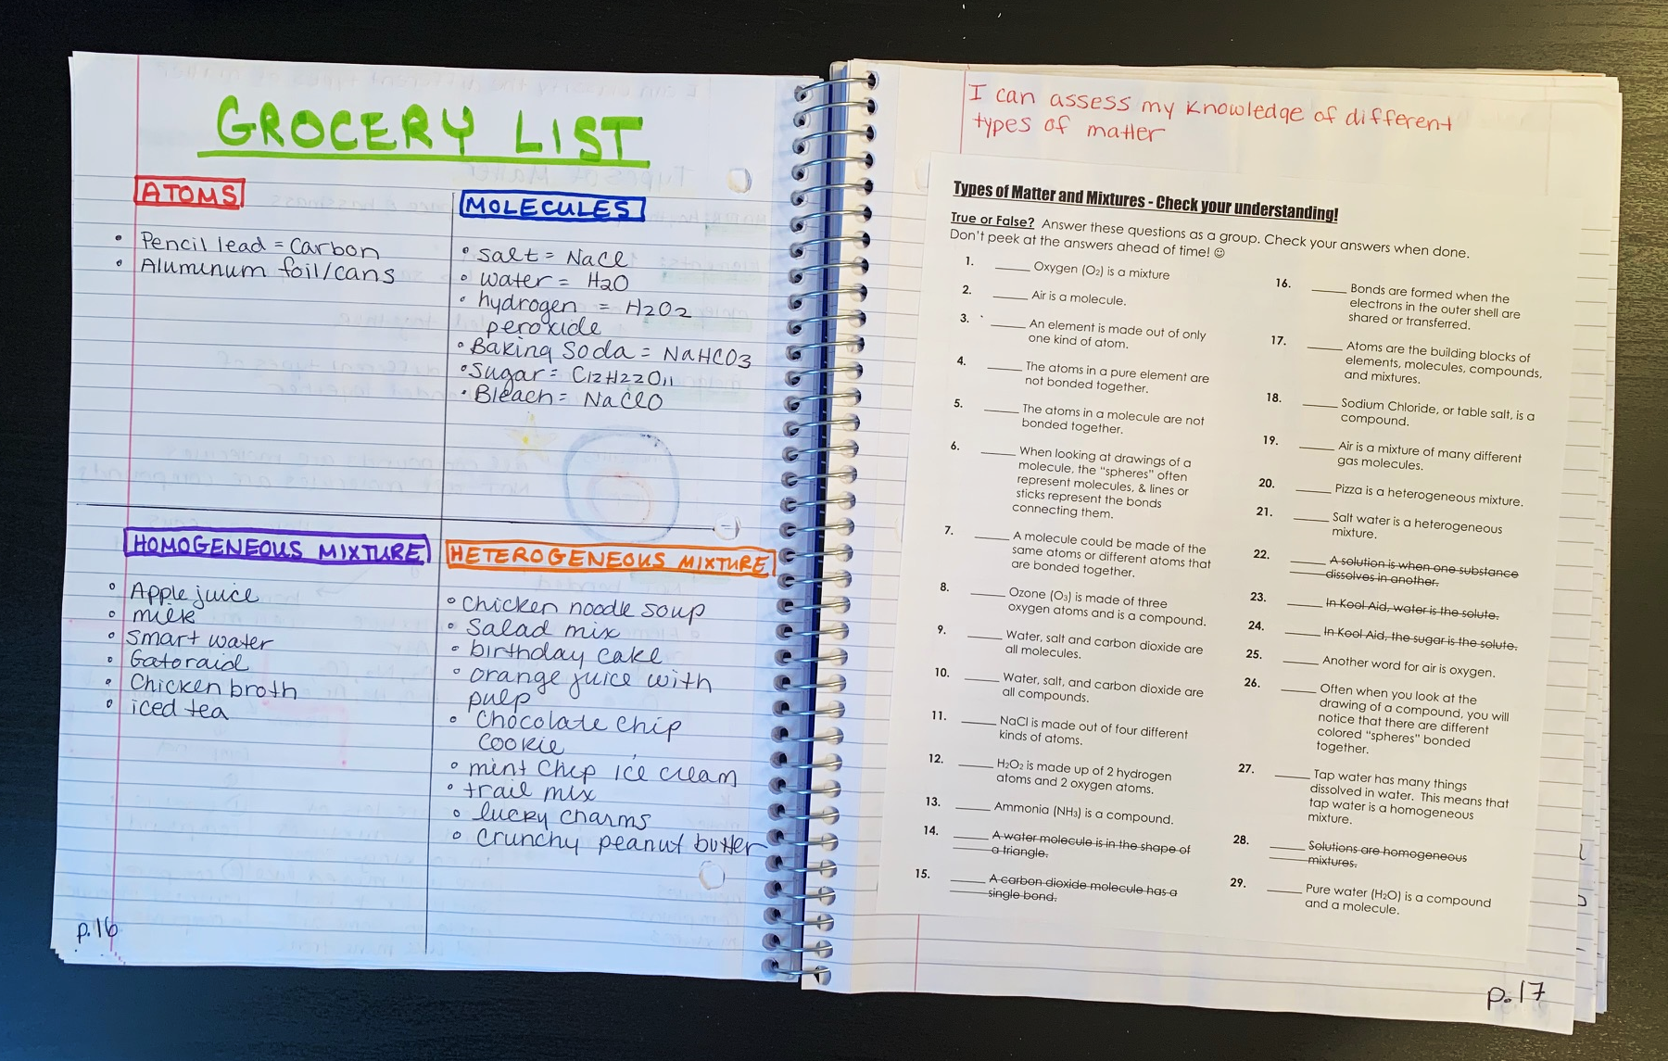

Slide 18
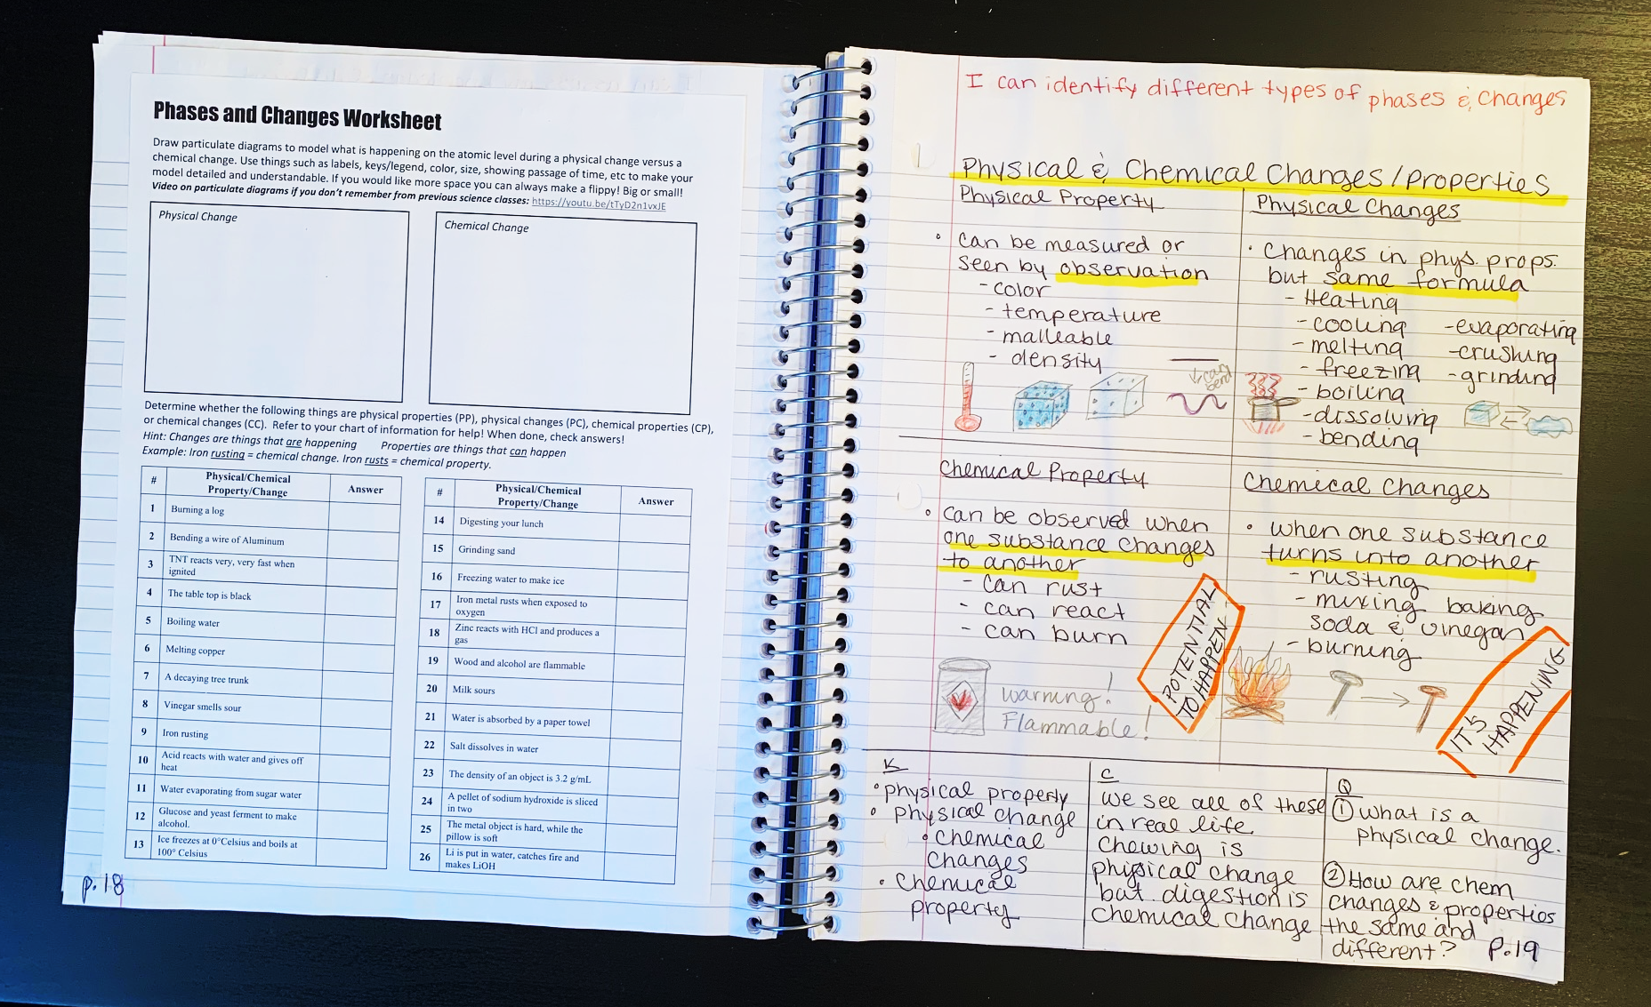

Slide 19
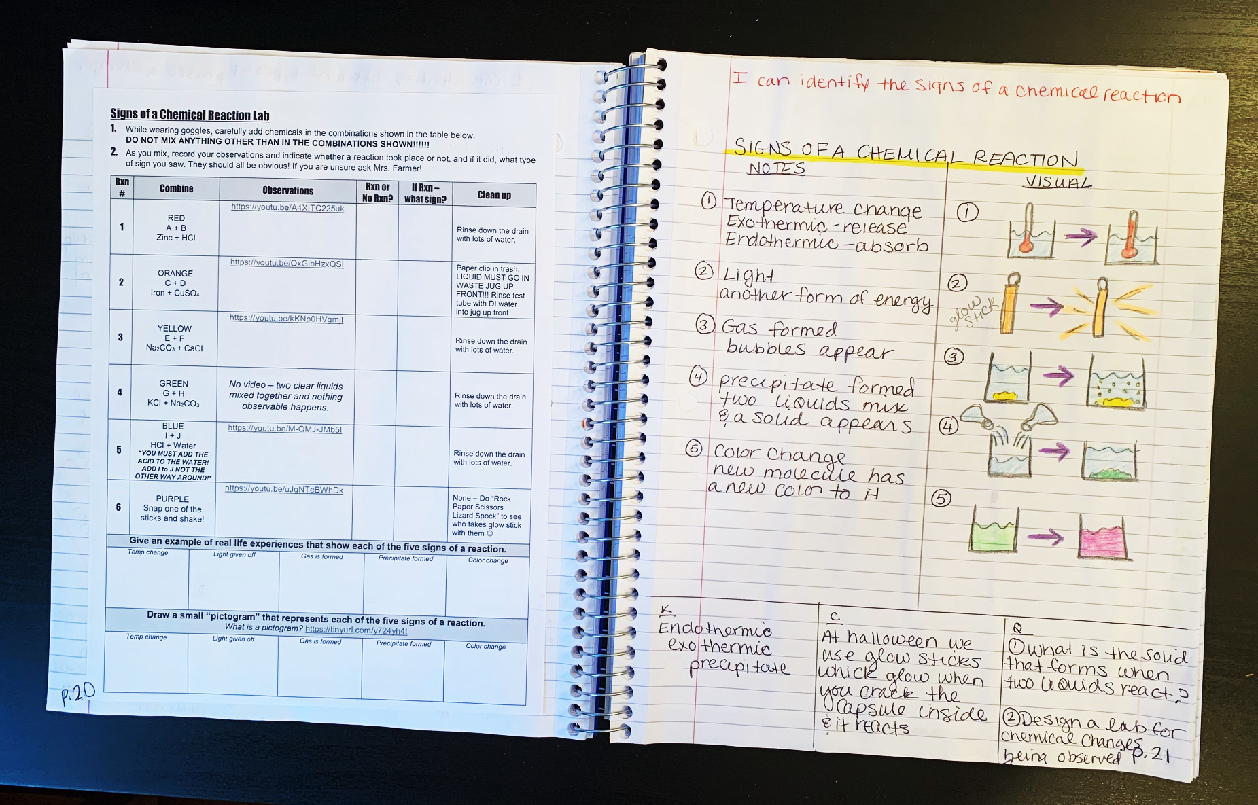

Slide 20
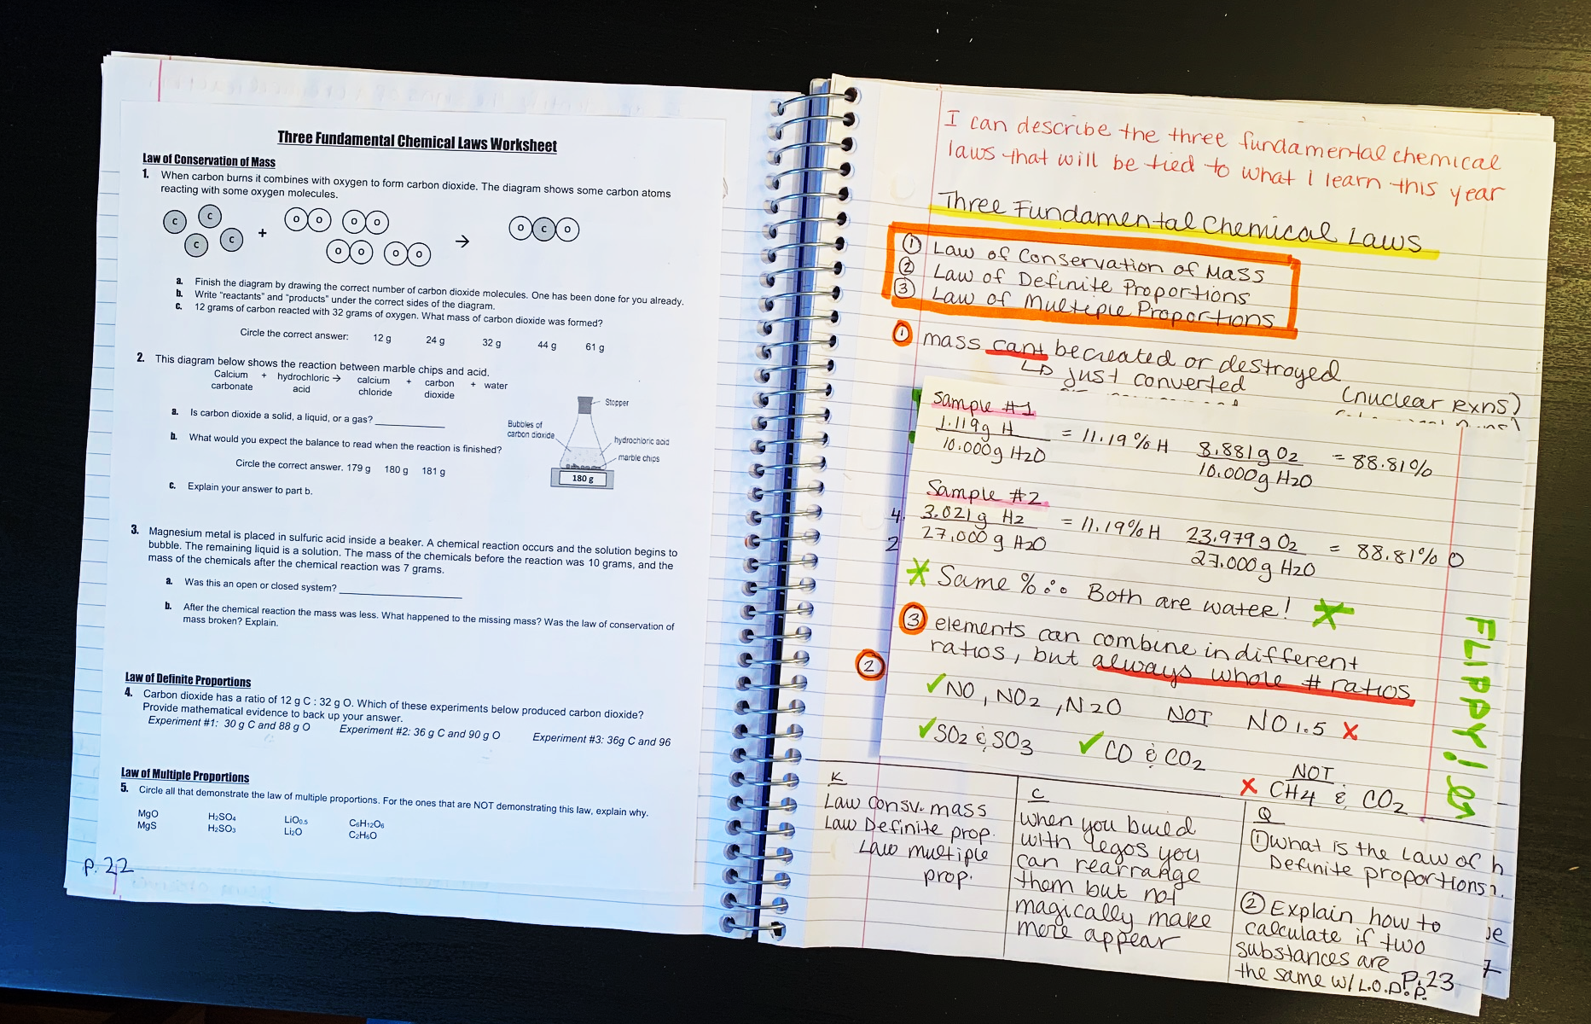

Slide 21
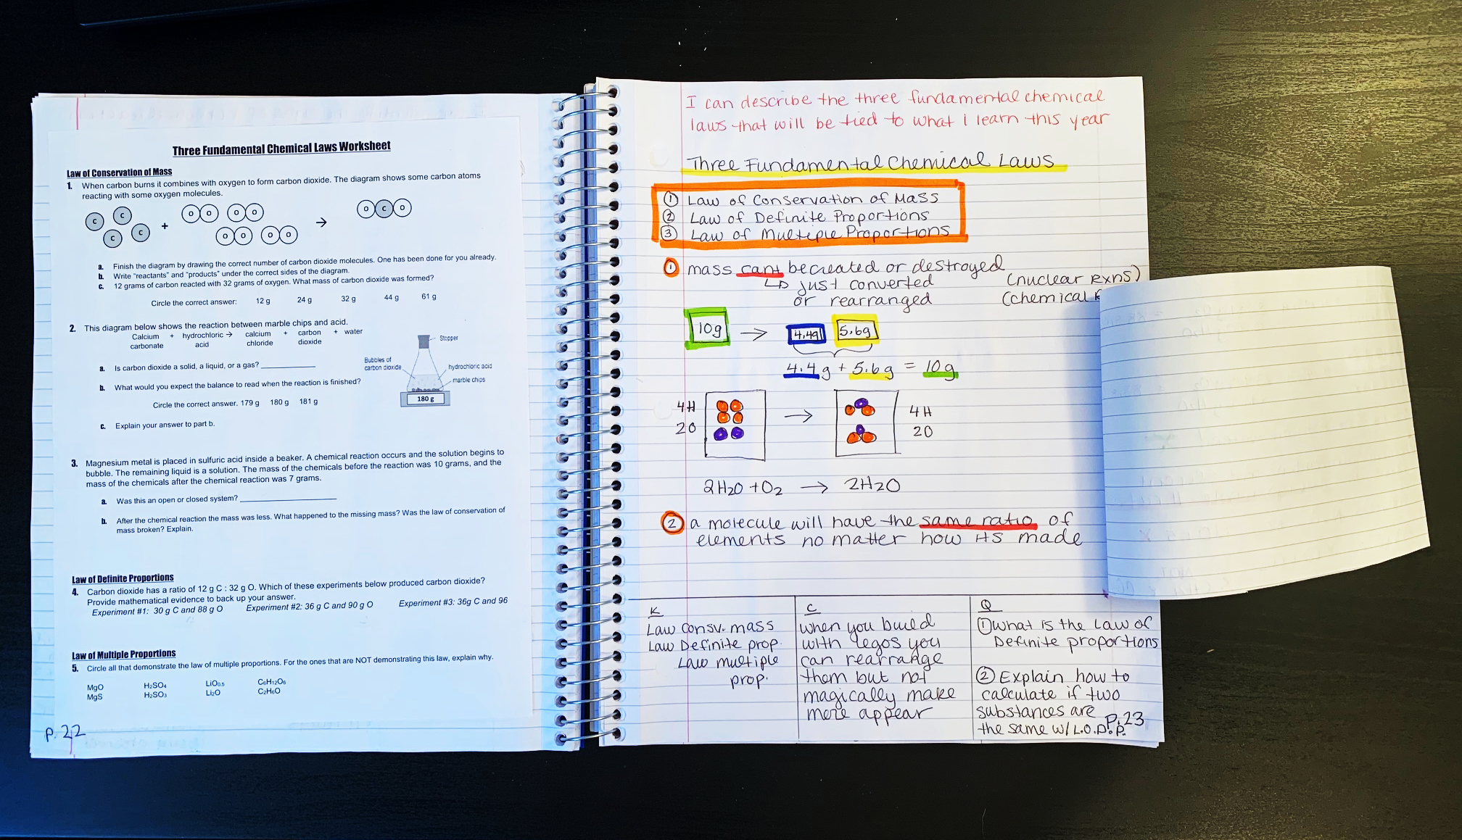

Slide 22
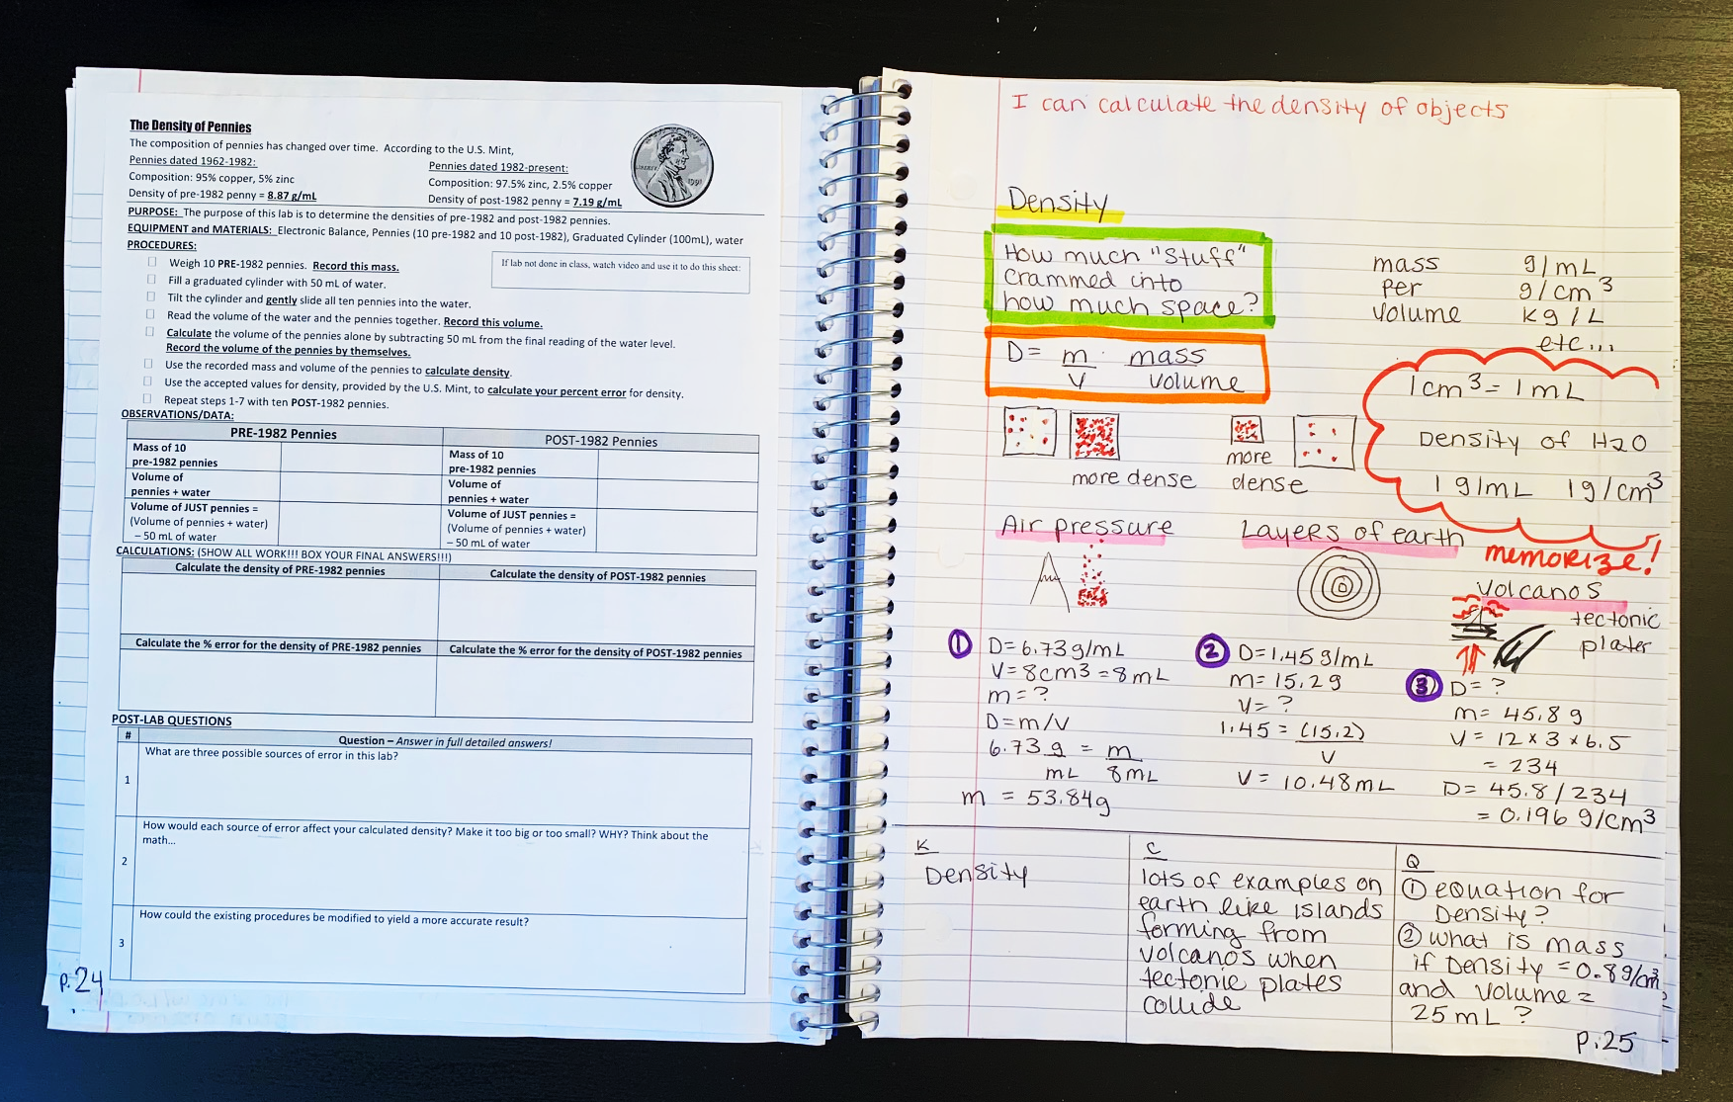

Slide 23
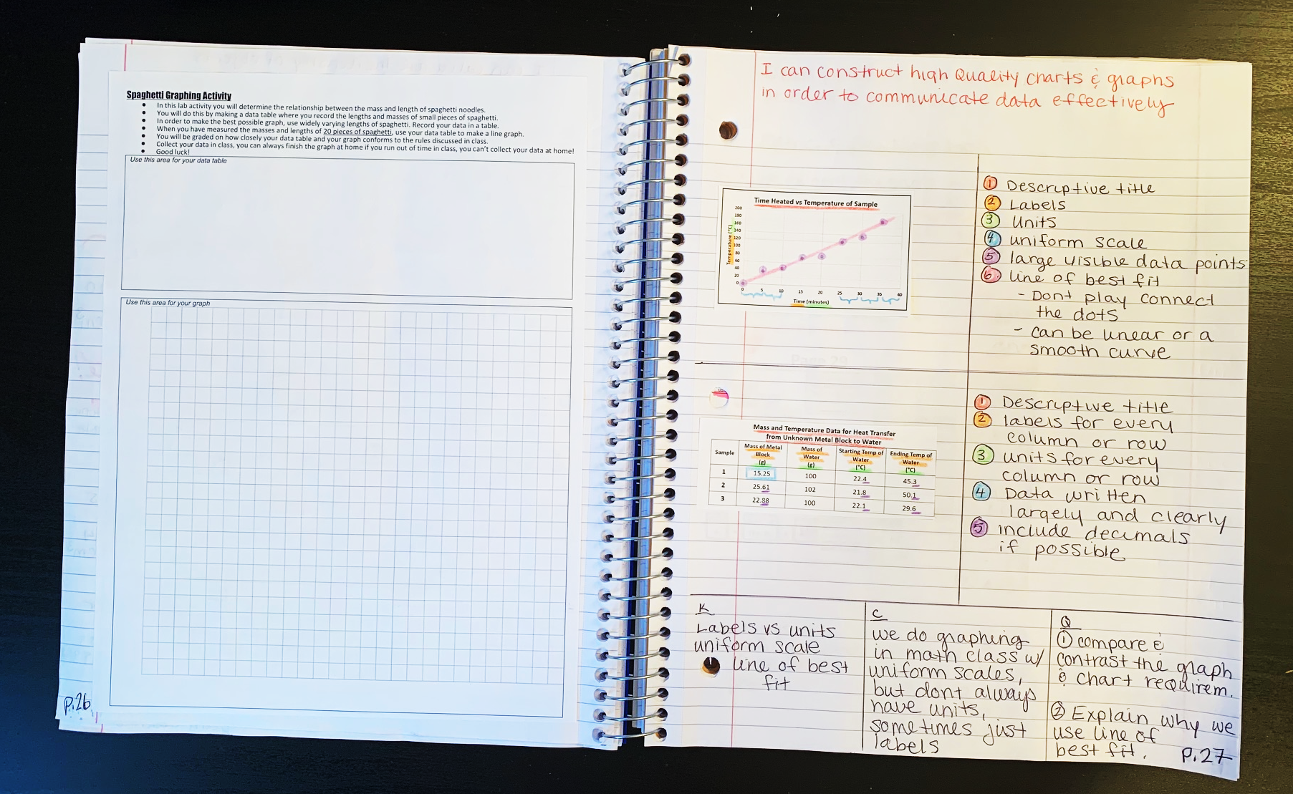

Slide 24
