Slide 1
Things for Lab Set Ups

Slide 2
Unit 1 – Chemistry Basics and Atomic Structure

Slide 3
Types of Changes/Properties Card Sort

Slide 4
Phys/Chem Changes/Props Card Sort
Cards in Activity Cupboard
Physical Prop | Chemical Prop. | Physical Change | Chemical Change | Separation Techn
8 | 5 | 8 | 13 | 4
Color | Ability to rust | Melting | Change in color | Distillation
Density | Smell | Tearing | Corrode | Filtration
Solid | Taste | Freeze | Produces odor | Crystallization
Liquid | No rxn to acid | Cut | Burn | Chromatography
Shape | Corrosive resistant | Boiling | Explode
Light weight |  | Breaking | Produce gas
Conducts heat |  | Vaporize | Rusting
White |  | Candle wax melting | Candle Burning
 |  |  | Mold Growing
 |  |  | Oxidize
 |  |  | Forms precipitate
 |  |  | Fermentation
 |  |  | Apple turning brown

Slide 5
Isotopes of Pennies

Slide 6
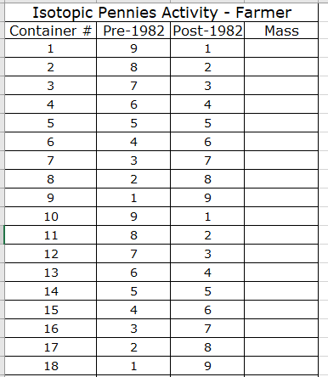
Isotopes of Pennies
Canisters in Activity Cupboard

Slide 7
Unit 2 – Nuclear Chem

Slide 8
Detecting Ionizing Radiation with Cloud Chamber

Slide 9
Cloud Chamber
Canisters in Activity Cupboard
Isopropyl alcohol
Pipette
Flashlight
Gas lantern mantle
Cloud chamber
Dry Ice
Lantern Mantles from Carolina
Item: SPEC39822
Item description: Lantern Mantle
Price: $7.95 Each
Special Order so MUST CALL to order:
1 (800) 334-5551

Slide 10
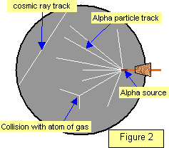
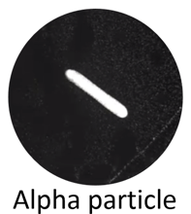
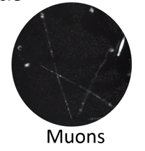
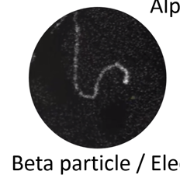
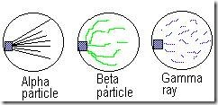

Slide 11
https://www.youtube.com/watch?v=pewTySxfTQk&feature=youtu.be
https://www.youtube.com/watch?v=e3fi6uyyrEs
https://www.symmetrymagazine.org/article/january-2015/how-to-build-your-own-particle-detector
Show if cloud chambers don’t work

Slide 12
Neat extension about cosmic rays and trying to find dark matter
https://www.sciencefriday.com/educational-resources/build-a-cloud-chamber/
If you’re looking for dark matter, background radiation is a major problem
Physicists have evidence that in addition to the known subatomic particles that make up most of the things we can see and touch, there is an entirely separate class of very small, potentially weakly interacting particles that make up the majority of our universe called dark matter. Though it comprises over 90 percent of our galaxy, dark matter is poorly understood.
Dark matter is difficult to study because it’s made of unimaginably small particles that we can’t see, and it interacts with other atoms very rarely. Detecting dark matter interactions that are so minute and rare is made especially difficult because they are grossly overshadowed by the background radiation that is constantly pouring down on our planet from cosmic rays. Our planet’s background radiation makes the search for dark matter like trying to hear a shy, whispering child in a party of shouting adults. Science Friday’s video producer, Luke Groskin, visited with scientists looking for dark matter, who describe this conundrum in the video “4850 below.”
Science Friday Documentary: “4850 Below”
In an effort to quiet the “noise” of background radiation, a long-running dark matter experiment called the LUX dark matter experiment (LUX stands for Large Underground Xenon) was built inside a giant water tank in an old mine a mile below the surface of the earth. The tank of water and mile of rock and dirt shield the experiment from background radiation by effectively putting a lot of other atoms – in the form of lots of dense materials like rock and water – between sources of radiation and the experiment.
https://www.youtube.com/watch?v=YxMGWQMoR10&feature=youtu.be

Slide 13
Unit 3 – Electrons

Slide 14
Flame Test

Slide 15
Flame Lab
SPRAY BOTTLES NEEDED
Calcium Chloride – CaCl₂
Copper (II) Chloride – CuCl₂
Barium chloride – BaCl₂
Potassium chloride – KCl
Sodium chloride – NaCl
Lithium chloride – LiCl
Copper (II) Sulfate – CuSO₄
Potassium Sulfate – K₂SO₄
Calcium Sulfate – CaSO₄
Strontium Nitrate – Sr(NO₃)₂
Unknown (__________)
ASK PATRICK ABOUT [ ] FOR EACH ONE
Bunsen burner
Gas hose
Matches
TURN GAS ON!
Plenty of paper towels in the room
Lysol spray to clean desks with
BUY SPRAY BOTTLES – 15ish

Slide 16
BE SAFE.
NO 2ND CHANCES.
NONE.
Spray at a slight upward angle.
AWAY FROM PEOPLE.
Don’t waste chemicals!
Only ONE person from each group walking around
REPLACE BOTTLES when done so others can use them!
CLEAN UP
Make sure gas is OFF
Wipe down table really well

Slide 17
Unit 4 – Periodic Table

Slide 18
Unit 5 – Bonding and Structure

Slide 19
Unit 6 – Reactions

Slide 20
Unit 7 – Stoichiometry

Slide 21
Types of Reactions Unit 2 – Reactions

Slide 22
Reactions Lab
CHEMICALS NEEDED
CuSO₄
0.15M SrCl₂
0.25M Na₂CO₃
Test Tube
Paper Clip – 1/period
Steel wool
White paper
100mL beaker x 1
50mL beaker x3
One with red tape, one with green tape, one with blue tape
Pipette x 3
One with red tape, one with green tape, one with blue tape
Graduated Cylinder
Squirt bottle H₂O
Bunsen Burner
Bunsen Burner Hose
Tongs
Gold paper with Reading

Slide 23
Stoichiometry Lab

Slide 24
Jumpstart (not on jumpstart paper today)
Take this time to go over the prelab with your nearby classmates – you need to make sure your answers are correct so you are allowed to start the lab! Use the chart on the wall by the clock to fill out the last row of #8 and #9

Slide 25
Stoichiometry Lab
Filter paper for each period
Scale
Distilled water bottle
Hot plate
Buchner funnel and filter flask with hose
Spoon with red tape
Spoon with yellow tape
Beaker with red tape
Beaker with purple tape
Beaker with yellow tape
Weigh boat with CaCl₂ and yellow tape
Weigh boat with Na₂CO₃ and red tape
Extra weigh boat for each period

Slide 26
Sodium Carbonate NaCO₃ in RED
Calcium Chloride CaCl₂ in YELLOW
How to label Weigh Boat and Purple Beaker: 4th period BENCH #1
Weigh Boat
Hot Plate
Put in oven overnight

Slide 27
Unit 9 – Gas Laws

Slide 28
Gas Law Stations Activity

Slide 29
Gas Stations Activity
CHEMICALS NEEDED
Cans
Marshmallows
Alka Seltzer
#1 Graduated cylinder Hot Plate Beaker Tongs Large beaker with water | #2 Cartesian Diver | #3 Marshmallows Syringe
#4 2L soda bottle Strip thermometer Fizz keeper | #5 Ceramic plate Playdough Candle Matches | #6 Alka Seltzer Mortar pestle Balloon Duct Tape Scale Scissors Metal scoop

Slide 30
Molar Mass of Butane Lab

Slide 31
Molar Mass of Butane Lab
Each Lab Bench Needs:
White Tray
Thermometer
Plastic tub
Butane Lighter
50mL Graduated Cylinder
Scale

Slide 32
Unit 10 – Thermochemistry

Slide 33
Calorimetry Lab

Slide 34
Calroimetry Lab
Calorimetor
Thermometer
Hot plate
Scale
Brass pipe fitting
100mL graduated cylinder
500mL beaker with water boiling

Slide 35
Jumpstart #5E
What is the equation for calculating the heat energy transfer involved in a reaction?
If a 10g piece of metal absorbs 500J of energy, and goes from 15deg C to 90deg C, what is the specific heat?

Slide 36
Q = mCΔT
Purpose of the lab: Solve for C (specific heat) of Brass
Energy absorbed→ Q = +
Energy released → Q = -
ENERGY IN = ENERGY OUT
beaker
calorimeter
Qmetal = -
Qwater = +
Qmetal = +
Qwater = -
Hot Water
Cold Water
Metal is heating up
Water is heating up
Energy transfer into METAL
Energy transfer into WATER

Slide 37
Q_{water} =
m_{water} =
C_{water} =
ΔT_{water} =
Q_{metal}=
m_{metal} =
C_{metal} =
ΔT_{metal} =
?
-Q_{water}
Energy IN must = energy OUT!
(opposite sign, not necessarily negative)
From the water you put in the calorimeter
1mL = 1g
From your scale
?
4.184 J/g°C
Tf – Ti
-
Tf – Ti
(From your thermometer readings)
Tf
From water
100°C
From boiling
(At the end the metal and water will be same temp)
(The metal was put in the boiling water so it reached 100°C)

Slide 38
Unit 11 – Solutions

Slide 39
Unit 12 – Kinetics

Slide 40
Kinetics Lab Iodination of Acetone

Slide 41
Kinetics Lab
4.0M ACETONE
Each class period needs: 320mL
294mL → add water to 1000mL
1.0M HCl
Each class period needs: 320mL
82.6mL 12M HCl → add water to 1000mL
0.0050M IODINE SOLUTION
Each class period needs: 448mL
1.27g Iodine crystals → add Isopropyl Alcohol until 1000mL
Stir on stir plate, heat to 50C to help dissolve
10mL graduated cylinder
125mL Erlenmeyer flask
100mL beaker
400 mL beaker x 3
Pipettes x 3
Distilled water bottle
Stop watch
4M acetone
1M HCl
0.0050 M iodine in isopropyl alcohol

Slide 42
Jumpstart
Grab the lab handout from the teal cart and START READING IT!!!!!!!

Slide 43
Sample Data for Iodination of Acetone Kinetics Lab
Trial | Time | Rate
1 | 92 sec | 5.43 x 10⁻⁶ M/sec
2 | 151 sec | 6.62 x 10⁻⁶ M/sec
3 | 184 sec | 8.15 x 10⁻⁶ M/sec
4 | 264 sec | 9.35 x 10⁻⁶ M/sec

Slide 44
Unit 13 – Equilibrium

Slide 45
Equilibrium of CO2

Slide 46
Equilibrium Lab
BUY DRY ICE!!!!!!!!!!
100mL beaker x2
50mL beaker
White piece of paper
Squirt bottle of universal indicator
Dry ice
Hot plate
Hot plate cord
Tongs
Syringe w/ cap and nail
1M HCl
0.0050 M iodine in isopropyl alcohol

Slide 47
Unit 14 – Acid Base

Slide 48
Salts Activity

Slide 49
Salt Activity
3 small beakers
3 stir rods
pH paper
pH paper color key
0.1 M solutions
NaC2H3O2
NaHCO3
NH4Cl

Slide 50
Titration Lecture

Slide 51
Titrations
8 tables x 6 trials per table
X 6 period
= 288
NaOH - _0.2__M HCl = __0.1___M
288 x ___5mL____amount of NaOH needed to reach end point = __1.5 L__ NaOH to make
288 x ____10mL___amount of HCl in each flask to titrate = ___3 L____ HCl to make
8 burettes
8 burette clamps
8 ring stands
8 200mL small beakers for NaOH
8 125mL flasks for HCl
8 Pheno bottles
2 50mL Graduated cylinder up front for HCl into their flask
2 400mL beaker up front with HCl
2 Pipettes up front for HCl
Funnel for NaOH
8 Distilled water bottles

