Slide 1
Jumpstart #G-2
Look through your entire notebook for the whole year. What topic was the hardest for you?
Look through your entire notebook for the whole year. What topic was the easiest for you?
Flip through your notebook and list page #s that you need to do/finish/add to before your final notebook check (you wont be marked down on this jumpstart if you have a lot of pages to fix...I just want you to see what needs to get done.)

Slide 2
Brainstorming review topics
22 topics from 2nd semester
You can use your notebook to help you!
Prizes for group that gets closest to my list!

Slide 3
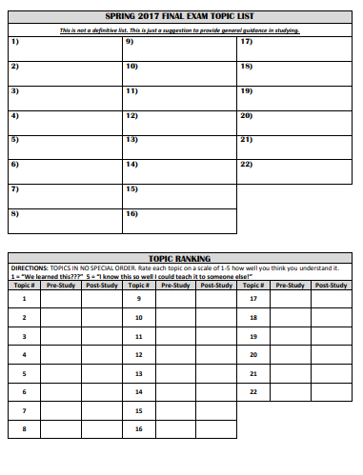
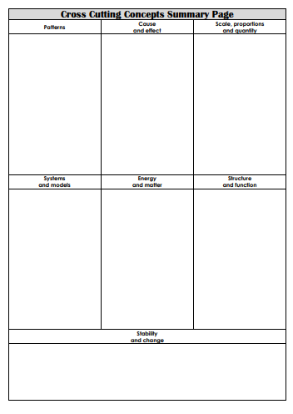
Page 240 page 241

Slide 4
Molar conversions
Stoichiometry
Thermochemistry basics
Q=mCΔT
Q=mL
Heating curves
Reaction diagrams
Rate affecting factors
Rate expressions
Rate Calculations
Equilibrium basics
Le Chatelier’s Principle
Lewis Structures
Polarity
Properties due to IMFs
Types of IMFs
Bulk Solids
Ranking IMFs
Balancing Equations
Phases and Changes
Types of Reactions
Predicting products

Slide 5
Topic Rankings
1s | We learned this?!?!
2s | I could do this if Mrs. Farmer was sitting there helping me do it
3s | I could do this if I had my notebook with me, or someone reminded me how to do it
4s | I could do this by myself but I don’t think I could teach someone, or I might make a mistake here or there
5s | I know this so well I could tell someone how to do it, and I know I will get them right on the final

Slide 6
Recommended Order to Study Things
4th | 2nd | 1st | 3rd | 5th
1s | 2s | 3s | 4s | 5s

Slide 7
Review Jumpstarts! Grab a handout from Table #8 – when the bell rings I will put up a question to work on
Getting ready for the final!

Slide 8
REVIEW JUMPSTART #1
List the scientists we talked about that had major advancements in atomic theory
What did Rutherford’s Gold Foil Experiment discover?

Slide 9
REVIEW JUMPSTART #2
What is 4390000 in scientific notation?
Convert 39cm into Dm

Slide 10
REVIEW JUMPSTART #3
How many protons, neutrons, and electrons does Sodium have?
How many protons, neutrons, and electrons does Cobalt-60 have?
How many protons, neutrons, and electrons does O²⁻ have?

Slide 11
REVIEW JUMPSTART #4
What is the molar mass of Ca(OH)₂?
Which element has a molar mass of 19?

Slide 12
REVIEW JUMPSTART #5
What is an electron orbital?
What are the main types of orbitals? Give names, how many of each orbital are in a “set” and sketch the first two shapes
How many electrons are allowed in each orbital?
How many electrons are allowed in each orbital “set?”

Slide 13
REVIEW JUMPSTART #6
What is the electron configuration for Bromine?
Which element is 1s²2s²2p⁶3s²3p²

Slide 14
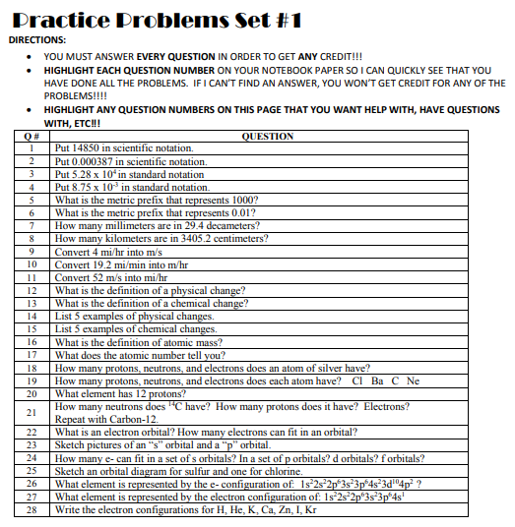
Glue paper to p. 243 show all work and give all answers on p. 242

Slide 15
Chunk #1 Answer Key
1.485 x 10⁴
3.87 x 10⁻⁴
52800
0.00875
K – kilo
c – centi
294000
0.034052
1.79 m/sec
1853568 m/hr
116.3 mi/hr
no change to the components – same molecules when done
change to the components – new molecules when done
melting, bending, freezing, crushing, cutting
burning, rotting, digesting, cooking
protons + neutrons
# of protons
47p, 61n, 47e

Slide 16
Chunk #1 Answer Key
17, 18, 17 56, 81, 56 6, 6, 6, 10, 10, 10
Mg
8, 6, 6 6, 6, 6,
an area an e is most likely to be found, a probability cloud, only 2 e
s orbital is sphere shaped, p orbital is shaped like a petal or a peanut
2, 6, 10, 14
→

Slide 17
Chunk #1 Answer Key
Ge
K
1s¹ 1s² 1s² 2s² 2p⁶ 3s² 3p⁶ 4s¹ 1s² 2s² 2p⁶ 3s² 3p⁶ 4s² 1s² 2s² 2p⁶ 3s² 3p⁶ 4s² 3d¹⁰ 1s² 2s² 2p⁶ 3s² 3p⁶ 4s² 3d¹⁰ 4p⁶ 5s² 4d¹⁰ 5p⁵ 1s² 2s² 2p⁶ 3s² 3p⁶ 4s² 3d¹⁰ 4p⁶

Slide 18
Chunk #2 Answer Key
USE YOUR GREEN PEN!
Answer Keys are class copies – hand it back to me when done.

Slide 19
Representative questions
Due at the end of the period!

Slide 20
Absent yesterday?????
TURN IN YOUR NOTEBOOK TO MY DESK!!!!!!!!!!!!!!!!!!!!!!!!
put your self grading sheet between p.124 and p.125 sticking out the top like a bookmark

Slide 21
Chunk #3 Answer Key
USE YOUR GREEN PEN!
Answer Keys are class copies – hand it back to me when done.

Slide 22
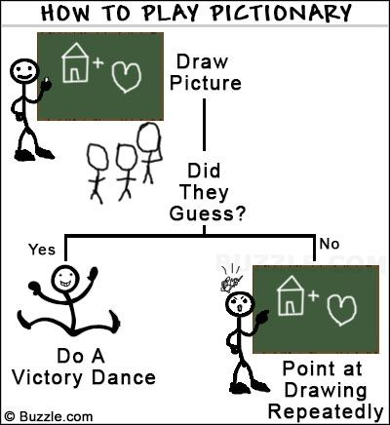
Pictionary
Due at the end of the period

Slide 23
REVIEW JUMPSTART #7
Describe what is happening during atomic absorption and emission
Draw a picture of absorption and a picture of emission. Label which is which!

Slide 24
REVIEW JUMPSTART #8
What are the three main types of radioactive particles – give names, symbols and numbers
Thorium-232 undergoes beta decay. Write the nuclear equation and predict the products of the reaction.

Slide 25
REVIEW JUMPSTART #9
What is the equation for half life?
If you started with 35 grams of a radioactive substance, and 6 half lives go by, how many grams are left?

Slide 26
REVIEW JUMPSTART #10
How many valence electrons does nitrogen have?
What class of element is Chlorine?
What kind of metal is calcium? (group name)

Slide 27
REVIEW JUMPSTART #11
Name K₂O
What is the formula for Calcium Sulfate?
Name C2H6
What is the formula for Trinitrogen Heptaoxide?

Slide 28
REVIEW JUMPSTART #12
Draw the Lewis structure for CH₄
Draw the Lewis structure for N₂
Draw the Lewis structure for BF₃

