Slide 1
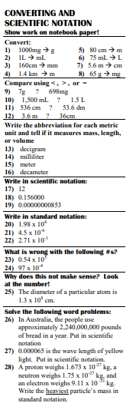
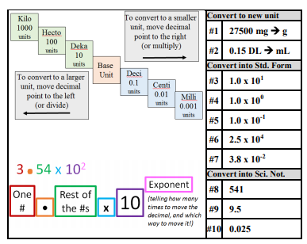
START - Scientific Notation and Metric System
Target: I can perform metric conversions and use scientific notation
Show your work here!
Be neat and organized so I can follow what you did and where the work for each question is.
K
C
Q

Slide 2
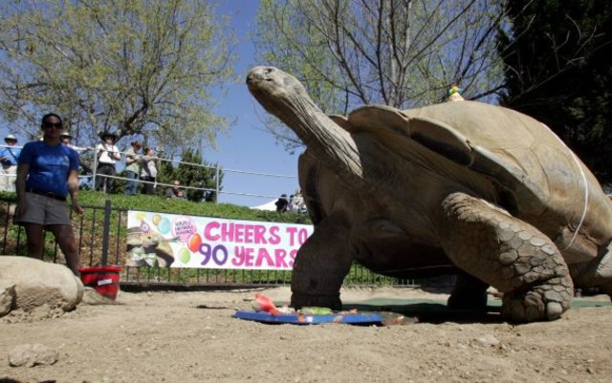
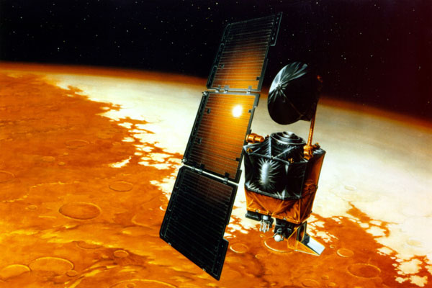
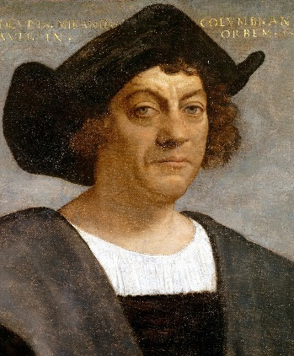
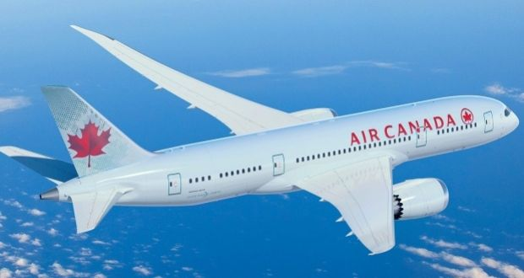

Measurements and Conversions Gone Wrong!

Slide 3
Measurements and Conversions Gone Wrong!
1999
NASA lost a Mars orbiter - $125 million loss. A calculation was done with pound-force seconds, not Newton seconds.

Slide 4
Measurements and Conversions Gone Wrong!
1983 – Air Canada plane ran out of fuel in the air. They thought the fuel was weighed in kilograms, but it was weighed in pounds.

Slide 5

Measurements and Conversions Gone Wrong!
1492 Columbus ended up in Bahama’s not Asia. Measured in Roman miles not Nautical miles.

Slide 6
Measurements and Conversions Gone Wrong!
2004
Tokyo Disneyland’s Space Mountain Accident. The building designs changed from inches to metric scale. An axle got made thinner than it should have been.

Slide 7
Measurements and Conversions Gone Wrong!
2001
LA Zoo loans Clarence to another zoo. Clarence destroys the enclosure. They thought he was 250lbs but it was 250 kg! 250kg is bigger than 250lbs!

Slide 8
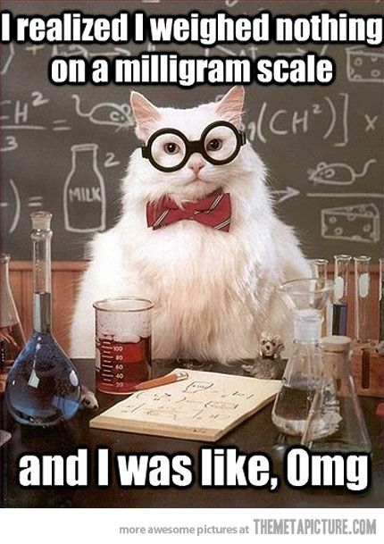
Why the Metric System?
We all need to speak the same “math language.”
Everyone else uses it!
It is easier!

Slide 9
How is it easier?
Unit | Compared to “base” unit of a foot
Foot | 1
Yard | 3
Fathom | 6.0761
Rod | 16.5
Chain | 66
Furlong | 660
Mile | 5,280
Nautical mi. | 6,076.1
League | 15,840
Metric system works on “BASE TEN”
Everything is changed by a factor of 10
English system is total random!
Unit | Compared to “base” unit of a meter
Meter | 1
Decameter | 10
Hectometer | 100
Kilometer | 1000

Slide 10
Converting Metric System
Just move the decimal!
To convert to a smaller
unit, move decimal
point to the right
(or multiply)
Kilo
1000
units
Hecto
100
units
Deka
10
units
Base
Unit
Deci
0.1
units
Centi
0.01
units
To convert to a larger
unit, move decimal
point to the left
(or divide)
Milli
0.001
units

Slide 11
What are the
“Base Units?”
Measuring | Unit
Length | Meter
Volume | Liter
Mass | Gram
Time | Second
Temp | Kelvin
# of molecules | Mole
Kilo
1000
units
Hecto
100
units
Deka
10
units
Base
Unit
Deci
0.1
units
Centi
0.01
units
Milli
0.001
units

Slide 12
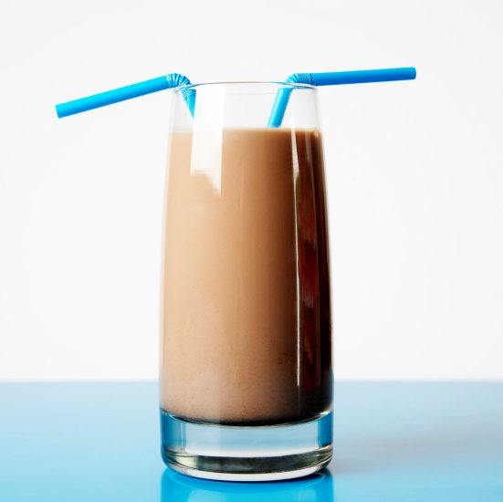

How do I remember the prefixes?
King Henry Died By Drinking Chocolate Milk
KILO
HECTO
DEKA
Base
DECI
CENTI
MILLI

Slide 13
Guided Practice
27500 mg → g
STEP 1
Are you going up or down the “ladder?”
STEP 2
How many steps to get there?
K H D B d c m
2 7 5 0 0.
STEP 3
Move decimal that many times, in that direction
27.500 g

Slide 14
Guided Practice
0.15 DL = ______ mL
STEP 1
Are you going up or down the “ladder?”
STEP 2
How many steps to get there?
K H D B d c m
0.1 5 0 0
STEP 3
Move decimal that many times, in that direction
1500 mL

Slide 15
Tired of really big or really small numbers???
Use scientific notation!
Move your decimal and rewrite it in “scientific
notation format”
3.54 x 10²
(tells us how many times to move the decimal, and which way to move it!)
Exponent
One
#
Rest of the #s
10
•
x

Slide 16
Big or small?
x 10^{positive #}
x 10^{negative #}
“Big” #
Multiplying by 10’s
“Small” #
Dividing by 10’s

Slide 17
Guided Practice
1.0 x 10¹ |  | 2.5 x 10⁴
1.0 x 10⁰ |  | 3.8 x 10⁻²
1.0 x 10⁻¹
10
25000
1
0.038
0.1

Slide 18
Guided Practice
541
9.5
0.025
5.41 x 10²
9.5 x 10⁰
2.5 x 10⁻²

