Slide 1
Target: I can explain the difference between accuracy and precision, and I can count sig figs
Summary
Q’s
Accuracy and Precision
p. 29

Slide 2
Accuracy
How close you are to the CORRECT number
Which answer is more accurate if the CORRECT number is 3.5?
3.1 or 3.6

Slide 3
Precision
When you take multiple measurements, how close the numbers are TO EACH OTHER
Does not mean they are CORRECT!!! They are all just similar to each other
Which set of numbers is more precise?
3 3.4
3.1 3
2.9 3.7

Slide 4
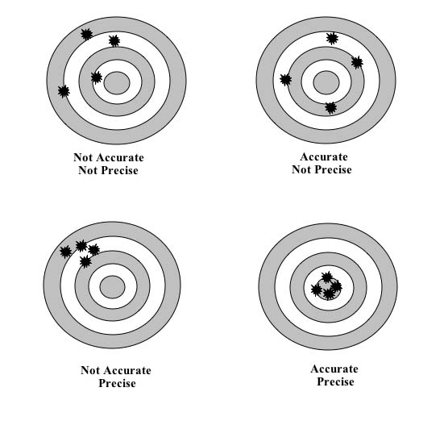
Choices:
Accurate Not Accurate
Precise Not Precise

Slide 5
Rounding!
Round to 2 or 3 decimal places
Round at the END of the problem.
If you get 4.2398 in your calculator and the only answer choices on the test are:
4.9 4.1 3.5
Which should you choose??

Slide 6
Significant Figures
Not all numbers are accurate because of rounding…so they aren’t all “significant.”
Numbers 1-9 --- ALWAYS significant
Zeros ----Depends:
Trapped between two numbers: 3008 --- 3008
Leading zeros--- NOT significant: 0.004 --- 0.004
Trailing zeros after a decimal pt: 0.04500 -- 0.04500
Trailing zeros without a decimal pt --- NOT sig.: 4500

Slide 7
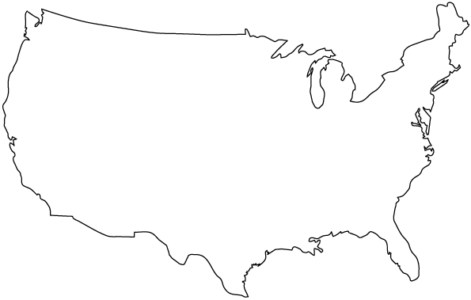
Sig Fig Country
Go the right direction until you hit a 1-9 number. Count everything else after that
PACIFIC OCEAN
ATLANTIC OCEAN
0.0005060
4809000
DECIMAL PRESENT
DECIMAL ABSENT

Slide 8
Lets Practice
Count the number of sig figs in each number:
5402000 0.0078
65.360780 8.05
0.0095030 80500

Slide 9
Fabulous Fold Up!!!
Accuracy vs. Precision
OUTSIDE FLAPS:
PICTURE of accuracy
PICTURE of precision
INSIDE FLAP:
The WORD accuracy
The WORD precision
INSIDE:
EXPLAIN in your OWN words what accuracy is
EXPLAIN in your OWN words what precision is

