Slide 1
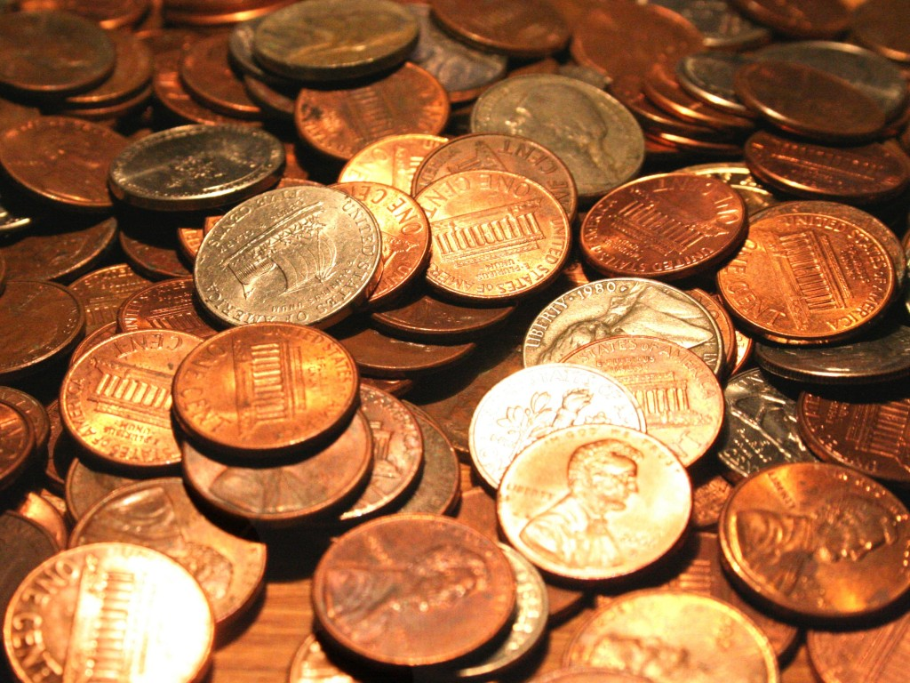
The Density of Pennies

Slide 2
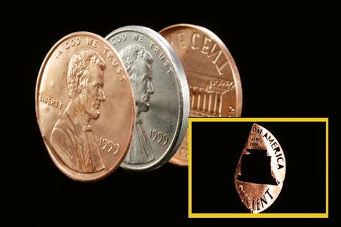
Not all pennies are the same!
Some are 95% copper and 5% zinc
Some are 2.4% copper and 97.6% zinc

