Slide 1
Target: I can use the density equation to solve for any of the three variables
Summary
Q’s
Density
p. 31

Slide 2
What is density?
How much “STUFF” in how much “SPACE”
mass volume
Density = Mass
Volume

Slide 3
Which one is more dense?
How about this: Which square is more dense?

Slide 4
Which one is more dense?
Now which one is more dense?

Slide 5
What is density?
Density = mass
volume
Most common units for density: g or g
cm³
mL
ALWAYS REMEMBER UNITS!

Slide 6
Let’s try a density problem together
Frank has a paper clip. It has a mass of 9g and a volume of 3cm³. What is its density?

Slide 7
Work on these problems with your neighbor.
Jack has a rock. The rock has a density of
6.73 g/mL and a volume of 8cm³. What is the mass of the rock? **1 mL = 1cm³

Slide 8
Sink or Float??? (Top half of p. 30)
OBJECT | PREDICTION | OUTCOME | WHY???
Wood
Coins
Soda can
Rock
Metal Balls

Slide 9
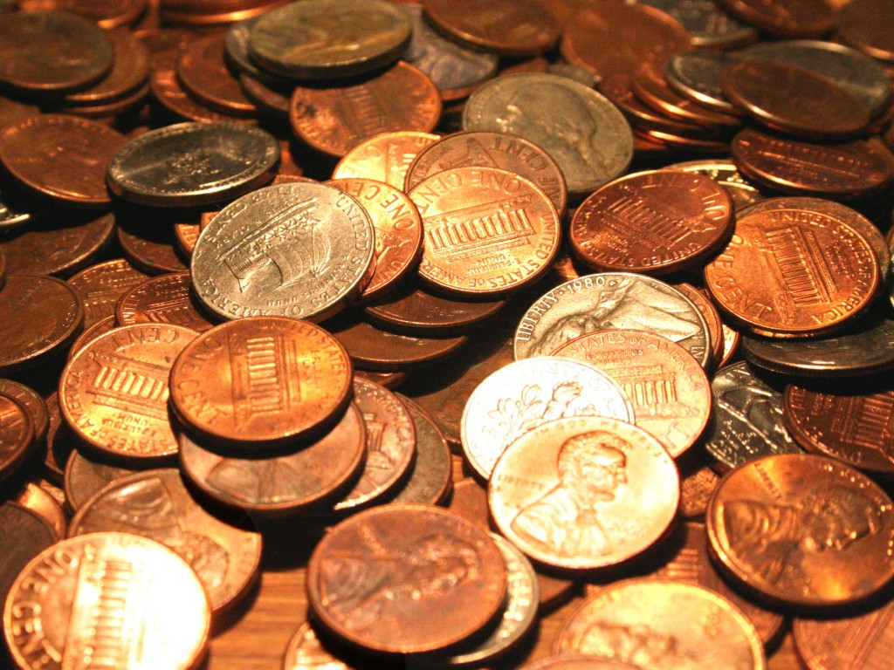
The Density of Pennies Lab

Slide 10
Calculations:
Density = mass
volume
Density of penny = mass of penny
volume of penny
Does it matter if you take the mass of 1 penny
and find the volume of 1 penny, or if you find
the mass of 40 pennies and the volume of 40
pennies?
Don’t forget your units!!!!!

Slide 11
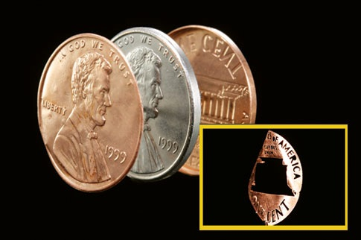
Not all pennies are the same!
Some are 95% copper and 5% zinc
Some are 2.4% copper and 97.6% zinc

Slide 12
Homework
Dense About Density
Read the Density of Pennies Lab

