Slide 1
Dimensional Analysis Converting from one unit to another unit

Slide 2
Table Groups
You will see a question on the projector
As a group come up with your best answer
Write it LARGELY on your whiteboard
When told to do so you will hold your whiteboard up for me to see.
If correct you will earn a point
Winners get a prize! ☺

Slide 4
Q1: In the drawing of the buyer’s thoughts, what does “2 pounds” represent?
STARTING VALUE KNOWN VALUE GIVEN

Slide 5
Q2: In the buyer’s thoughts, which part is a CONVERSION FACTOR
$1.99 1 pound

Slide 6
Q3: What unit does the final answer have?
$

Slide 7
Q4: Why does “pounds” disappear in the final answer? Explain using a MATH term!
The “pounds” CANCELS out!

Slide 8
Q5: Another market offered 5 pounds of apples for $6. SHOW using DA how the buyer would do this problem. She still needs 2 pounds!
2lbs $6 = $2.40
5 lbs

Slide 9
Q6: How much money will the buyer save by switching to the other market?
$3.98 - $2.40 = $1.58

Slide 10
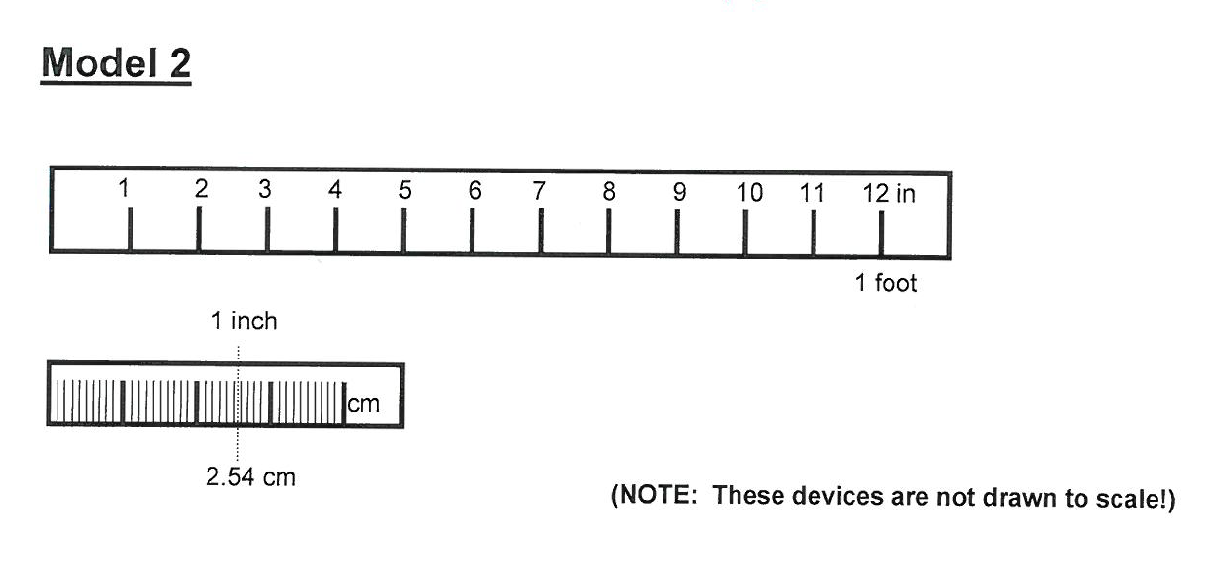
Q1: Based on Model 2, complete the following equality statements
1 in = ___ cm
____in = 1 foot
1 in = 2.54 cm
12 in = 1 foot

Slide 11
Q2: Write each of the equalities as a fraction
1 in = ___ cm
____in = 1 foot
1 in 12 in 2.54 cm 1 foot

Slide 12
Q3: Houston Rocket’s basketball player Yao Ming is 7.5 feet tall. Show using DA how tall he is in INCHES
1 in = ___ cm
____in = 1 foot
7.5 ft 12 in = 90 in
1 ft

Slide 13
Q4: Now convert his height from inches to centimeters using DA
1 in = ___ cm
____in = 1 foot
90 in 2.54 cm = 228.6 cm
1 in

Slide 14
Q5: Using one long multi step DA problem convert his height from feet to cm!
1 in = ___ cm
____in = 1 foot
7.5 ft 12 in 2.54 cm = 228.6 cm 1 ft 1in

Slide 15
Q6: Does the order of the conversion factors matter?
1 in = ___ cm
____in = 1 foot
No! Multiplying and dividing can be in any order!

Slide 16
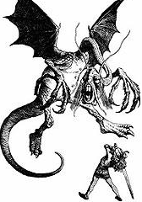
The Jabberwocky!

Slide 17
And the winner of Round 2 is…

Slide 18
And the winner of Round 1 is…

