Slide 1
Target: I can construct quality graphs and charts to communicate data effectively
General Guidelines
Use the space provided! No tiny graphs! No tiny charts!
Use a ruler! Make it look like you put in the time and effort to care!
Write clearly, neatly, large enough!
Glue in the printed graph and chart!
K
C
Q

Slide 2
Graphing and Data Table Expectations
Informative
Descriptive
Professional

Slide 3
#1 – DESCRIPTIVE title
#3 – Units
#4 – Uniform Scale
#5 – Large visible data points
#2 – Labels
#4 – Uniform Scale
#2 – Labels
#3 – Units

Slide 4
What else is missing?!

Slide 5
#6 Line of Best Fit!
Don’t play “connect the dots!”

Slide 6
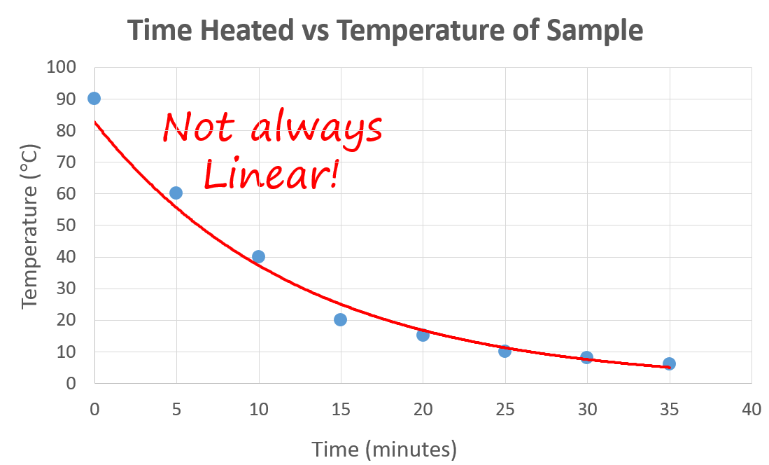
Not always liner
Line of best fit can be a “smooth curve”

Slide 7
#3 – Units for every column (or row)
#2 – Labels for every column (or row)
#1 – DESCRIPTIVE title
Mass and Temperature Data for Heat Transfer from Unknown Metal Block to Water
Sample | Mass of Metal Block (g) | Mass of Water (g) | Starting Temp of Water (°C) | Ending Temp of Water (°C)
1 | 15.25 | 100 | 22.4 | 45.3
2 | 25.61 | 102 | 21.8 | 50.1
3 | 22.88 | 100 | 22.1 | 29.6
#4 – Data written largely and clearly
#5 – Include decimals if possible

Slide 8
Mass and Temperature Data for Heat Transfer from Unknown Metal Block to Water
Sample | Mass of Metal Block (g) | Mass of Water (g) | Starting Temp of Water (°C) | Ending Temp of Water (°C)
1 | 15.25 | 100 | 22.4 | 45.3
2 | 25.61 | 102 | 21.8 | 50.1
3 | 22.88 | 100 | 22.1 | 29.6

Slide 9
YouTube Link to this Presentation
https://youtu.be/1E63AME0KWM

