Slide 1
METRIC CONVERSIONS

Slide 2
What if you have really big measurements, or really small ones?
Do I usually measure my height in inches?
  No! I use feet.
Do I usually measure my road trip in feet?
        No! I use miles.
Instead of meters, you can use kilometers,
or centimeters, or millimeters

Slide 3
THE METRIC CONVERSION CHART (STAIRCASE METHOD)
To convert to a smaller unit, move
decimal point to the right or
multiply.
Kilo
1000
units
Hecto
100
units
Deka
10
units
Base
Unit
Deci
0.1
units
Centi
0.01
units
Milli
0.001
units
To convert to a larger unit, move
decimal point to the left or divide

Slide 4
TRY THIS USING THE STAIRCASE METHOD
1000 mg = ______ g
Step 1: Determine if you are going to go up or down the ladder.
Step 2: Determine how many steps there are from milligrams to
grams.
Step 3: Move the decimal point the amount of places that was
determined in steps 1 & 2.

Slide 5
TRY THIS USING THE STAIRCASE METHOD
1000 mg = ______ g
1
Step 1: Determine if you are going to go up or down the ladder.
Step 2: Determine how many steps there are from milligrams to
grams.
Step 3: Move the decimal point the amount of places that was
determined in steps 1 & 2.

Slide 6
TRY THIS USING THE STAIRCASE METHOD
0.15 L = __________ ml

Slide 7
TRY THIS USING THE STAIRCASE METHOD
0.15 L = __________ ml
150

Slide 8
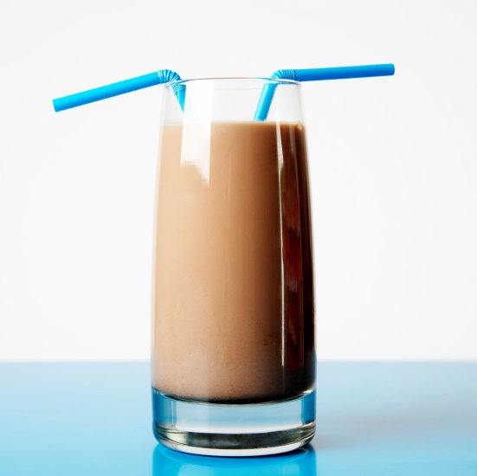
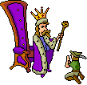
How can I remember the order of the staircase???
King Henry Died By Drinking Chocolate Milk
KILO
HECTO
DEKA
Base
DECI
CENTI
MILLI

