Slide 1
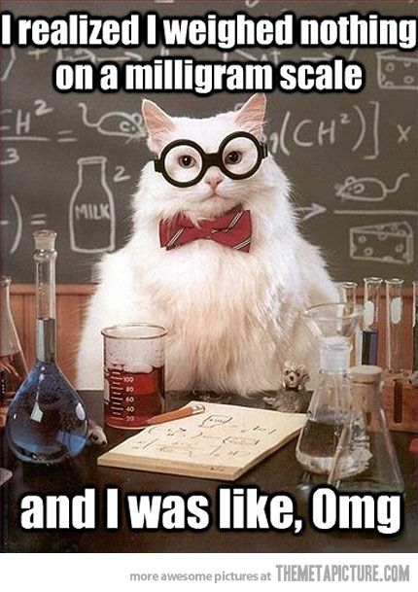

Slide 2
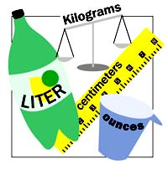
THE METRIC SYSTEM

Slide 3
WHY DO WE USE THE METRIC SYSTEM?
Everyone else does!!!
We all need to speak the same “math language”
IT IS EASIER!!!!!!!!!!

Slide 4
English System vs. Metric System
Which is easier???
Metric system works on “BASE TEN”
Everything is changed by a factor of ten.
English system is totally random!!!
1 meter = 100 centimeters
1 yard = 36 inches
1 liter = 1000 milliliters
1 gallon = 128 ounces
1 kilometer = 1000 meters
1 mile = 5,280 feet

Slide 5
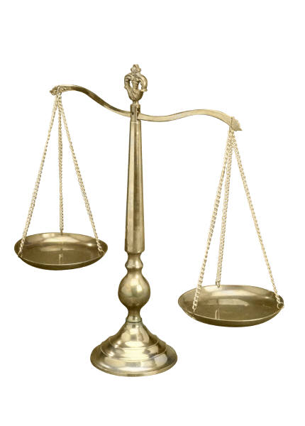
WHAT DOES THE METRIC SYSTEM MEASURE?
What it measures | Metric Unit
Mass | Gram
Volume | Liter
Length | Meter

Slide 6
SCIENTIFIC NOTATION
How we deal with very large numbers, and very small numbers

Slide 7
Who wants to write this number out over and over????
602,000,000,000,000,000,000,000
Not me!!! There is a way to write it out in a shorthand so it is faster and easier to write.
MOVE THE DECIMAL!
6.02 x 10²³

Slide 8
10^{positive number}
  To put in “Standard form” →
  Move your decimal to the RIGHT
  Makes a BIG number
10^{negative number}
  To put in “Standard form” →
  Move your decimal to the LEFT
  Makes a SMALL number

Slide 9
  TRY THESE –
  put in “standard notation”
  2.5 x 10⁴
  3.8 x 10⁻²

Slide 10
  Put in “Standard Notation”
  2.5 x 10⁴ 3.8 x 10⁻²
25000 0.038

Slide 11
Lets go the other way
Put 45,000 in “Scientific Notation”
Put ONE number 4.5
Then a decimal and the rest of the #s
Count how many times you 4 times
would need to move that decimal
to get the original number
That becomes your exponent 4.5 x 10⁴
^{COMPARE:} ^{45,000 > 4.5}
^{so exponent is POSITIVE!}

Slide 12
Try These
12000000
0.000034

Slide 13
Try These
12000000 = 1.2 x 10⁷
0.000034 = 3.4 x 10⁻⁵

Slide 14
3.5 x 10⁴ =3.5E4
3.5 x 10^4
3.5 x 104
3.5 x 104

Slide 15
1) The approximate distance from Saturn to the Sun is 888,000,000 miles. Convert this number to scientific notation.
      A) 888 x 10⁶
      B) 8.88 x 10⁻⁸
      C) 8.88 x 10⁸
      D) 88.8 x 10⁷

Slide 16
2) The age of the Earth is 4.6 x 10⁹ years. Which is the correct conversion of this number to standard form?
      A) 4,600,000,000
      B) 46,000,000,000
      C) 0.0000000046
      D) 0.00000000046

Slide 17
3) The thickness of a human
hair is 3 x 10⁻⁶ millimeters. Express this number in standard form.
      A) 3,000,000
      B) 300,000
      C) 0.000003
      D) 0.0000003

