Slide 1
Target: I can classify types of matter.
K
C
Q

Slide 2
Classification of types of matter

Slide 3
Matter
Anything that takes up space and has mass.
Things like thoughts, feelings, and ideas are “real” but they don’t have mass or take up space so they are not classified as matter.
This is a very broad category so it is helpful to break it up into smaller, more specific categories.

Slide 4
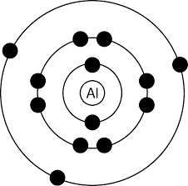
Elements
Pure elements are made up of all 1 kind of atom.
An element: An element:
Single Aluminum Atom Many of the same type of Atoms next to each other
Every atom will have the same number of protons.

Slide 5
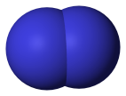
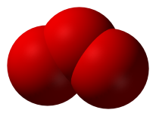
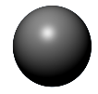
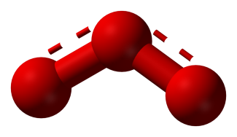
Molecules
More than one atom bonded together
.
Elements bond when they share or transfer their outer shell electrons (called valence electrons).
Lots of ways to draw this as you can see!
Can have - Single bonds - Double bonds - Triple bonds
Oxygen (O₂) Ozone (O₃)
Oxygen
Oxygen
Oxygen
Oxygen
Oxygen

Slide 6
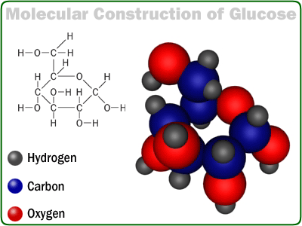
Molecules
Molecules can have more than one type of element.
Sugar (C₆H₁₂O₆)
The small numbers are called subscripts. These tell how many atoms of each element are bonded together. In C₆H₁₂O₆, there are 6 C’s (carbon atoms), 12 H’s (hydrogen atoms), and 6 O’s (oxygen atoms).

Slide 7
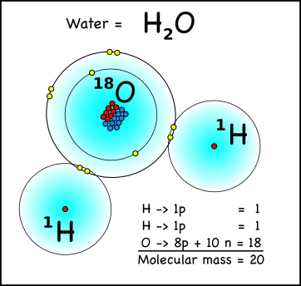
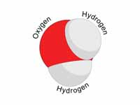
Compounds
More than one different types of elements bonded together.
Water (H₂O)
Water, H₂O, has two hydrogen and one oxygen atom.
You can tell it is a compound because there are two different chemical symbols (H and O).

Slide 8
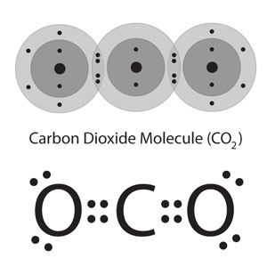
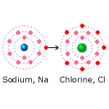
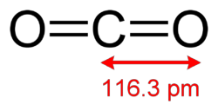
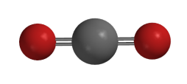
Compounds
Carbon Dioxide (CO₂)
Sodium Chloride
Salt (NaCl)
Can have - Ionic bonds - Single bonds - Double bonds - Triple bonds
Notice again that there are two different kinds of elements, Na and Cl. This makes it a compound.
Na Cl

Slide 9
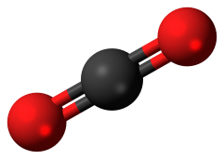
Compounds
All compounds are also molecules!
(But not all molecules are compounds.)
Carbon dioxide (CO₂) is a molecule and a compound.
There is more than one atom bonded together it is a molecule.
Because the two atoms are different types of elements (notice the shading of the balls is different), it is also a compound.
Oxygen (O₂) is a molecule. It is not a compound.
Because there is more than one atom bonded together it is a molecule.
Because the two atoms are the same type of element (notice the shading of the balls is the same), it cannot be a compound.

Slide 10
Compounds
All compounds are also molecules!
(But not all molecules are compounds.)
Molecules
Any 2+ atoms bonded together
Compounds
Must be 2+ TYPES of elements bonded together

Slide 11
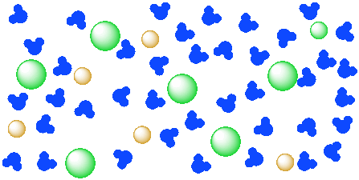
Mixtures
Multiple types of elements, compounds and/or molecules mixed together, but not bonded together.
Salt water is a solution. The water molecules are not bonded to the salt
Example Mixtures:
kool aid, salt water, air, brass,
14 carat gold, soda
Salt Water
(NaCl dissolved in H₂O)

Slide 12
Mixtures
There are two types of mixtures.
Heterogeneous:
Mixtures that are not well mixed together.
Examples: pizza, cookie dough, chex mix, Italian dressing dirt, oil and vinegar
Homogeneous: Mixtures that are perfectly mixed together and now uniform.
Examples: air, tree sap, soda, tap water

Slide 13
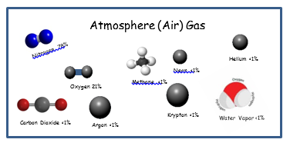
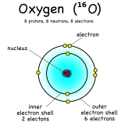
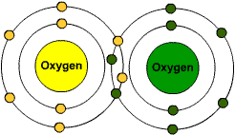
Mixtures
NOT A MIXTURE
This an oxygen atom. A pure element.
NOT A MIXTURE
This an oxygen (O₂) the molecule. A pure molecule.
YES A MIXTURE!
“Air” is a mixture. There are many molecules mixed together but not bonded together. IMPORTANT: Oxygen is NOT air!!!! It is just one of many things that is inside what we call “air.”

Slide 14
Matter
Pure Substances
Mixtures
Elements
Molecules
Homogeneous
Heterogeneous
Compounds

Slide 15
YouTube Link to Presentation:
https://youtu.be/tdUqZhMYog4

