Slide 1
Chemical and Physical Changes

Slide 2
Phases of Matter
Solid
Definite volume
Definite shape
Atoms barely vibrating
Atoms packed close
Liquid
Definite volume
Indefinite shape
Atoms vibrating more than a solid
Atoms close together, but
can move past each other
Gas
Indefinite volume
Indefinite shape
Atoms vibrating a lot
Atoms very far apart
Plasma
High temperature state
Atoms loose most of
their electrons

Slide 3
Phases of Matter
Solid
Liquid
Gas

Slide 4
Phase Changes
Solid → Liquid
Melting

Slide 5
Phase Changes
Liquid → Solid
Freezing

Slide 6
Phase Changes
Liquid → Gas
Vaporizing

Slide 7

Phase Changes
Gas → Liquid
Condensing

Slide 8
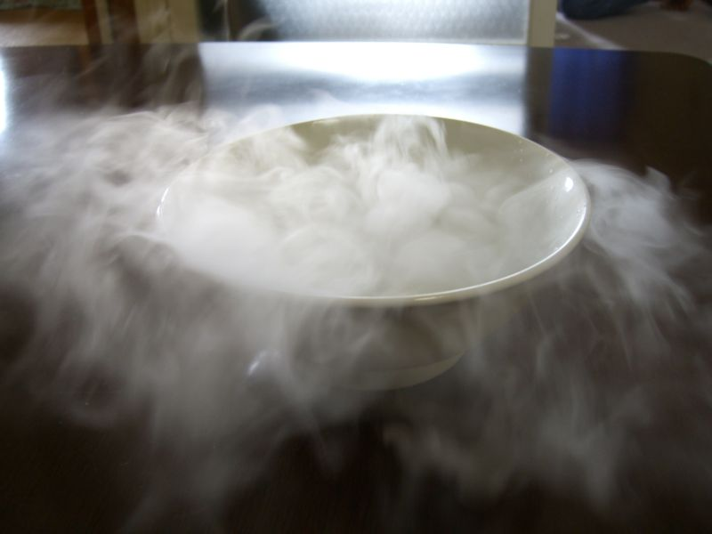
Phase Changes
Solid → Gas
Sublimation

Slide 9

Phase Changes
Gas → Solid
Deposition

Slide 10
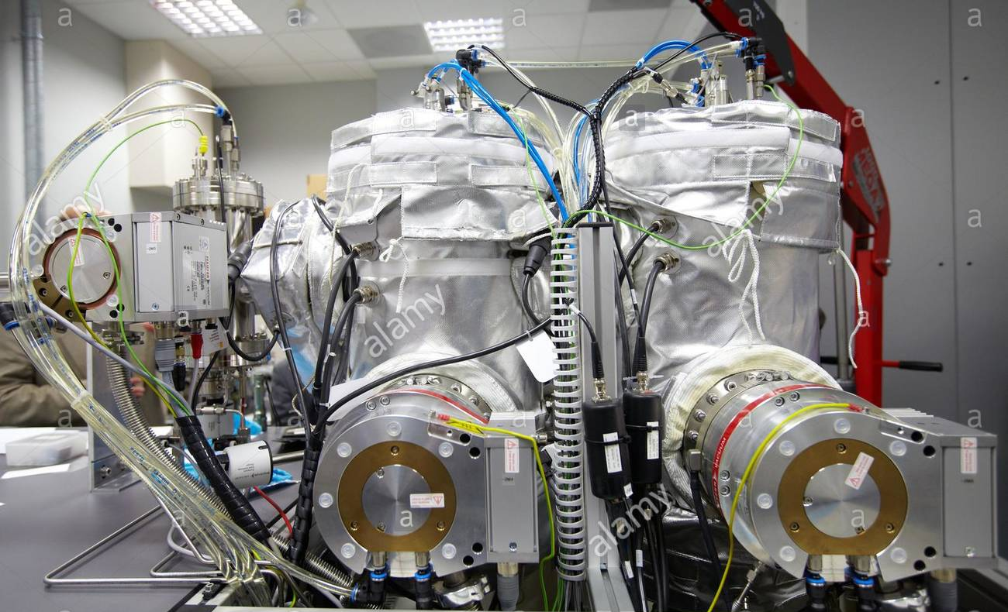

Slide 11
Physical
Changes
Chemical
Changes
IT IS STILL THE SAME SUBSTANCE after a physical change.
Change in one or more physical properties
NO change in the components that make up the substance.
IT IS NOT THE SAME SUBSTANCE after a chemical change.
Change in the components that make up the substance.

Slide 12
Physical
Change
Chemical
Change
Melting
Freezing
Vaporizing
Condensing
Deposition
Sublimation
Tearing
Grinding
Cutting
Combustion (burning)
Rusting
Cooking
Signs of chemical Rxs
  - color change
  - gas given off
  - solid product formed
  - Temp. change
Phase Changes

Slide 13
Chemical change vs Chemical Property
Change = IS/DID happening
Property = CAN happen

