Slide 1
Atomic Absorption & Emission, Line Spectra and the Chemical Composition of Stars

Slide 2
Where did the elements come from?

Slide 3
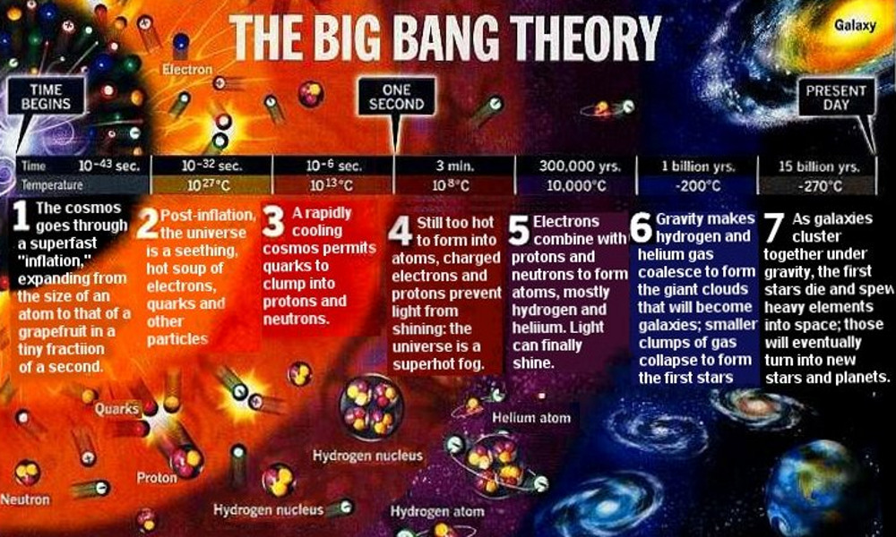
Time begins
One Second
Present Day
1 Cosmos goes through super fast inflation
2 Universe is a hot soup of electrons, quarks, other particles
3 Rapid cooling, lets quarks clump together to make protons and neutrons
4 Still too hot to form atoms, no light can travel, super hot fog
5 Electrons combine with protons and neutrons to make atoms – H and He. Light can finally shine!
6 Gravity makes H and He condense to form clouds of galaxies and stars
7 Galaxies cluster together, stars die and spew heavy elements into space to make new stars an planets

Slide 5
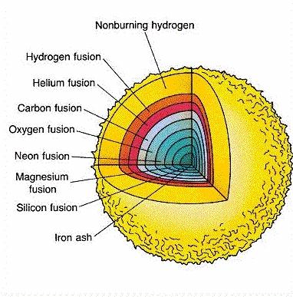
Out of fuel
Implosion
Forms nebula of elements

Slide 6
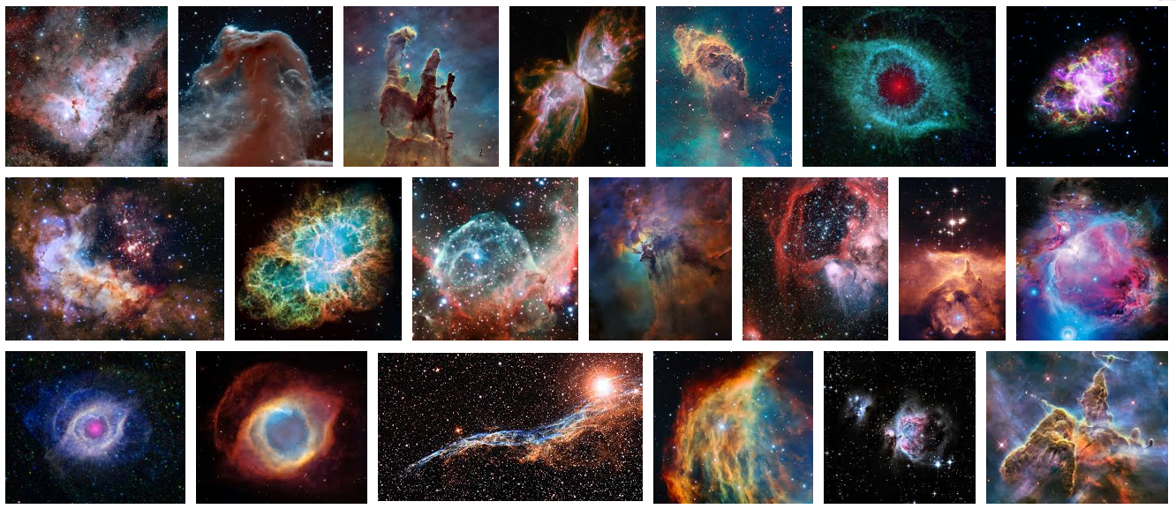

Slide 7
How do we know which stars have which elements?

Slide 8
We can analyze the wavelengths of light that are absorbed or released by the stars

Slide 9
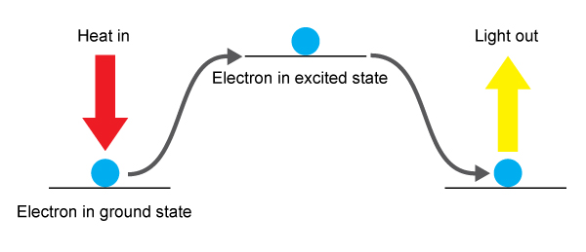
ABSORPTION
If you give an atom energy, the electron can be pushed up to a higher energy level

Slide 10
EMISSION
The electron does not want to stay at that higher level (Aufbau Principle!) so it will fall back down.

Slide 11
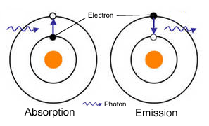
LOTS OF WAYS TO DRAW THIS
Make sure to show if energy is coming in or out, and which direction the electron is moving.
ABSORPTION
EMISSION

Slide 12
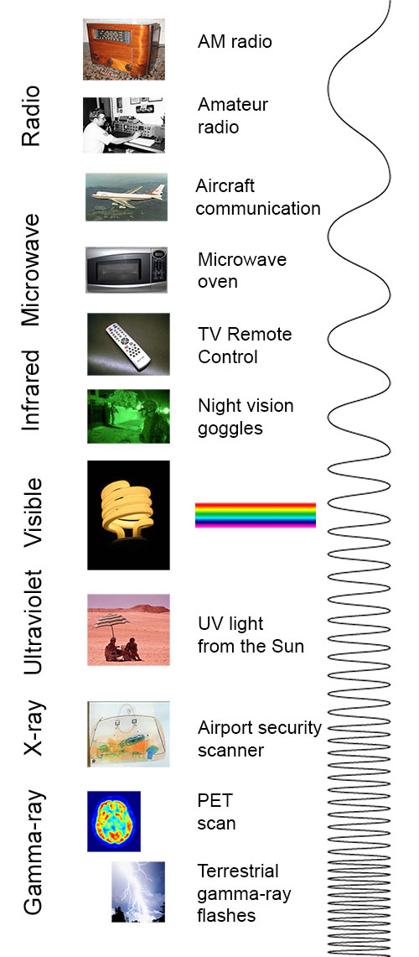
ENERGY RELEASED DURING EMISSION
Sometimes the released energy can be seen as LIGHT! The amount of energy given off depends on which energy levels the electron is falling from.
We can only see this little range here

Slide 13
ENERGY SPECTRUM
You can measure the exact wavelength and it can tell you how big the energy gap was that the e- fell from
Red Orange Yellow Green Blue Purple
LOW HIGH energy energy

Slide 14
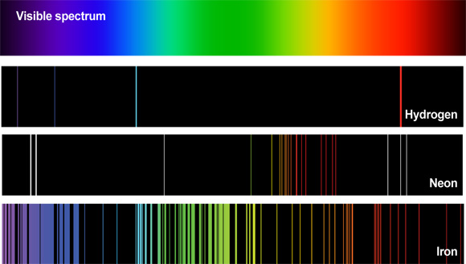
UNIQUE LIKE A FINGERPRINT
So just like people have unique finger prints, atoms have unique wavelengths they release (or absorb)

Slide 15
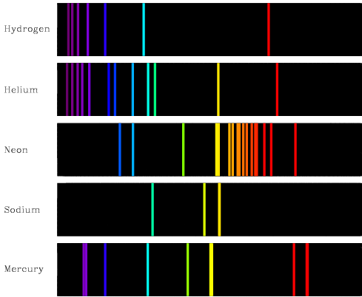

Slide 16
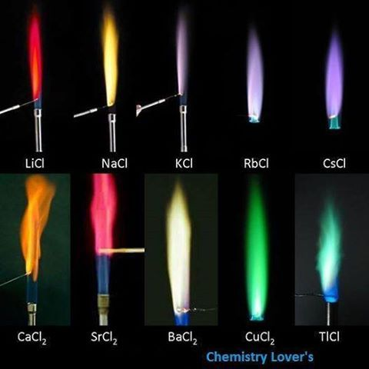
FLAME TESTS IN THE LAB
Compounds containing certain ions can be recognized by burning the compound and observing the colors produced

Slide 17
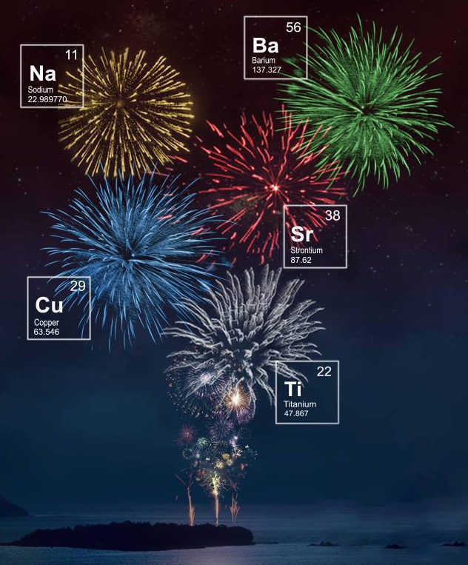

Slide 18
Emission – seeing wavelengths of energy being RELEASED (emitted)
IN LAB HEAT ATOMS
Absorption – seeing MISSING bands of energy being ABSORBED by a cold gas
IN THE STARS

Slide 19
ABSORPTION LINES FOR STARS
The “colder” outer layers of the stars absorb the emission energy from the hotter inside of the star, so what we can see are absorption lines

Slide 20
Betelgeuse – Old star, lots of absorption lines because lots of elements have been made
Rigel – Young star, few absorption lines because not many elements have been made yet

Slide 21
YouTube Link to Presentation
https://youtu.be/j-kMg-dtRpg

