Slide 1
Atomic Absorption and Emission TARGET: I can explain how energy is absorbed or released when electrons move from one energy level to another

Slide 2
ABSORPTION

Slide 3
EMISSION

Slide 4
Energy given off during emission:
When energy is released during emission it can sometimes be seen as LIGHT.

Slide 5
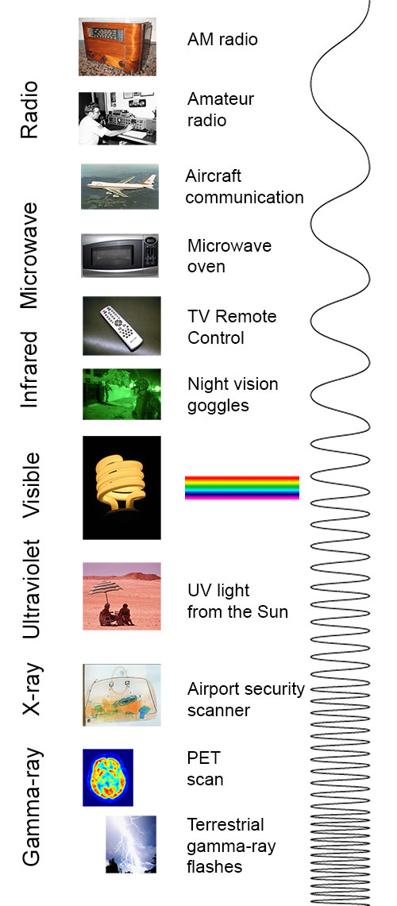
We can only see this little range here

Slide 6
Energy given off during emission:
The energy and color of this light will change based on which element it is.
The amount of energy is different because the energy difference between different energy levels is not exactly the same for every level or every element.

Slide 7
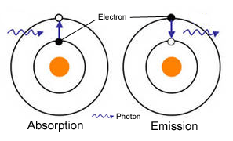

Slide 9
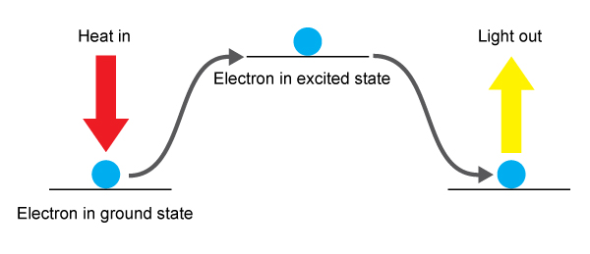
ABSORPTION
EMISSION

Slide 10
You can identify elements based on the color (wavelength) of light given off!

Slide 11
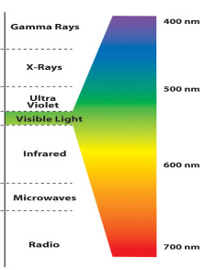
Red Orange Yellow Green Blue Purple
LOW HIGH
High Energy
Low Energy

Slide 12
Flame Tests
Compounds containing lithium, sodium, potassium, calcium, and barium ions can be recognized by burning the compound and observing the colors produced

Slide 13
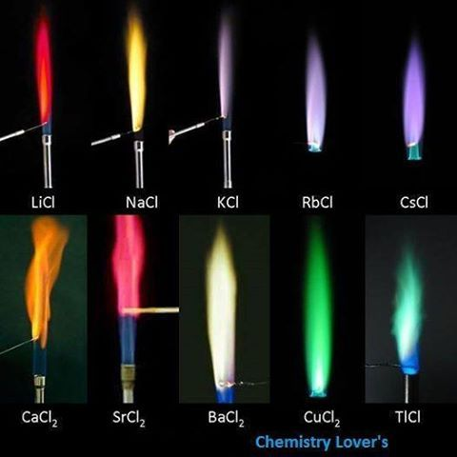

Slide 14
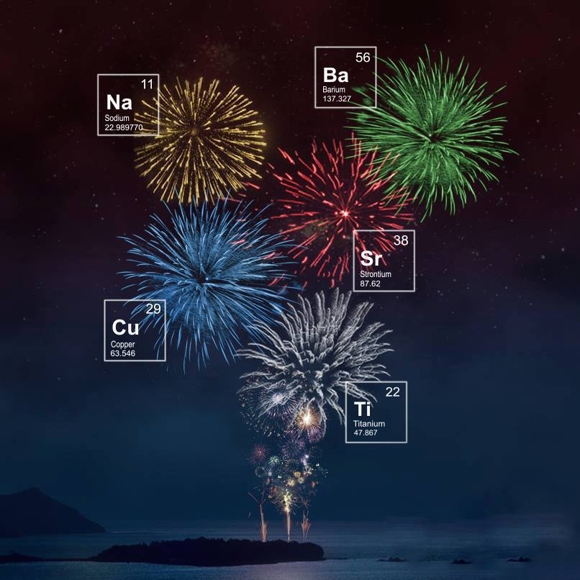

Slide 15
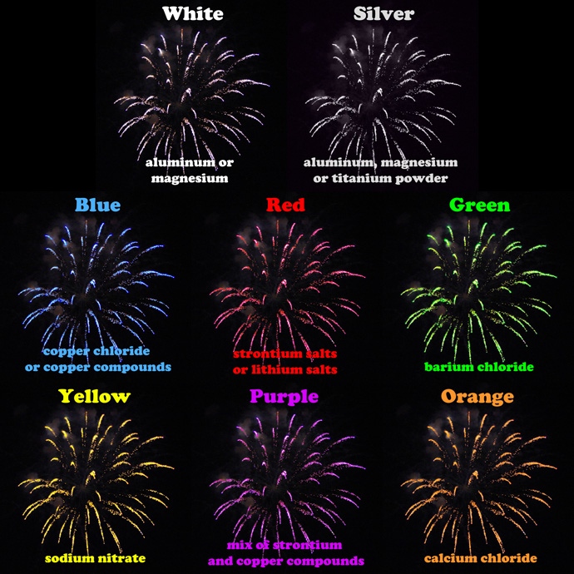

Slide 16
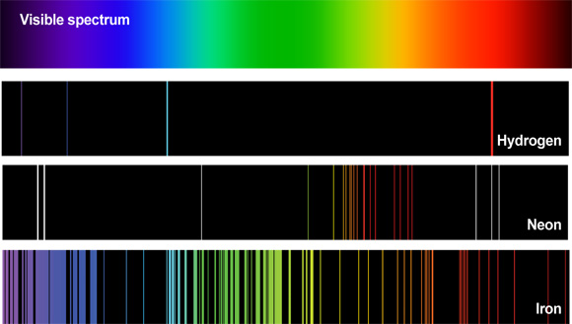

Slide 17
