Slide 1
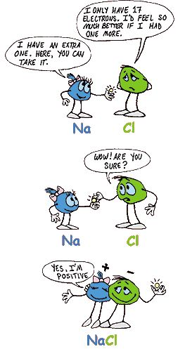
Ions – when P ≠ e-
https://www.youtube.com/watch?v=dRfrvpVdKGM
https://www.youtube.com/watch?v=ZzkL3DNjz_s

