Slide 1
ADD TO IT NOTES
1) Go through the following PowerPoint
2) TAKE NOTES in BLACK PEN. And ONLY black pen.
3) LEAVE SPACE around your notes! VERY important
4) The next day in class we will go over the PowerPoint with more details added, and I will point out the key information
5) During step #4 you will ADD TO YOUR NOTES using a GREEN PEN that I will give you.

Slide 2
Just ONE suggestion on how to chunk your notes so you have space – always quickly flip through the PPT to get an idea of how much space you will need!
Target: I can use scientific notation and metric conversion to think about how small the atom is
Measuring the atom
Videos to watch in class
Parts of the atom
Add To It Questions
K
C
Q

Slide 3
Measuring the Atom

Slide 4
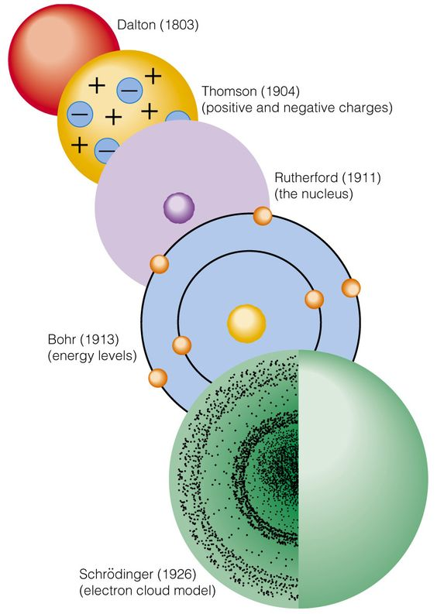
Atoms do NOT have tangible outer shells! So how do you know the diameter?! You cant measure to an edge that doesn’t exist!

Slide 5
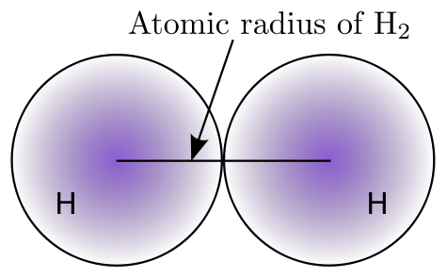
Nuclei ARE tangible!
SAVE SPACE TO ADD TO DURING CLASS
Put two identical atoms RIGHT next to each other and measure between the nuclei. Divide by two!

Slide 6
Parts of the Atom

Slide 7
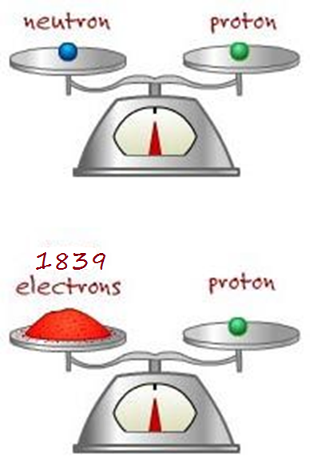
SAVE SPACE TO ADD TO DURING CLASS
Protons and Neutrons are basically the same mass
Electrons are TINY!!!

Slide 8
VIDEOS TO WATCH IN CLASS
https://www.youtube.com/watch?v=EMLPJqeW78Q
https://www.youtube.com/watch?v=yqLlgIaz1L0
https://www.youtube.com/watch?v=6IeeshkVATY

Slide 9
ADD TO IT QUESTIONS – Things to think about it before class…Answer the following questions in your notes before class. You do NOT have to copy the questions!
QUESTION #1
Why would it be difficult/annoying/silly to use Standard Notation to measure parts of the atom? Why is Scientific Notation better?
QUESTION #2
Do we measure the diameter of the earth in inches? Why not? What should we measure it in?
QUESTION #3
If someone gave you the size of an atom in kilometers could you convert it to meters? Why would we use meters and not millimeters or an even smaller unit?

