Slide 1
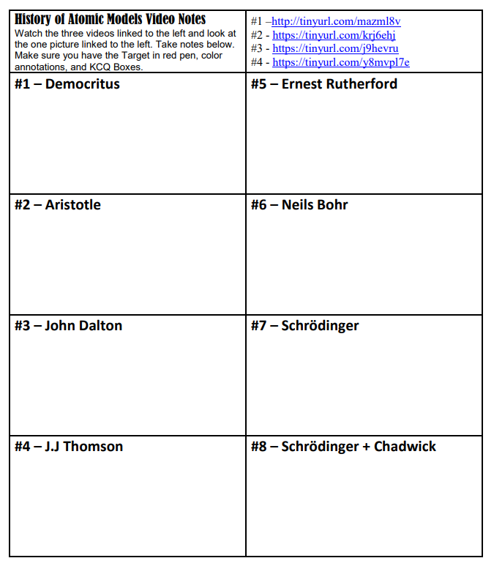
Target: I can describe advancements in the model of the atom
K
C
Q

