Slide 1
UNIT #C1 – Atomic Structure

Slide 2
Friday

Slide 3
Jumpstart #3A
Take out your “Jumpstart Paper” and answer the following question in Box #3 Q: What do you know about the structure of the atom? You cant say “nothing.” If you knew “nothing” then you wouldn’t have been allowed to graduate middle school! Ha!
Ask a neighbor for help if you are stuck!

Slide 4
History of the Atomic Model – Card Sorting Activity
Work with your lab group
Sort the cards into “same type” groups – they may not look identical, but are they trying to model the same structure?
Try to place in order from oldest to newest model – focus on what changes between each group to help you – simple to complex

Slide 5
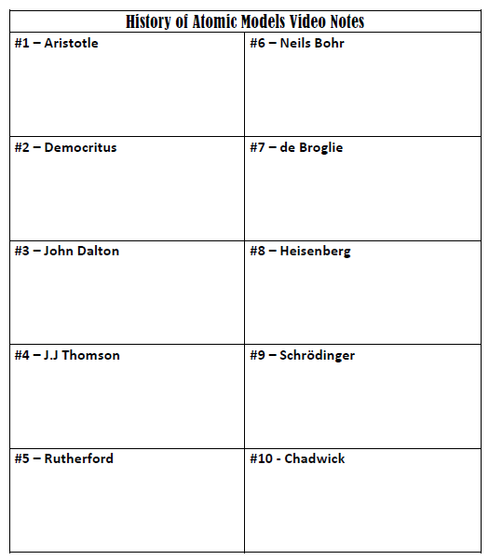
Past Models of the Atom – pg. 17
p. 16
Target: I can sort atomic models from least to most complex.
K
C
Q

Slide 6
History of the Atomic Model – Video Notes – p. 17
https://www.youtube.com/watch?v=IO9WS_HNmyg
https://www.youtube.com/watch?v=thnDxFdkzZs

Slide 7
History of the Atomic Model – Card REsorting Activity
Work with your lab group
After viewing the two atomic structure videos check to see if you want to change any of your card sorting.
On page 16 – Draw your representation of each of the main leaps in our understanding of what an atom looks like. Use color in your diagrams

Slide 8
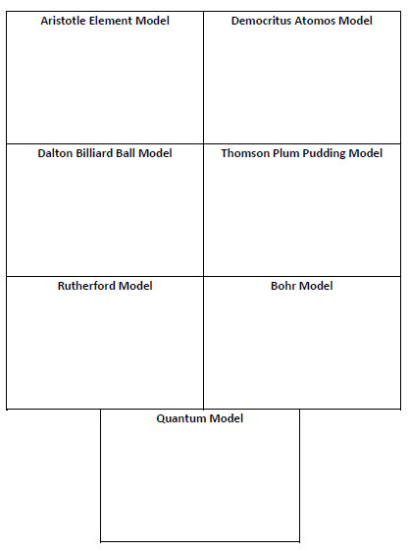
Past Models of the Atom – pg. 17
p. 16
Target: I can sort atomic models from least to most complex.
K
C
Q

Slide 9
HOMEWORK
Make sure notebook is up to date from pg 1-15 – due Monday
Complete Mrs. Farmer’s Online Survey – on the front page of class website – due Monday
Check School Loop for other homework
Donations PLEASE! ☺

Slide 10
Monday

Slide 11
Jumpstart #3A
Q1: What is scientific notation?
Q2: Why would people want to use it?
Ask a neighbor for help if you are stuck!

Slide 12
History of the Atomic Model – Video Notes – p. 17
https://www.youtube.com/watch?v=IO9WS_HNmyg
https://www.youtube.com/watch?v=thnDxFdkzZs

Slide 13
History of the Atomic Model – Card REsorting Activity
Work with your lab group
After viewing the two atomic structure videos check to see if you want to change any of your card sorting.
On page 16 – Draw your representation of each of the main leaps in our understanding of what an atom looks like. Use color in your diagrams

Slide 14
Past Models of the Atom – pg. 17
p. 16
Target: I can sort atomic models from least to most complex.
K
C
Q

Slide 15
HOMEWORK
Make sure notebook is up to date from pg 1-17 – due Tuesday
Finish p. 16 Atomic Model Drawings
Finish p. 17 KCQ Notes

Slide 16
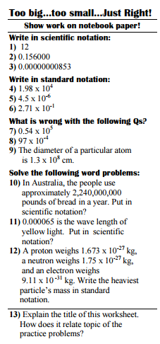
Scientific Notation and Metric System – pg. 19
Pg. 18
Target: I can use scientific notation and the metric system in chemistry class
Show your work here! Be neat and organized so I can follow what you did and where the work for each question is.
K
C
Q

Slide 17
HOMEWORK
p. 19 – KCQ - due Tuesday
p. 18 – Scientific Notation Worksheet due Tuesday

Slide 18
Tuesday

Slide 19
Jumpstart #4A
Q1: What is 0.00875 in scientific notation? Q2: What do you know about the metric system?
THEN COME SHOW ME YOUR P. 17 NOTES SO I CAN GIVE YOU SOME FEEDBACK ON HOW YOU DID ON YOUR FIRST SET OF KCQ NOTES!
Ask a neighbor for help if you are stuck!

Slide 20
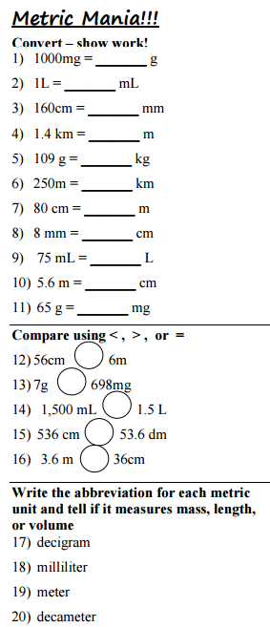
Metric Conversions – pg. 21
Target: I can perform metric conversions
Show your work here! Be neat and organized so I can follow what you did and where the work for each question is.
Take notes here
Save this space for later
K
C
Q

Slide 21
HOMEWORK
p. 21 – KCQ Notes – due Block Day
p. 20 – Metric Mania Worksheet – due Block Day

Slide 22
Block day

Slide 23
Jumpstart #14
Ask a neighbor for help if you are stuck!
FIRST
Q1: Describe an atom – what particles are inside an atom? What are the parts of the atom? Is it big or small? etc…

Slide 25
Visual Notes – Atomic Structure – pg. 43
#2 Clock Questions
Democratis
John Dalton
Cathode Rays
J.J. Thomson
Ernest Rutherford
James Chadwick
Target: I can describe the important advancements in atomic structure
Prompts/topics from reading on a strip of paper to guide note taking.
Instead of normal notes, notes must be in VISUAL form! Pictures, diagrams, images, etc.
You may label your visuals, write a date down, and other small pieces of writing, but the main focus should be using images
Use color to enhance your note taking. Make sure your visuals are large and clear.

Slide 26
HOMEWORK
p. 44 – #2 Clock Questions– due Tuesday

Slide 27
Tuesday

Slide 28
Jumpstart #13
Ask a neighbor for help if you are stuck!
Q1: Convert 12 mi/min into m/day
Q2: Is rusting a chemical or physical change?
Q3: Convert 3.5 cL into DL
Q4: An object has a density of 0.85g/cm³ and a mass of 43 grams. What is the volume in mL?

Slide 29
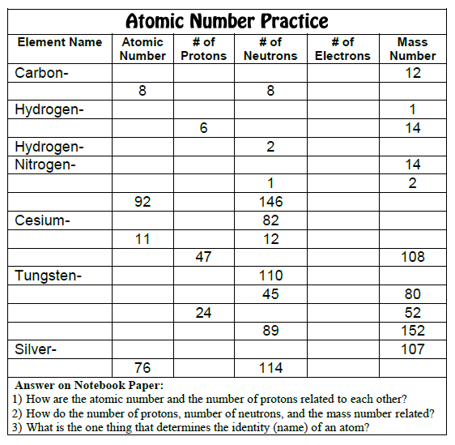
KCQ notes – Atomic Numbers – pg. 45
Target: I calculate atomic numbers
K
C
Q

Slide 30
HOMEWORK
p. 47 – KCQ – due Block Day
p. 46 – Atomic # Practice– due Block Day

Slide 31
Block Day

Slide 32
Jumpstart #16
Ask a neighbor for help if you are stuck!
Q1: How many protons, neutrons and electrons does the most common isotope of Vanadium have?
Q2: What is the name of the element with 54 electrons and 79 neutrons?
Q3: Where are electrons in an atom??? What do they do???

Slide 33
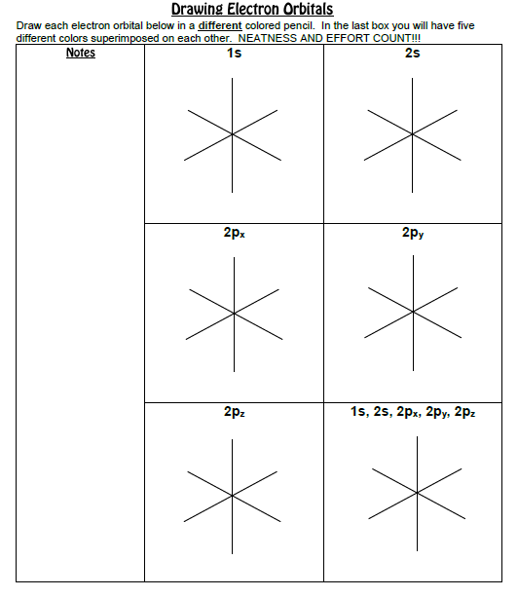
Drawing Electron Orbitals – pg. 47
Target: I can identify electron orbitals by shape
Science Photo Project Topic: electron orbitals
Photo from Mrs. Farmer
Paragraph(s) linking your photo to the topic

Slide 34
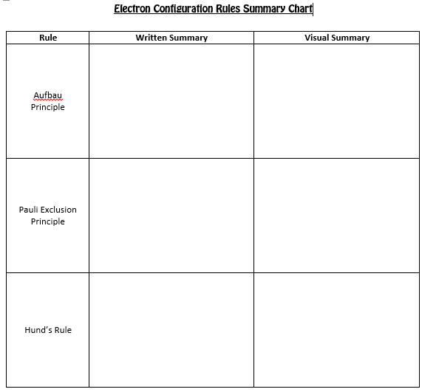
KCQ notes – Writing e- Configuration– pg. 49
Target: I can describe electron configurations
K
C
Q

Slide 35
HOMEWORK
p. 48 – Science Photo Project – due Friday
p. 51 – KCQ (IF we finish it, otherwise not due!) - due Friday

Slide 36
Friday

Slide 37
Jumpstart #14
Ask a neighbor for help if you are stuck!
Q1: What are the main types of orbitals
Q2: Why don’t we need to bother drawing d or f orbitals?
Q3: Explain how the electrons behave and where they are in an atom.

Slide 38
KCQ notes – Writing e- Configuration– pg. 49
Target: I can describe electron configurations
K
C
Q

Slide 39
HOMEWORK
p. 51 – KCQ - due Monday

Slide 40
Monday

Slide 41
Jumpstart #18
Ask a neighbor for help if you are stuck!
Q1: If an object has a mass of 3.2 kg and a volume of 4500 mL, will the object float or sink
Q2: How many protons, neutrons, electrons does Cobalt-61 have?
Q3: What are the three rules for writing electron configurations?

Slide 42
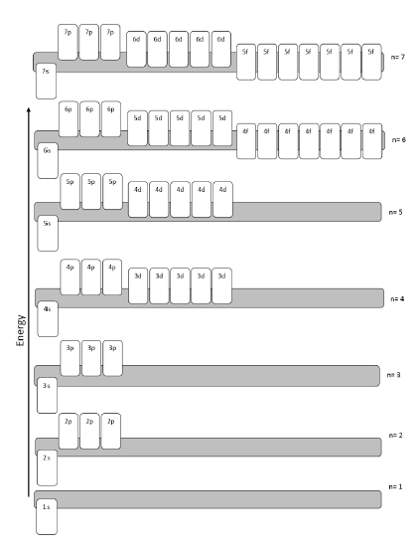
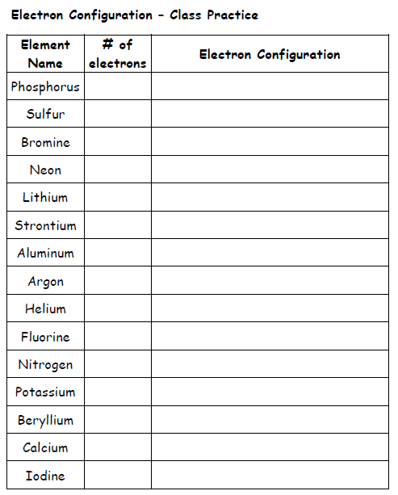
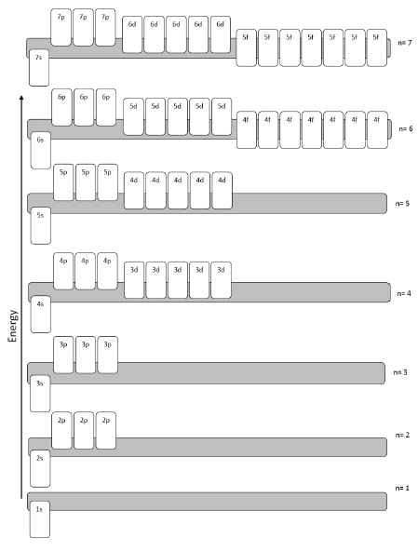
Writing e- Configuration– pg. 51
Target: I can write electron configurations using an orbital diagram.

Slide 43
HOMEWORK
p. 53 – Finish if not finished in class - due Tuesday

Slide 44
Tuesday

Slide 45
Jumpstart #16
Ask a neighbor for help if you are stuck!
Q1: What is the electron configuration for Se?
Q2: How many unpaired electrons does it have?
Q3: How many protons, electrons, neutrons does selenium-89 have?

Slide 46
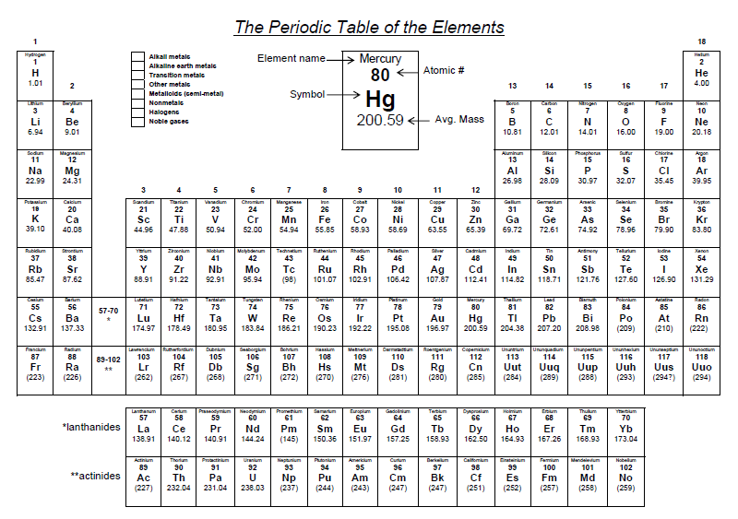
e- Config. Using Periodic Table – pg. 53
Target: I can write electron configurations using the periodic table
Periodic table folded in half
Fold in half

Slide 47
HOMEWORK
p. 54 – Finish if not finished in class - due Block Day

Slide 48
Block Day

Slide 49
Jumpstart #17
Ask a neighbor for help if you are stuck!
Q1: Use just the periodic table and write the configuration for Zirconium

Slide 50
Friday

Slide 51
Jumpstart #21
Ask a neighbor for help if you are stuck!
Q1: What ion does Te like to make?
Q2: What is the Nobel Gas configuration of Cr?

Slide 52
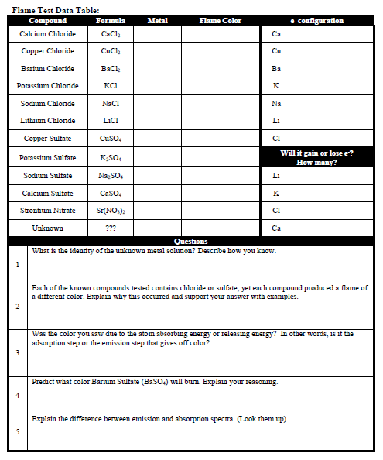
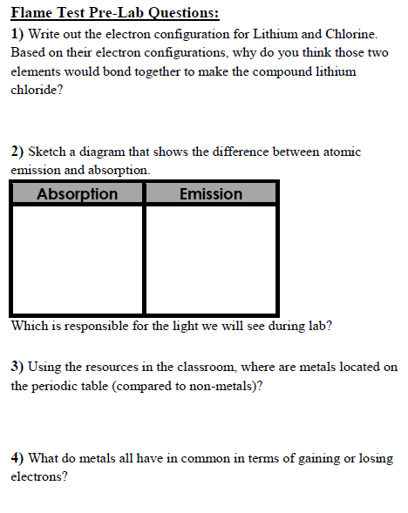
KCQ – Atomic Absorption & Emission – pg. 57
Target: I can diagram atomic absorption and emission
K
C
Q

Slide 53
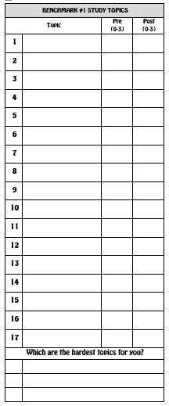
Benchmark Review– pg. 59
Target: I can review for my benchmark
30 min of Self Review from Resources Tab
Your three hardest topics - make smart choices!
STUDY PLAN

Slide 54
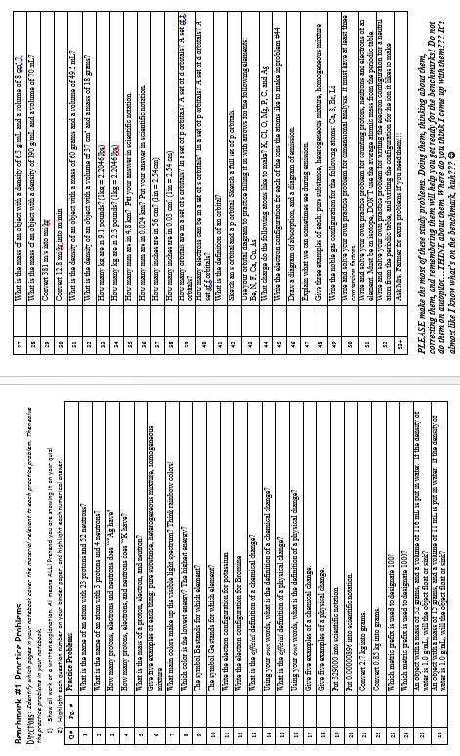
Benchmark Review– pg. 61
Target: I can review for my benchmark
Work for Benchmark Review Q's (Show it just like you do for quizzes - EVERY single problem needs something shown or explained!)

Slide 55
HOMEWORK
p. 59 – KCQ - due Monday
p. 58 – Flame Test Lab – due Monday

