Slide 1
Equilibrium -
Target: I can determine how to re-establish equilibrium when a reaction undergoes a “stress”
↔

Slide 2
What is a reversible reaction?
Some reactions can go forwards AND backwards
N₂ (g) + 3H₂ (g) → 2NH₃ (g) + 92.05 KJ
OR
2NH₃ (g) + 92.05 KJ → N₂ (g) + 3H₂ (g)
Use a “double headed arrow” so you don’t have to write it both ways! ↔

Slide 3
Reactions will reach “equilibrium”
EQUILIBRIUM = the point at which the forward reaction is happening at the same RATE as the reverse reaction
Are the CONCENTRATIONS of reactants and products the same?????
NO!!!!! (well maybe, but it doesn’t have to be!)

Slide 4
“Finding” equilibrium point
EQUILIBRIUM POINT We use ratios of [products] to [reactants]
You can have different ratios that all result in the rate forward being the same as the rate backwards!
There isn’t just one equilibrium point!
If you are pushed away from the original equilibrium point, then find a NEW ratio of concentrations that is “at equilibrium!”

Slide 5
Le chatelier’s principle
If a stress is applied to a reaction at equilibrium the reaction changes to relieve that stress, it will find a new equilibrium point where the forward and backwards reactions are equal again. It will try to “undo” whatever you did!
Took something away? Make more of it!
Added extra of something? Use some up!

Slide 6
How do you “stress” a reaction?
Concentration change
Temperature change
Pressure/volume change for gases
the equivalent of a concentration change!

Slide 7
Strange factS…
ONLY changes to aqueous and gas phases affect equilibrium
Solids and liquids do NOT affect equilibrium!
They do not have “concentrations” so they can’t factor in.
Adding an Noble Gas, an INERT gas, does NOTHING
Adding a catalyst does NOTHING! You will reach equilibrium faster but it won’t change the equilibrium point.

Slide 8
Quick example
N₂ + 3H₂ ↔ 2NH₃ + 92.05 KJ
Add more N₂
Shift to the right, use up the extra by making more products!
Remove H₂
Shift to the left, replace what you took away by making more reactants!

Slide 9
Can’t get back to the start, but you can find a new equilibrium
You can’t completely undo the stress and get back to your original concentrations…BUT you can at least end up “better off” than when totally stressed.
The reaction will find new ratios of concentrations where the forward and backwards rate can once again be equal.

Slide 10
[N₂] DURING the Stress no longer @ equilibrium
Didn’t get back to starting point, but better than during the stress!
So comparing BEFORE stressor to AFTER stressor, there is a SLIGHT increase to the thing you added extra of.
[N₂] AFTER reacting a NEW equilibrium position
[N₂] BEFORE Stress Applied @ ORIGINAL equilibrium position

Slide 11
What about changing pressure?
Increasing pressure causes molecules to be too crowded, too close together
If you can reduce the number of moles of gas particles it will make things less crowded and relieve some of the pressure
Move to the side with fewer moles of gas!
Reducing pressure?
Move to the side with more moles to get the pressure back up!

Slide 12
Quick example
N_{2 (g)} + 3H₂ _{(g)} ↔ 2NH₃ _{(g)} + 92.05 KJ
4 moles of gas 2 moles of gas
Increase pressure
Shift to the right, fewer moles, less crowded, lowers pressure back down
Decrease pressure
Shift to the left, more moles gas, more crowded, raises pressure back up

Slide 13
Equilibrium videos
Blue Bottle Demo: https://www.youtube.com/watch?v=kGSPAkOgN3U
Bozeman Science Reversible Reactions: https://www.youtube.com/watch?v=b6WmwtVNDf4
Water Beaker Demo Video: https://www.youtube.com/watch?v=_QnRt7PYzeY
TED what is Equilibrium Cartoon Explanation: https://www.youtube.com/watch?v=dUMmoPdwBy4
Fuse School Dynamic Equilibrium: https://www.youtube.com/watch?v=wlD_ImYQAgQ
TEDEd The chemical reaction that feeds the world https://www.youtube.com/watch?v=o1_D4FscMnU
Crash Course Equilibrium: https://www.youtube.com/watch?v=g5wNg_dKsYY
Fuse School Intro to Le Chatelier’s Principal https://www.youtube.com/watch?v=7zuUV455zFs

Slide 14
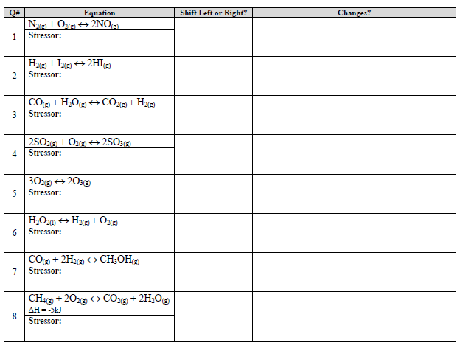
Le Chatelier’s Practice Problems

Slide 15
YouTube Links:
Link to YouTube Video of Presentation
https://youtu.be/h2GhVv8w1G0
Link to YouTube Video of Practice Problems
https://youtu.be/SBU2BwFmj-c

