Slide 1
Jumpstart
Ca(OH)₂ + 2KBr ↔ 2KOH + CaBr₂
Which way does equilibrium shift if you add extra KBr
What happens to the amount of KOH once the shift happens?
What happens to the amount of CaBr₂ once the shift happens?
What happens to the amount of Ca(OH)₂ once the shift happens?

Slide 2
Jumpstart
Ca(OH)₂ + 2KBr ↔ 2KOH + CaBr₂
Add extra KBr = shift right, need to use it up!
Amount of KOH
= increases, you moved toward it so you made some more
Amount of CaBr₂
= increases, you moved toward it so you made some more
Amount of Ca(OH)₂
= decreases, you moved away from it so you used some up

Slide 3
Would shift it LEFT to replace what you took out
Would shift LEFT because there are only 3 moles of gas which is less crowded than 5 moles of gas on the right
It is ENDOTHERMIC so heat is reactant, so if I raise the temperature I need to use up some heat, so it shifts to the RIGHT
Would shift to the LEFT to use up the CS₂ that you added

Slide 4
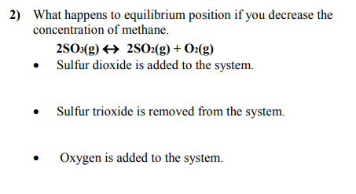
Shift LEFT to use up the extra SO₂
Shift LEFT to replace what you took out
Shift LEFT to use up the extra O₂

Slide 5
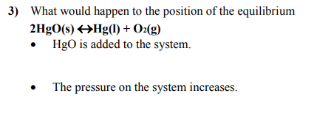
NOTHING! It is a SOLID!
Shift LEFT to go to side with fewer moles of GAS so it feels less crowded and the pressure goes back down. Left side has 0 moles of GAS, right side has 1 mole of GAS

Slide 6
If volume is increased, then pressure goes down. The reaction needs to raise the pressure back up. So it shifts to the LEFT because that side is more crowded with 5 moles of gas instead of only 4 on the right side

Slide 7
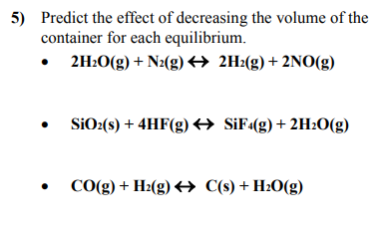
Decrease volume means pressure goes up. So shift to LEFT because less crowded with only 3 mol of gas instead of 4 mol
Decrease volume means pressure goes up. So shift to RIGHT because less crowded with only 3 mol of gas instead of 4 mol
Decrease volume means pressure goes up. So shift to RIGHT because less crowded with only 1 mol of gas instead of 2 mol

Slide 8
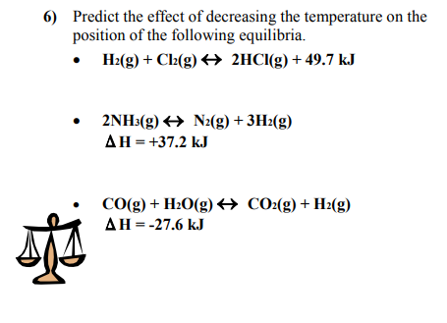
Exothermic – so heat is a product - so if you decrease the temperature, shift RIGHT in order to replace heat you took away
Endothermic – so heat is a reactant - so if you decrease the temperature, shift LEFT in order to decrease the heat you took away
Exothermic – so heat is a product - so if you decrease the temperature, shift RIGHT in order to replace the heat you added

Slide 9
Target: I can pay attention to small details when doing Le Chatelier’s principle problems
Things to look for BEFORE answering an equilibrium problem
Stressor | Question | What does it tell us?
Increase or decrease [ ] products or reactants | Which phase? | Gas, aqueous - change things Solid, Liquid – DON’T CHANGE ANYTHING!
Increase or decrease Temperature | Endo or exo? | Endo = absorbed, so it is a REACTANT Exo = released, so it is a PRODUCT
Increase or decrease total Pressure (Same as change in volume or number of moles of gas) | How many moles of GAS are on each side of the equation? | Increase pressure = move to side with FEWER moles of gas Decrease pressure = move to side with MORE moles of gas

