Slide 1
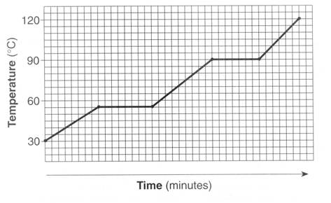
#1 – what is the freezing point?
120
90
60
30

Slide 2
#2 – Which takes longer – melting or boiling. WHY?

Slide 3
#3 – What is the opposite of vaporizing?

Slide 4
#4 – Which areas of a heating curve undergo an increase in kinetic energy? Use our numbering system (1, 2, 3, 4, 5)

Slide 5
#5 – What are the units for latent heat?

Slide 6
#6 – If water vapor condenses on the outside of a soda can is energy absorbed or released? Is it endo or exothermic?

Slide 7
#7 – The quantity of heat required to change the temperature of 1 g of a substance by 1°C is defined as what?

Slide 8
#8 – How many kJ is 85300 J?

Slide 9
#9 – What section of the heating curve have atoms moving the most? Use our numbering system, 1, 2, 3, 4, 5

Slide 10
#10 – If a reaction is endothermic do you feel hot or cold?

Slide 11
#11 – If a reaction is exothermic is Q positive or negative? Is ΔT positive or negative?

Slide 12
#12 – Calculate the energy transferred when 4.6g of ice is melted.

Slide 13
#13 – Calculate the energy transferred when 36.8 grams of water forms an ice cube in a freezer.

Slide 14
#14 – How much energy is required to heat 25 grams of ice from -10°C into water at 0°C?

Slide 15
#15 – How much energy does it take to raise 50 grams of ice at 0 °C to 100 °C and then boil.

