Slide 2
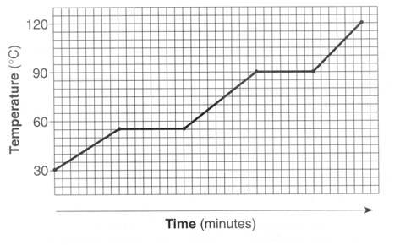
#1 – what is the freezing point?
120
90
60
30

Slide 3
#2 – Which takes longer – melting or boiling. WHY?

Slide 4
#3 – What is the opposite of vaporizing?

Slide 5
#4 – Which areas of a heating curve undergo an increase in kinetic energy? Use our numbering system (1, 2, 3, 4, 5)

Slide 6
#5 – What are the units for latent heat?

Slide 7
#6 – If water vapor condenses on the outside of a soda can is energy absorbed or released? Is it endo or exothermic?

Slide 8
#7 – The quantity of heat required to change the temperature of 1 g of a substance by 1°C is defined as what?

Slide 9
#8 – How many kJ is 85300 J?

Slide 10
#9 – What section of the heating curve have atoms moving the most? Use our numbering system, 1, 2, 3, 4, 5

Slide 11
#10 – If a reaction is endothermic do you feel hot or cold?

Slide 12
#11 – If a reaction is exothermic is Q positive or negative? Is ΔT positive or negative?

Slide 13
#12 – Calculate the energy transferred when 4.6g of ice is melted.

Slide 14
#13 – Calculate the energy transferred when 36.8 grams of water forms an ice cube in a freezer.

Slide 15
#14 – How much energy is required to heat 25 grams of ice from -10°C into water at 0°C?

Slide 16
#15 – What is the energy during a phase change being used for?

Slide 17
#16 – How much energy does it take to raise 50 grams of ice at 0 °C to 100 °C and then boil.

Slide 18
#17 – A metal spoon is used to stir a cup of hot chocolate. What is the sign (+ or -) of the Q_{spoon}?

Slide 19
#18 – Which part of the heating curve for water requires the most amount of energy to speed up the molecules?

Slide 20
#19 – Compare a piece of brass with a specific heat of 0.85 J/g°C and water with a specific heat of 4.184 J/g°C. Which of these substances heats more quickly? Why?

Slide 21
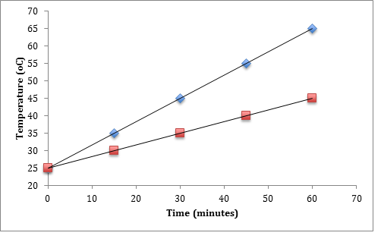
#20 – Which of the two substance (blue or red marks) would cool the fastest?

Slide 22
#21 – What “law” is important for calorimeter calculations?

Slide 23
#22 – Which way does heat flow? Hot → cold OR cold→Hot

Slide 24
#23 – Why does a bathtub full of water heat faster than a swimming pool full of water?

Slide 25
#24 – How much energy in joules does 30.0 g of sulfur lose when it lowers from 120 °C to 114 °C. The specific heat of sulfur is 0.71 J/g°C

Slide 26
#25 – A piece of iron is heated until it absorbs 300J of energy. It is dropped into a cup of cold water. What is the Q_{iron}, and Q_{water} once the metal is in the water?

Slide 27
#26 – The amount of energy needed to heat 40.00 g of iron from 40.0ºC to 100.0ºC is 100 J. The specific heat capacity is what?

Slide 28
#27 – The specific heat capacity of aluminum is 0.89 J/gºC. Calculate mass of the aluminum block if 8900 J were needed to heat the aluminum from 75.0ºC to 145.0ºC

Slide 29
#28 – an unknown metal has a mass of 280g, absorbs 3000kJ of energy and goes from 10 °C to 95 °C. What is the specific heat?

Slide 30
#29 – How much energy is required to boil 10 grams of mercury if the latent heat of vaporization is 294 J/g

Slide 31
#30 – mercury is a neurotoxin that when inhaled can be highly dangerous. Calculate the amount of energy required to change 14g of liquid mercury into a gas at 357 °C. The latent heat of fusion is 11 J/g and the latent heat of vaporization is 294 J/g

Slide 32
#31 – a substance has a melting point of 27°C and a vaporization point of 168°C. Draw the heating curve.

Slide 33
#32 – How much energy is released when cooling 10g steam from 150°C to ice at -15°C?

