Slide 1
GET OUT YOUR CALCULATORS!
Turn your phone into the pockets on wall - get calculator based on your seat #

Slide 2

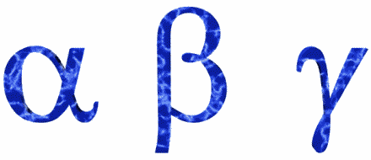
Half Life Calculations

Slide 3

Rates of Decay & Half Life
Atoms are radioactive when too many neutrons. Strong force cant hold nucleus together.
Radioactive elements have different stabilities and decay at different rates.

Slide 4
Half Life
The length of time it takes for 50% of the material to have undergone radioactive decay.
Example: Carbon-14, half life = 5,730 years

Slide 5
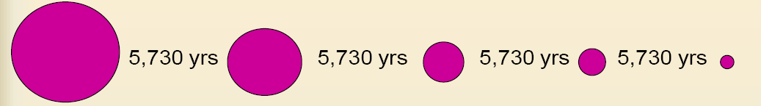
Half Life
100 % 50% 25% 12.5% 6.25%
1 half life
1 half life
1 half life
1 half life

Slide 6
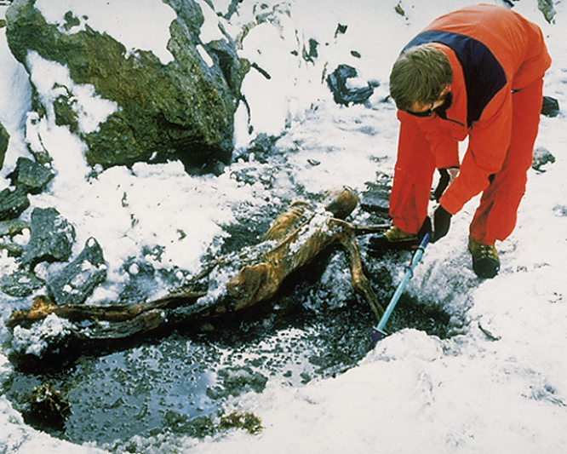
Oetzi, the “ice man” was found by hikers in the Alps between Switzerland and Italy. He was carbon dated to 5,300 yrs old! One of the oldest frozen humans ever found – and the best preserved.

Slide 7
How much is left?
If I start with 20 grams of Carbon-14 and the half life is 5,730 years…how many grams am I left with after 5,730 years?
5,730 years = 1 half life
20 grams/2 = 10 grams
But what if the problem is harder??? What if you started with 17.4 grams, and 12,901 years went by? How much would you be left with???

Slide 8
We have a handy-dandy equation we can use!!!
t
#
of half lives
h
A_{E}
=
A_{S}
x
0.5
A_{E} = amount ending with
A_{S} = amount starting with
t = time gone by (time elapsed)
h = length of the half life

Slide 9
Let’s give it a try!
You start with 157 grams of carbon-14 and the half-life of carbon-14 is 5730 years. How much would be left after 2000 years?
A_{E} = amount ending with = ???
A_{S} = amount starting with = 157 grams
t = time gone by = 2000 years
h = half life = 5730 years

Slide 10
A_{E} = amount ending with = ???
A_{S} = amount starting with = 157 grams
t = time gone by = 2000 years
h = half life = 5730 years
2000
5730
A_{E}
=
157
x
0.5
123.26
grams
is still
radioactive!
=
t
h
A_{E}
=
A_{S}
x
0.5

Slide 11
How much is stabilized?
157 g radioactive to start
-
123.26
grams still radioactive
=
33.74 g has stabilized – no longer radioactive

Slide 12
Fraction left over? Percent left over?
t
A_{E}
X
Fraction Left Over
=
0.5
h
A_{S}
t
A_{E}
h
x 100
% left over
0.5
=
A_{S}

