Slide 1
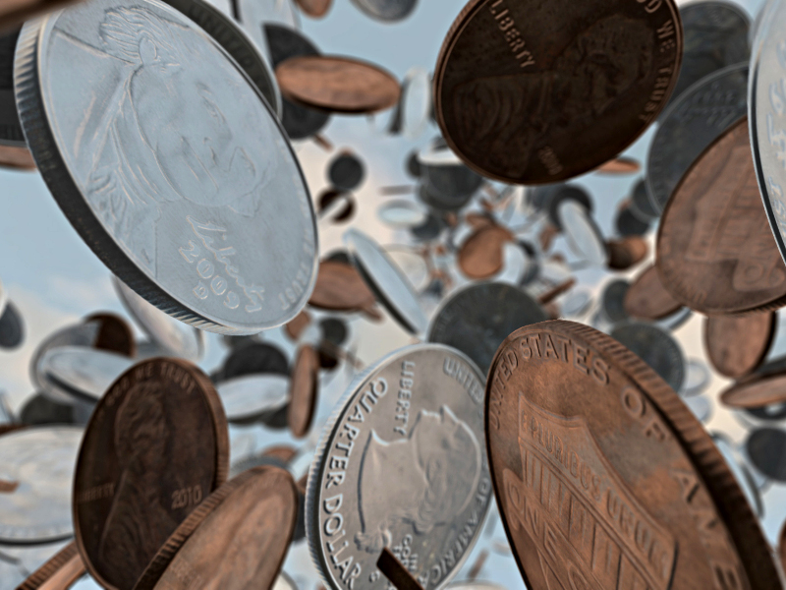
VERBAL JUMPSTART! Talk to your neighbor!!!!
Brainstorm a connection between the photo you see on the screen, and HALF LIFE. Be as creative as you need to be, but make sure to “connect the dots” – you have to be able to explain it to someone!

Slide 2
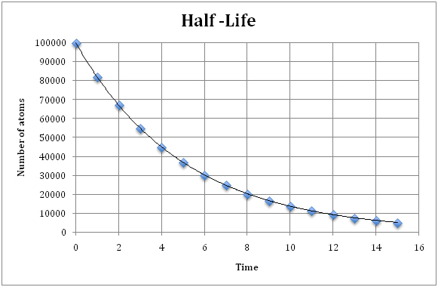
(minutes)

Slide 3
HOMEWORK QUIZ Put Name, Period, Seat # in top right corner. Title the paper HALF LIFE HOMEWORK QUIZ
How many grams of a 15 gram sample will remain after 50 days if the half life is 5 days?
SHOW ALL WORK
BOX AROUND FINAL ANSWER
DON’T FORGET UNITS ON ANSWER

