Slide 1
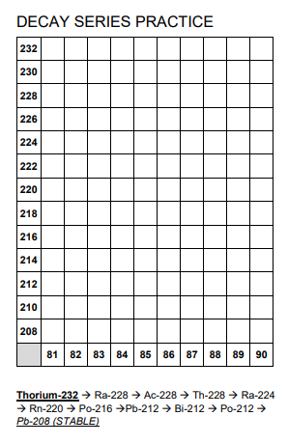
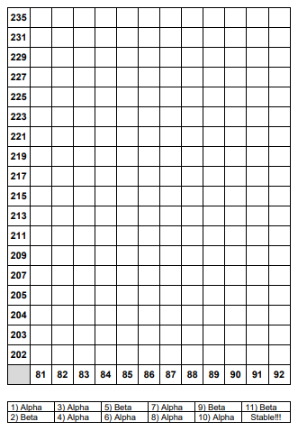
TARGET:
Page 69
Page 68
Decay of Uranium-235
Symbols
START: ${}_{92}^{235}U$ ↓ α
1) ${}_{90}^{231}{Th}$ ↓ 𝛽
2) ${}_{91}^{231}{Pa}$ ↓ 𝛽
3) ${}_{89}^{227}{Ac}$
↓ etc…
Decay of Thorium-232
Symbols
$${}_{90}^{231}{Th}$$
↓ α
$${}_{88}^{228}{Ra}$$
↓ 𝛽
$${}_{89}^{228}{Ac}$$
↓ etc…

