Slide 1
Nuclear decay series

Slide 2
Nuclear decay series
Things don’t always decay in one single step!
Sometimes it takes lots of little decays before it reaches a more stable isotope

Slide 3
Nuclear decay series
Parent #1 decays into Daughter Product #1
Daughter Product #1 is now the Parent #2 !
Parent #2 decays into Daughter Product #2
Etc…etc…etc…
$P_{1}→ D_{1}$ + radioactive particle
$P_{2}→ D_{2}$ + radioactive particle

Slide 4
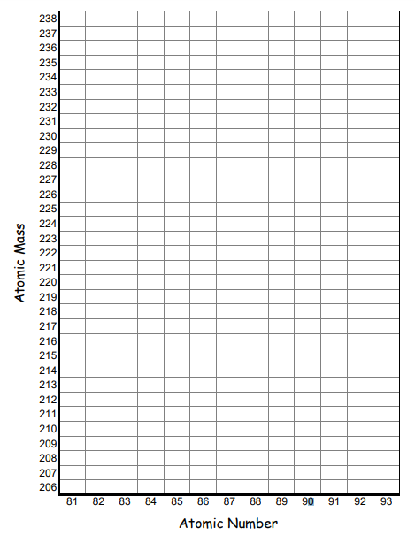
Graphing decay series
(Going to zoom in so its big enough to see on the screen)

Slide 5
KEEP GOING! All the way to the end!
U
$$α$$
Th
Pa
U
$$β$$
$$β$$

Slide 6
