Slide 1
Keys to Practice p. 64-67

Slide 2
Get out your GREEN pen please!
Page 64
#-ing is off a bit, oh well! ☺
Loses pieces to become more stable
From notes!
Gamma
Alpha
Beta
Beta
Gamma
4/2 He, alpha
0/-1 e, beta
4/2 He, alpha
210/81 Tl, alpha
212/84 Po, beta
Page 64
4/2 He, alpha
0/-1 e, beta
230/89 Ac
216/84 Po
216/85 At
0/-1 e, 210/84 Po
Np turns into Pa but still isn’t stable. Keeps under going decays until it is more stable. It is a “chain decay” or a “series decay” or a “decay series”

Slide 3
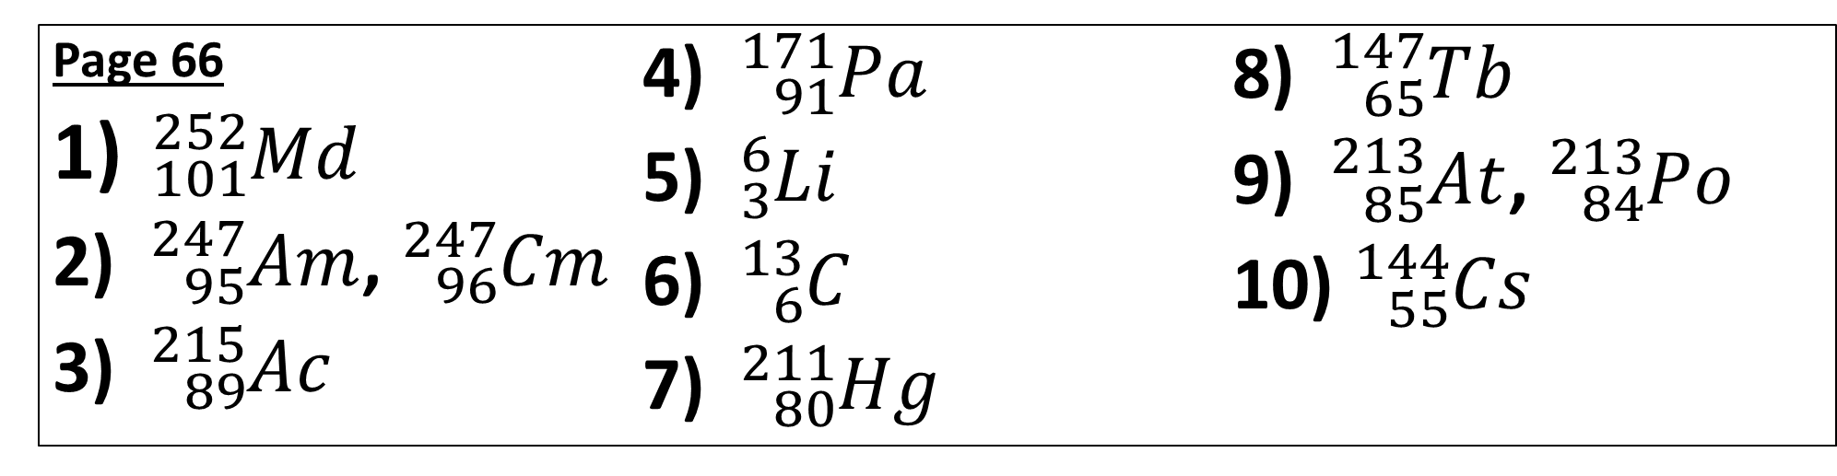
Get out your GREEN pen please!
Page 66
${}_{101}^{252}{Md}$
${}_{95}^{247}{Am}$, ${}_{96}^{247}{Cm}$
${}_{89}^{215}{Ac}$
${}_{91}^{171}{Pa}$
${}_{3}^{6}{Li}$
${}_{6}^{13}C$
${}_{80}^{211}{Hg}$
${}_{65}^{147}{Tb}$
${}_{85}^{213}{At}$, ${}_{84}^{213}{Po}$
${}_{55}^{144}{Cs}$

Slide 4
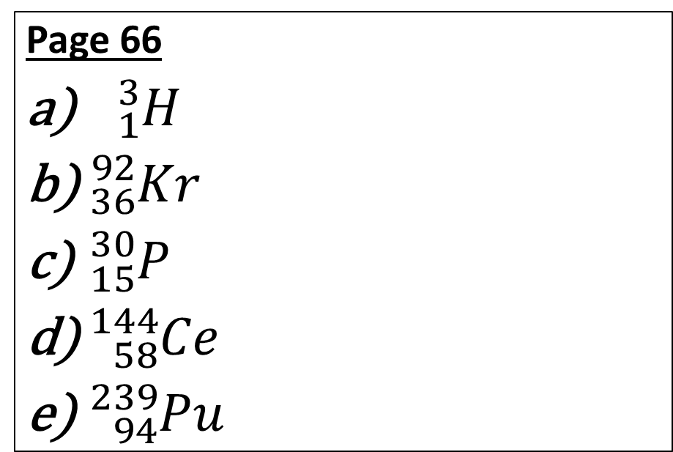
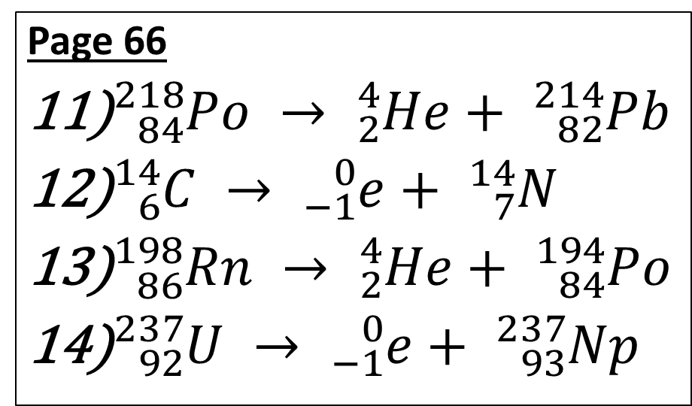
Get out your GREEN pen please!
Page 66
${}_{84}^{218}{Po} → {}_{2}^{4}{He}+ {}_{82}^{214}{Pb}$
${}_{6}^{14}C → {}_{−1}^{0}e+ {}_{7}^{14}N$
${}_{86}^{198}{Rn} → {}_{2}^{4}{He}+ {}_{84}^{194}{Po}$
${}_{92}^{237}U → {}_{−1}^{0}e+ {}_{93}^{237}{Np}$
Page 66
${}_{1}^{3}H$
${}_{36}^{92}{Kr}$
${}_{15}^{30}P$
${}_{58}^{144}{Ce}$
${}_{94}^{239}{Pu}$

Slide 5
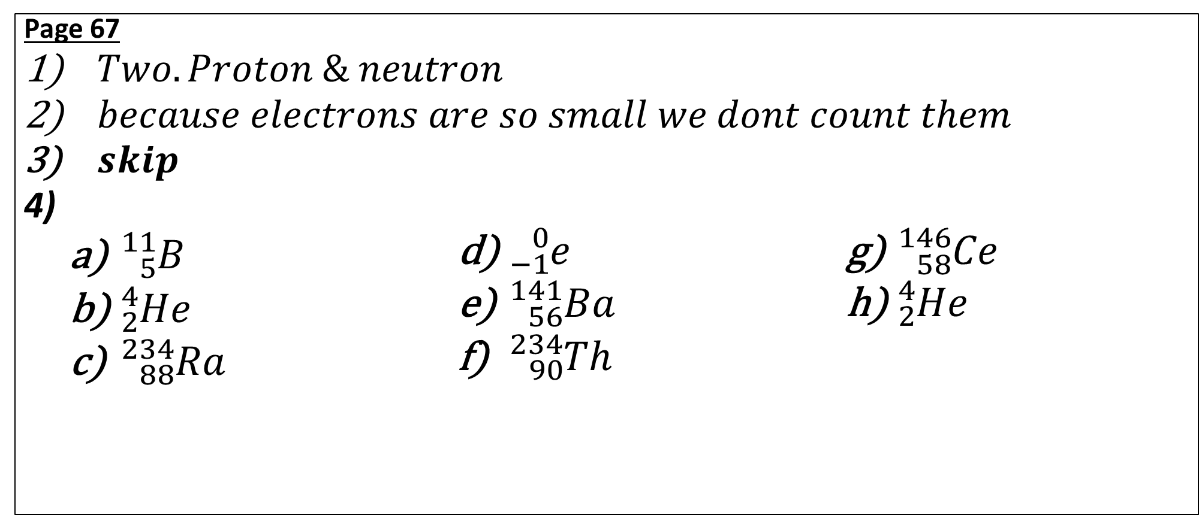
Get out your GREEN pen please!
Page 67
$Two. Proton \& neutron$
$because electrons are so small we dont count them$
$skip$
  ${}_{5}^{11}B$
  ${}_{2}^{4}{He}$
  ${}_{88}^{234}{Ra}$
  ${}_{−1}^{0}e$
  ${}_{56}^{141}{Ba}$
  ${}_{90}^{234}{Th}$
  ${}_{58}^{146}{Ce}$
  ${}_{2}^{4}{He}$

Slide 6
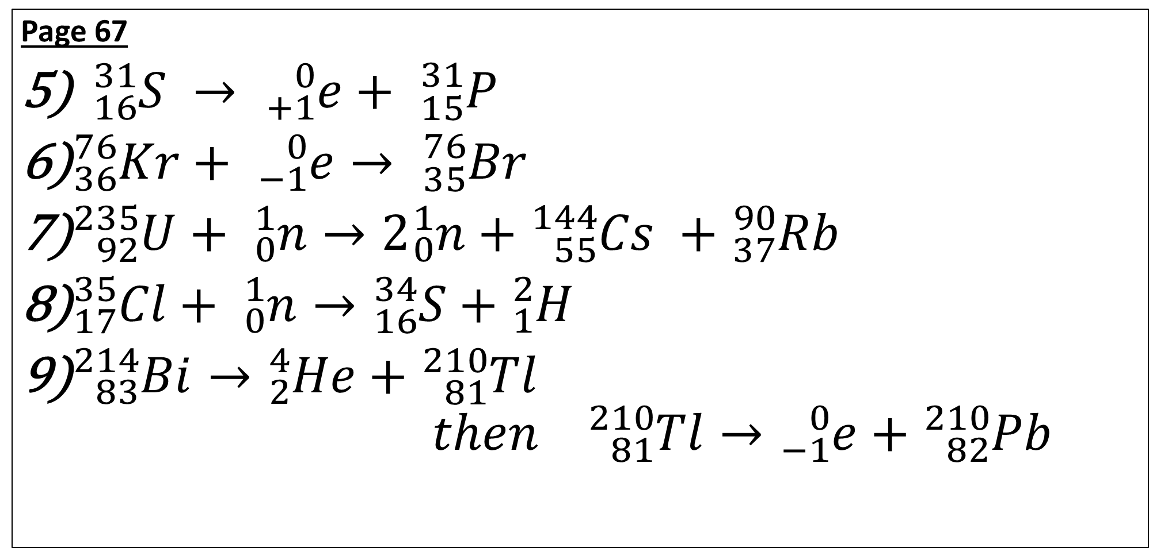
Get out your GREEN pen please!
Page 67
${}_{16}^{31}S → {}_{+1}^{0}e+ {}_{15}^{31}P$
${}_{36}^{76}{Kr}+ {}_{−1}^{0}e→ {}_{35}^{76}{Br}$
${}_{92}^{235}U+ {}_{0}^{1}n→2{}_{0}^{1}{n+{}_{55}^{144}{Cs} }+{}_{37}^{90}{Rb}$
${}_{17}^{35}{Cl}+ {}_{0}^{1}n→{}_{16}^{34}{S+{}_{1}^{2}H}$
${}_{83}^{214}{Bi}→{}_{2}^{4}{He+{}_{81}^{210}{Tl} }$
$then {}_{81}^{210}{Tl}→{}_{−1}^{0}e+{}_{82}^{210}{Pb}$

