Slide 1
Argumentative writing

Slide 2
Persuasion vs. argument
 | Argument | Persuasion
Goal | Discover the “truth” | Promote an opinion on a particular position that is rooted in truth
General technique | Offers good reasoning and evidence to persuade an audience to accept a “truth” | Uses personal, emotional, or moral appeal to convince an audience to adopt a particular point of view
Methods | Considers other perspectives on the issue Offers facts that support the reasons (in other words, provides evidence) Predicts and evaluates the consequences of accepting the argument | May considers other perspectives on the issue Blends facts and emotion to make its case, relying often on opinion May predict the results of accepting the position, especially if the information will help convince the reader to adopt the opinion

Slide 3
Effective arguments
Building an effective argument means to use logic and reliable evidence to prove a point.
Being persuasive means to convince someone to accept your point of view.
Commercials almost always attempt to persuade, but they are seldom logical or reasonable.
A strong argument can be persuasive but only if it’s logical and thoughtful.

Slide 4
Argument vocabulary
Claim/thesis
Counterclaim/counterargument
Rebuttal
Support/evidence
Refute
Validity
Call to action
Bias

Slide 5
What is a claim?
Claim: thesis / central idea that you want to persuade your readers to agree with
E.g. Parents should not search their children’s rooms without their knowledge

Slide 6
How to back up a claim
Support/evidence: Your specific facts or specific evidence used to support why your claim is true
Types of evidence:
Facts / statistics
Examples
Anecdotes
Quotations
Definitions
Reasons
reflections

Slide 7
How to recognize a good argument
Look at the types of rhetorical appeals
Ethos (appeal to speaker’s credibility)
Pathos (appeal to emotions)
Logos (appeal to logic)

Slide 9
Validity of evidence
Consider all information provided
Is the evidence presented so far relevant and connected to the argument?
Is it sufficient, or thorough and specific enough, to support the argument?

Slide 10
Faulty logic
The opposite of effective evidence is evidence that is fuzzy, exaggerated, illogical, or dishonest
You’ll find this type of slanted evidence in advertisements, political ads, in radio and TV programs that are biased

Slide 11
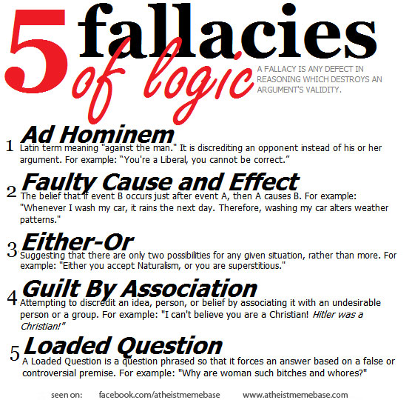

Slide 12
Bias
Bias: A preconceived and often unfair feeling for or against something related to the topic

Slide 13
Topic sentence
Reasons you are presenting the claim
Supported with relevant evidence
Use at least 2-3 main points

Slide 14
THESIS STATEMENT
HIGHLIGHT!!!!
One sentence that appears at the END of your introduction paragraph
Two traits of a well-written thesis:
Includes topic or subject
Includes your stance or position on that topic

Slide 15
Conclusion
Restate the main ideas in the argument
Include concluding statement
Call to action

Slide 16
Example outline
Claim: Parents should respect their children’s privacy.
Topic sentence 1: Children have a right to privacy.
Topic sentence 2: A good parent-child relationship is built on trust.
Topic sentence 3: Kids will become more secretive if they feel their privacy isn’t respected.
Concluding statement: Without enough respect for their children’s privacy, parents may damage their family life.

Slide 17
Essay structure
Introduction paragraph:
Main claim (thesis statement)
Body paragraphs:
Supporting ideas (what are your main points?)
Counterargument paragraph:
Key objections, rebuttal
Conclusion paragraph:
Sum up your ideas, offer final words, call to action

Slide 18
Counterargument
Counterargument: A solid and reasonable argument that opposes or disagrees with your claim
Acknowledge the other side (what would someone who opposes you think?)
Anticipate and address objections to your arguments
Address the other side, explain why they are wrong
Argument:
The curfew interferes with teens’ social life.
Objection:
Teenagers can hang out downtown during the daytime.
Rebuttal:
Because the weather is so hot in Texas, teenagers don’t want to be outside in the afternoon.

Slide 19
Rebuttal
A response to a counterargument.

Slide 20
Conclusion & Call to action
Conclusion: Summarize your position and major supporting points
Call to action: tell your audience what you want them to do. Be clear and specific.
Example:
The curfew law penalizes good kids and does nothing to benefit local businesses or to make our city safer. People should write to the mayor and urge her to lift the curfew on teens. It’s the right thing to do.

