Slide 1
Classes of elements color coded on tiny periodic table that is a glue in on your KCQ Notes page, group names color coded on big periodic table inside the worksheet questions

Slide 2
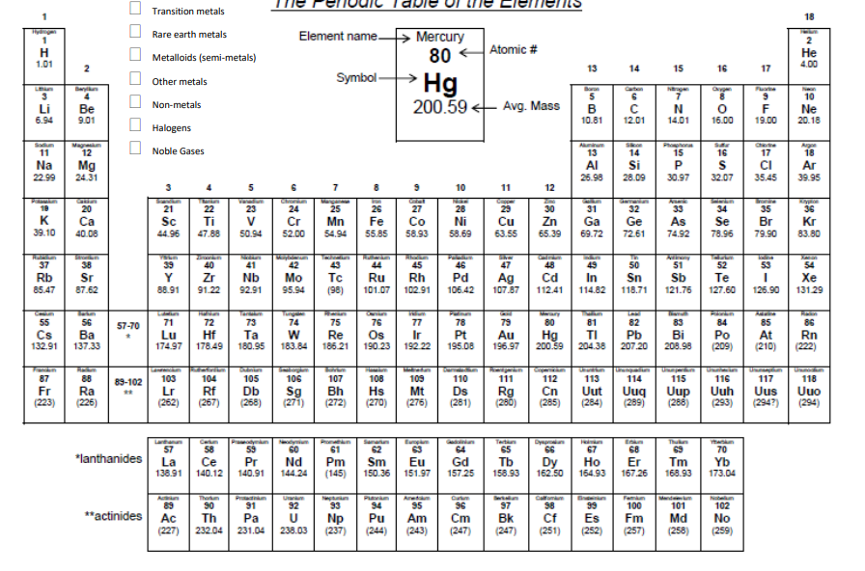
Using this as a guide, color code your periodic table to show the three CLASSES of elements.
Metals
Non-metals
Metalloids
Polonium is sometimes considered a metal, metalloid, or a non-metal depending on which table you are looking at. Astatine is sometimes considered a nonmetal, sometimes a metalloid. No big deal, it is weird!

Slide 3
Alkali Metals
Alkaline Earth Metals
Transition Metals
Other Metals
Rare Earth Metals
Metalloids/ Semimetals
Other Non-metals
Halogens
Noble Gases
Using this as a guide, color code your periodic table to show the GROUP NAMES
Polonium sometimes considered an other metal, sometimes a metalloid/ semimetal. Astatine sometimes a metalloid sometimes a halogen. No big deal, its weird!

