Slide 1
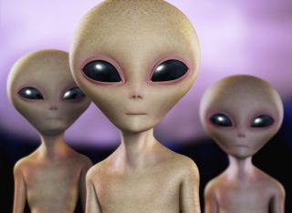
Periodic Table of Aliens!

Slide 2
Goals
Find the two missing aliens
Identify a potential NEXT alien that would exist if you expanded your table to be even bigger

Slide 3
How?
Arrange your table into GROUPS and PERIODS
It should make a rectangle!
Leave blank spots for the two missing aliens
Every GROUP should have:
Something that is the same as you go down
Something that changes in a predictable way as you go down.
Every PERIOD should have:
Something that is the same as you go down
Something that changes in a predictable way as you go down.

Slide 4
 | ?
 |  |  |  | ?
Next Alien?
Identify BOTH missing Aliens and describe/draw each. Pick ONE “Next Alien” to predict and describe/draw
Next Alien?
Next Alien?
Next Alien?
Next Alien?
Next Alien?
Next Alien?
Next Alien?
Next Alien?
Next Alien?
Next Alien?

