Slide 1
Jumpstart #
Take out your periodic table.
Work on these questions quietly by yourself. When you finish then check your answers with your neighbor.
Write 3 sentences about why the periodic table is set up how it is.
2) Identify each element as an alkali metal, alkaline earth metal, transition metal, halogen, or noble gas
a) Lithium b) Krypton c) Cobalt d) Barium e) Chlorine
3) Give 1 example of elements for each category that are NOT used in #2
a) noble gases c) halogens e) alkali metals b) alkaline earth metals d) transition metal

Slide 2
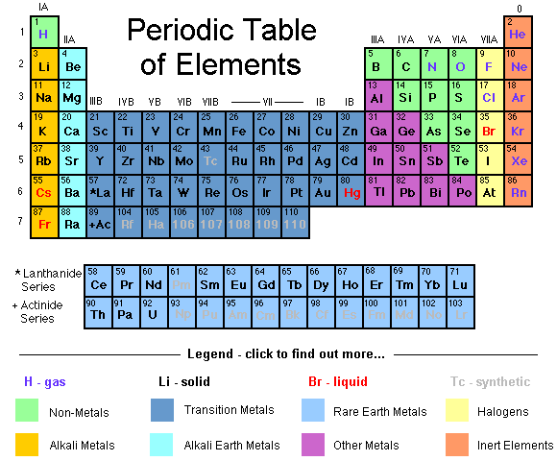
Structure of the Periodic Table

Slide 3
Reactivity
Has to do with electron configuration

Slide 4
Reactivity
Least Reactive - INERT
Most Reactive
Already have a full shell! Don’t want to lose it!
Closest to a full Octet – Full Valence Shell
Most Reactive

Slide 5
Elements in the same group have similar behaviors
Because they have the same number of valence electrons!!!

Slide 6
Reactivity in Groups
Metals – more reactive as you go DOWN
Easier to lose electrons because valence electrons are further away from nucleus
Non-metals – more reactive as you go UP
Smaller the atom the more it wants an electron to gain
Brainiac Video
Disposal of Sodium

