Slide 1
ADD TO IT NOTES
1) Go through the following PowerPoint
2) TAKE NOTES in BLACK PEN. And ONLY black pen.
3) LEAVE SPACE around your notes! VERY important
4) The next day in class we will go over the PowerPoint with more details added, and I will point out the key information
5) During step #4 you will ADD TO YOUR NOTES using a GREEN PEN that I will give you.

Slide 2
Introduction to Types of Bonds

Slide 3
Types of Chemical Bonds
Ionic (Metal - Nonmetal)
Covalent (Nonmetal - Nonmetal)
Identify types of bonds by types of elements!
Metallic (Metal - Metal)

Slide 4
Chemical Reactions
They do this by transferring or sharing electrons in order to make “bonds”
Ionic – electrons transferred
Covalent – electons shared
Metallic – free flowing electrons
Q: What is a…
Q: What happens during a…

Slide 5
Why bother making bonds?
Atoms want to have a full outer shell like the noble gases have:
WHY BOND???
TO HAVE A FULL VALENCE SHELL!
Ne: 1s²2s²2p⁶
Ar: 1s²2s²2p⁶3s²3p⁶
*NOTICE: A full outer shell = 8 e⁻

Slide 6
Which electrons are involved in bonding?
Valence Electrons: The e- in the highest occupied energy level of an atom

Slide 7
IONIC BONDS
Transferring Electrons

Slide 8
Ionic Bonds
metal + nonmetal
low ionization energy high e⁻ affinity
Wants to get rid Wants to gain
of an electron an electron
Therefore:
Metal + Nonmetal
Cation (positive) + Anion (negative)
e⁻

Slide 9
NaCl – opposites attract!
The two “happy” ions now attract each other electrically. The resulting attraction is an ionic bond. A bond between ions.
Cl⁻
Electrostatic attraction
Na⁺

Slide 10
Properties of Ionic Compounds
They are solids with high melting points (typically > 400°C)
Many are soluble in water

Slide 11
Properties of Ionic Compounds
Molten compounds conduct electricity well because they contain mobile charged particles (ions).
Aqueous solutions conduct electricity well for the same reason.
Like frogs on a lilypad
Electrons can move around because ions are broken apart

Slide 12
COVALENT BONDS
Sharing Electrons

Slide 13
Each atom is tricked into thinking it has a full shell

Slide 14
Each atom is tricked into thinking it has a full shell

Slide 15
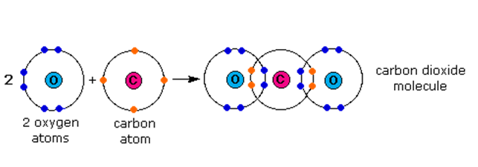
Can get complicated molecules

Slide 16
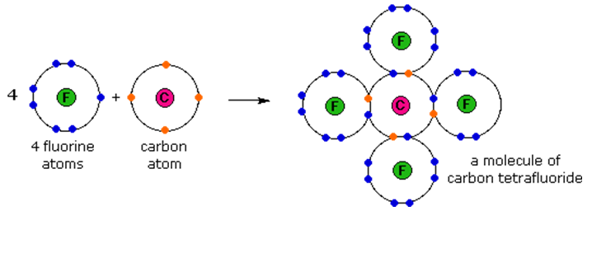

Slide 17
Properties of Covalent Bonds
Don’t Conduct Electricity
Low melting points
Usually not soluble in water

Slide 18
METALLIC BONDS
Free Flowing Electrons

Slide 19
Metal – Metal
Electrons are able to flow freely through the metal in a
“SEA OF ELECTRONS”
Sea of Electrons Animation

Slide 20
Properties of Metals
Solid at room temperature (except for mercury…it is a liquid!)
Conduct electricity
Malleable
Ductile
Have a wide range of melting points.

