Slide 2
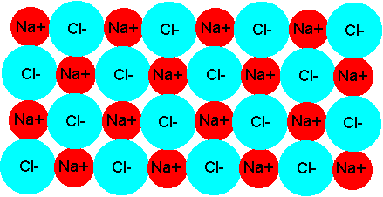
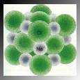
Sodium Chloride (Ionic Molecule)

Slide 3
Properties of Ionic Compounds
They are solids with high melting points (typically > 400°C)
Many are soluble in water

Slide 4
Properties of Ionic Compounds
Molten compounds conduct electricity well because they contain mobile charged particles (ions).
Aqueous solutions conduct electricity well for the same reason.

Slide 5
Properties of Compounds
Properties of compounds often have VERY different properties than the individual elements.
Sodium is an explosive metal
Chlorine is a poisonous gas.
Sodium Chloride you put on your fries

Slide 6
Properties of Compounds
Because chemical properties are due to the electron configuration of the valence electrons. During bonding, this configuration changes.

