Slide 1
Lewis Diagrams Lewis Structures Lewis Dot Diagrams Lewis Dot Structures
All the same thing! ☺

Slide 2
A way to figure out the structure of molecules
You have to know the # of valence electrons for EACH atom in the molecule!
From the periodic table group number!
1A = 1 valence electron
2A = 2 valence electrons
3A = 3 valence electrons
etc…

Slide 3
Practice…
Lithium
1 valence
Magnesium
2 valence
Nitrogen
5 valence
Neon
8 valence
“8 is great!” – many things want 8 valence e- = “full shell” or “octet”

Slide 4
Why valence electrons and not all electrons?
Because the valence electrons are the only ones on the outside! They are available for bonding. They are “accessible”

Slide 5
Octet “Rule”
More like a suggestion than a “rule”
Most elements want 8 valence electrons if possible
ANYTHING can break the “rule” if it has to!
Common exceptions – things that break the rules more often than they follow the rules
Memorize them!
Element | H | B | P | S
# of Valence e- it is ok having | 2 | 6 | 10 | 12

Slide 6
Drawing Single Atoms
Li Be B C
N O F Ne

Slide 7
Drawing Anions – a change has been made!
O²⁻
Oxide
Oxygen normally has:
6 v.e-
Change:
+ 2 v.e- (two extra)
New Total:
8 v.e-
[ ]
2-
O

Slide 8
Drawing Anions – a change has been made!
N³⁻
Nitride
Nitrogen normally has:
5 v.e-
Change:
+ 3 v.e- (three extra)
New Total:
8 v.e-
[ ]
3-
N

Slide 9
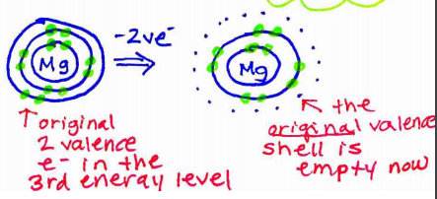
Drawing Cations – a change has been made!
Mg²⁺
Magnesium Ion
Mg normally has:
2 v.e-
Change:
- 2 v.e- (lost two)
New Total:
0 v.e-
[ ]
???? v.e-
2+
Mg
0 v.e- in the ORIGINAL valence shell
ONLY DRAW ORIGINAL valence shell!

Slide 10
Drawing Ionic Compounds – Draw the ions next to each other! That’s it!
Sodium Chloride
NaCl
[ ]
[ ]
1+
1-
Na
Cl
Magnesium Oxide
MgO
[ ]
[ ]
2+
2-
Mg
O

Slide 11
Drawing Ionic Compounds – Draw the ions next to each other! That’s it!
Calcium Fluoride
MgF₂
[ ]
[ ]
[ ]
1-
2+
1-
Mg
F
F
Don’t waste all your time! Don’t draw two fluorides! Just use subscripts! ☺
[ ]
[ ]
2+
1-
Mg
F
2

