Slide 1
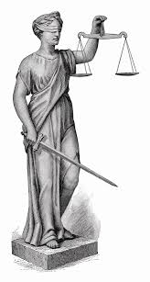
VERBAL JUMPSTART! Talk to your neighbor!!!!
1) What are the differences & similarities between IONIC & COVALENT bonds?
2) Brainstorm a connection between the photos you see, and WRITTING IONIC COMPOUNDS. Be as creative as you need to be, but make sure to “connect the dots” – you have to be able to explain it to someone! Don’t forget to include some key vocabulary!

Slide 2
EXIT TICKET In top right corner: Name, Period Seat # EXIT TICKET C4-3-A
1) What is the formula for barium nitride?
2) What is wrong with the formula: NaO ?
3) What should the formula be for #2?
SHOW ALL WORK WITH CROSSING OVER METHOD FOR #1 AND #3

