Slide 1
Target: I can identify polarity of molecules
K C Q
Molecule | Lewis Structure | Polar or non polar?
H2O
Br2
CH4
NH3
BF3
CH3Br
Polarity Flow Chart Handout

Slide 2
Polarity

Slide 3
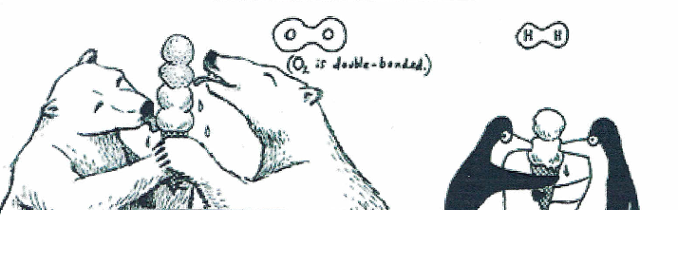
What’s happening inside covalent molecules like O₂ or H₂?
Electrons are shared equally

Slide 4
Molecules become POLAR when electrons are not shared equally
Example: HF
HF is covalent but electrons are not shared equally

Slide 5
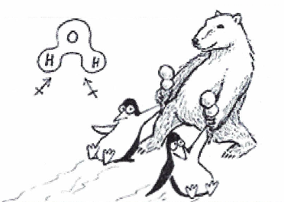
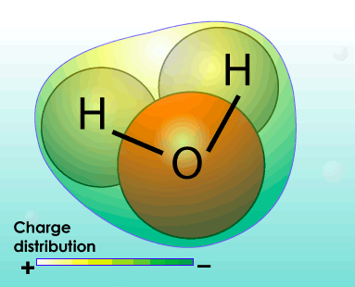
Polar molecules with more than 2 atoms
Water has:
2 H’s willing to almost give up electrons
1 electronegative O Ends up UNEQUAL

Slide 6
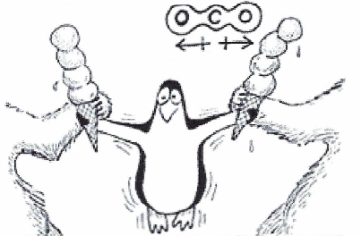
Symmetry…the pole destroyer!
CO₂
Has 1 carbon surrounded by 2 electronegative Oxygens, but is NOT polar?!?!
Electron density is still SYMETRICAL which makes it non-polar

Slide 8
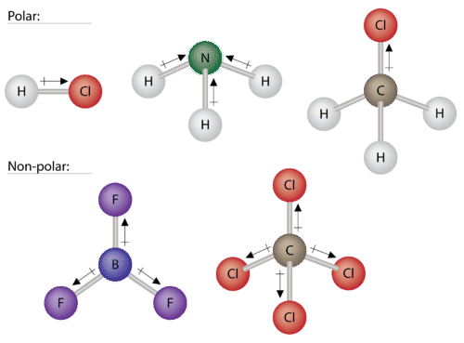
Careful about polar BOND versus polar MOLECULE
Polar bond AND Polar molecule
Polar bond AND NON-polar molecule

Slide 9
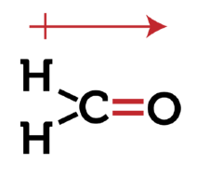
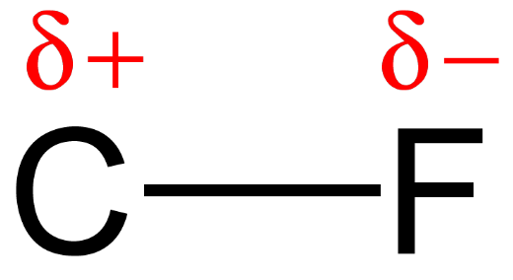
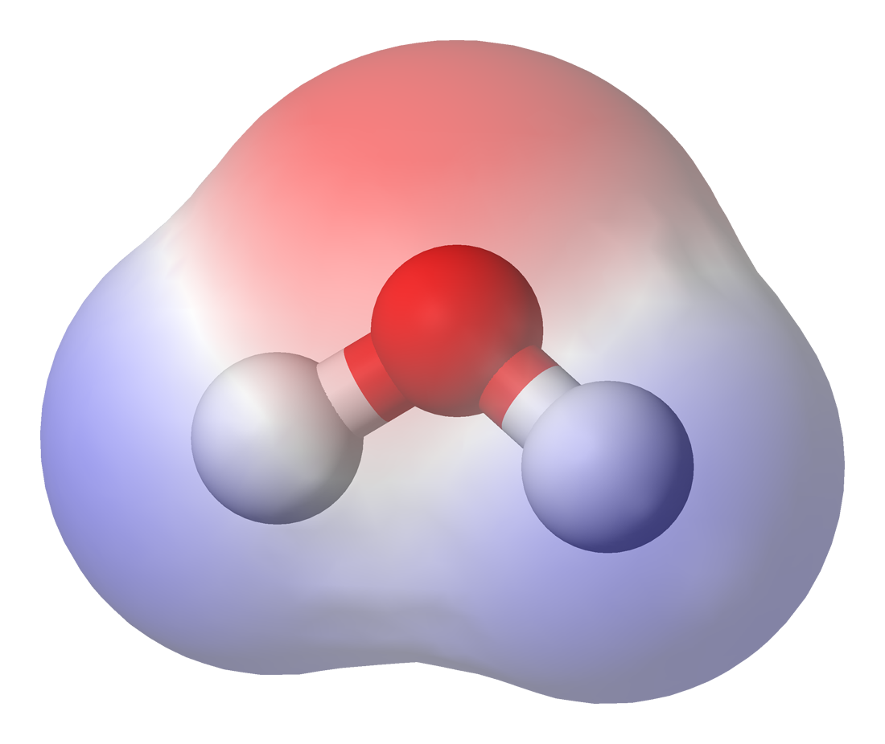
Three ways to diagram “dipoles”

Slide 10
NO
Are ions present?
YES
Ionic Compound
Are there more than two atoms?
YES
NO
Is the lewis structure symmetrical?
Are both atoms the same element?
YES
NO
NO
YES
Non-polar
Polar
Polar
Non-polar

Slide 11
Target: I can identify polarity of molecules
K C Q
Molecule | Lewis Structure | Polar or non polar?
H₂O
Br₂
CH₄
NH₃
CS₂
CH₃Br
Polarity Flow Chart Handout

Slide 12
YouTube Link to Presentation
https://youtu.be/RqmDU2u3aNw

