Slide 1
Target: I can describe how intermolecular forces affect properties
K C Q

Slide 2
Properties due to Intermolecular Forces

Slide 3
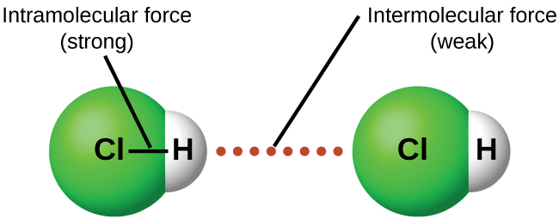
Vocabulary
INTRAmolecular Forces
Forces holding together the atoms INSIDE a molecule or compound. What we usually think of as “bonds.” Relatively strong.
Types: Ionic forces, covalent forces
INTERmolecular Forces
Attractions or repulsions which act between neighboring molecules. Holds different molecules next to each other. Very weak. Not strong enough to be called real “bonds.”

Slide 4
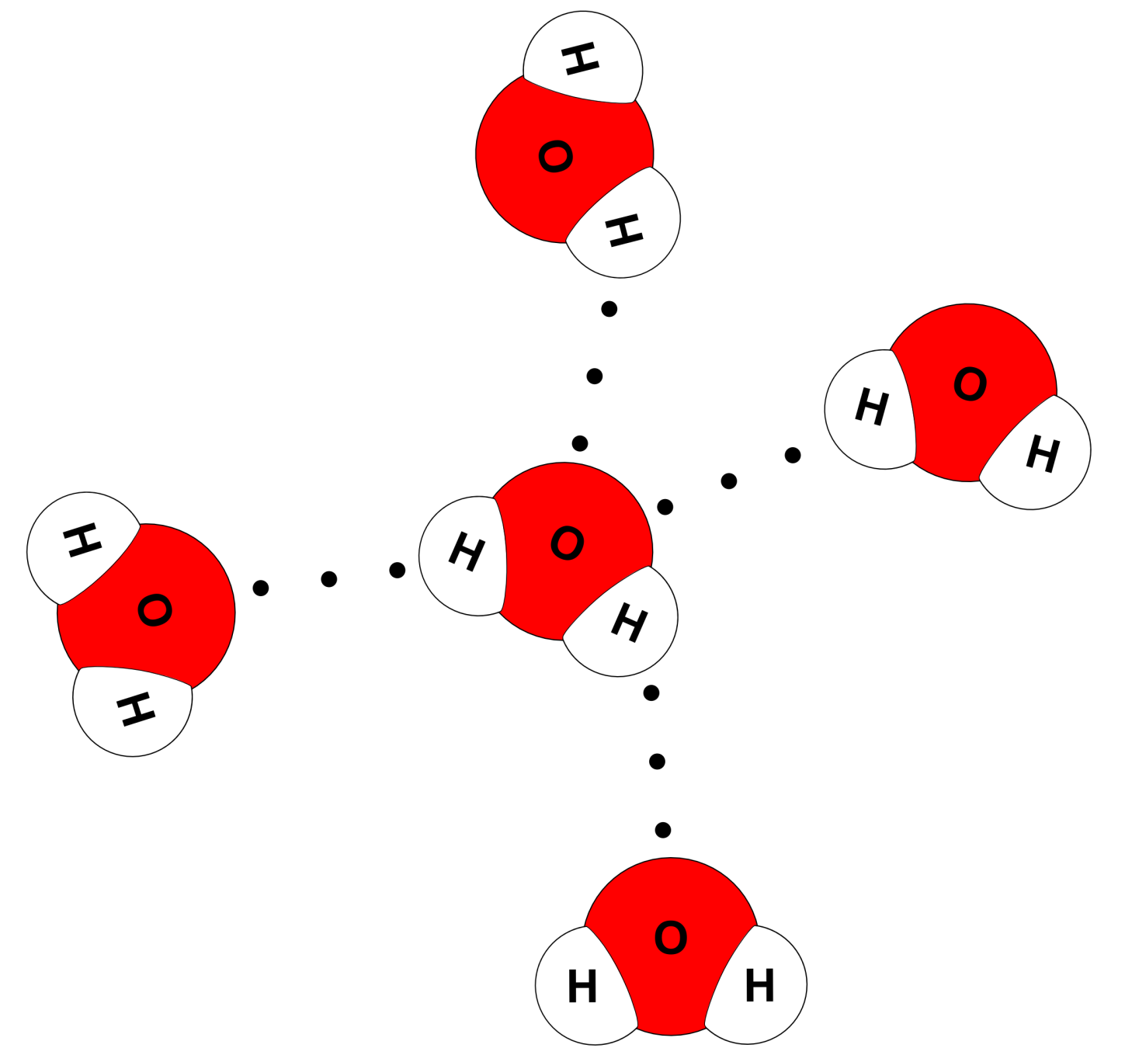
Use dotted lines to represent an intermolecular force.
They are much much weaker than a real “bond” so we want to show that somehow – the dotted line emphasizes the fact that it is weaker.

Slide 5
If there are lots of intermolecular forces (or IMF to abbreviate)
Then the molecules will be held near each other like a bunch of magnets.
The more IMFs, the stronger they are being held near each other.
The harder it is to separate the molecules from each other.

Slide 6
Some properties that relate to intermolecular forces
When you increase IMFs the properties increase too!
The more forces present, the higher the properties will be.
Will boil at a higher temp
Will melt at a higher temp
Will be thicker (more viscous)
Higher surface tension.
All because it will be harder to separate the molecules!
Boiling point
Melting point
Viscosity
Surface tension

Slide 7
Some properties that relate to intermolecular forces
Not all substances will mix with all other substances Think oil and water. They don’t mix!
Polar substances like to mix with other polar substances.
Non-polar substances like to mix w/ non-polar substances.
Polar and non-polar don’t mix.
Miscibility (Mixing) | “Like dissolves like” “Like mixes with like”
 | Polar mixes with polar | Non-polar mixes with non-polar

Slide 8
Examples
HBr
Br₂
- Polar
- Nonpolar
HBr – higher boiling point, melting point, viscosity, surface tension

Slide 9
Examples
HBr
Br₂
- Polar
- Nonpolar
HBr and Br₂ – will not mix!

Slide 10
Examples
F₂
Br₂
- Nonpolar
- Nonpolar
F₂ and Br₂ – will mix!

Slide 11
Examples
H₂O
CO
- Polar
- Polar
H₂O and CO – will mix!

Slide 12
WATCH THIS VIDEO – TAKE NOTES https://youtu.be/PVL24HAesnc Crash Course – Polar & Non-Polar Molecules

Slide 13
WATCH THIS VIDEO – TAKE NOTES
https://youtu.be/ohaI9yMZ8lc
KClassScienceChannel - Polar and Non Polar Substances

Slide 14
YouTube Link to Presentation
https://youtu.be/6aoRchysAzc

