Slide 1
Types of IMFs
Get KCQ and Target set up!

Slide 2
INTER molecular forces (forces between neighboring molecules)
London < Dipole-dipole < Hydrogen Dispersion bonding
WEAKEST
STRONGEST
“Van der Waals Forces” are London Dispersion Forces and Dipole-Dipole Forces added together

Slide 3
INTER molecular forces (forces between neighboring molecules)
London < Dipole-dipole < Hydrogen Dispersion bonding
WEAKEST
STRONGEST
“Van der Waals Forces” are London Dispersion Forces and Dipole-Dipole Forces added together

Slide 4
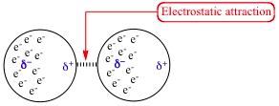
London Dispersion Forces
VERY WEAK and TEMPORARY!!!!
Caused by temporary unequal electron distribution that makes weak and temporary dipoles. Also called “instantaneous dipole”
Example I₂

Slide 5
London Dispersion Forces Continued…
EVERYTHING HAS LONDON DISPERSION FORCES BECAUSE EVERYTHING HAS ELECTRONS!
Bigger molecules will have more LDFs – more places to get temporary unequal electrons
C₈H₁₈ will have more LDFs than C₃H₈

Slide 6
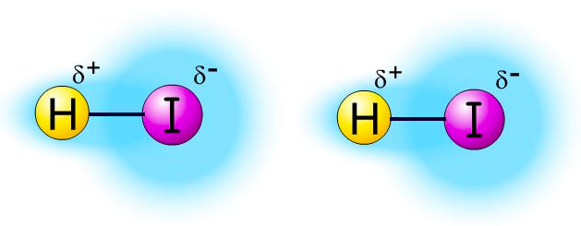
Dipole - Dipole
ONLY OCCURS IN POLAR MOLECULES
Partially negative portion of one polar molecule attracted to Partially positive portion of the second polar molecule
Example: 2 molecules of HI

Slide 7
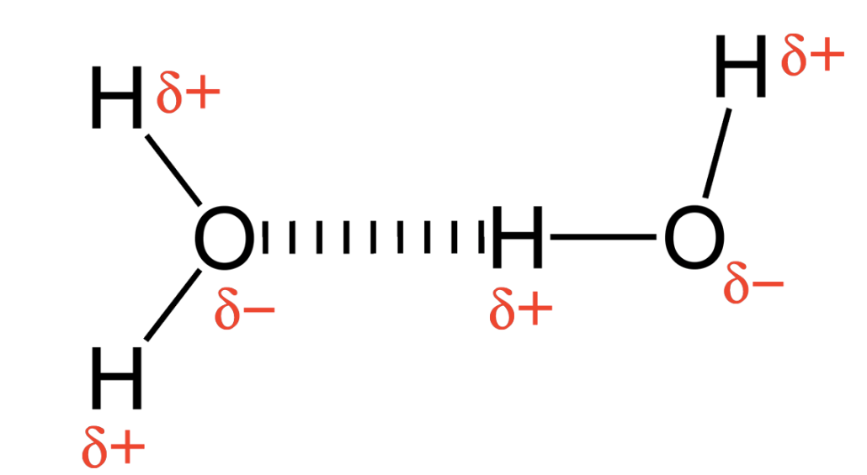
Hydrogen Bonding
A TYPE OF DIPOLE-DIPOLE! (Strongest Kind of IMF!)
:
Must have: “H-NOF:”
ATTRACTION BETWEEN:
Hydrogen end of an O-H, N-H, or F-H bond
the partially negative part of a lone pair on an N, O, or F, atom
-
+

Slide 8
NO
Is the molecule polar?
YES
London Dispersion Forces (ONLY)
Does the molecule have any of the following bonds: H-N H-O
H-F
WITH LONE PAIR(S)!
NO
Dipole-Dipole (and London dispersion)
YES
Hydrogen Bonds (and Dipole-Dipole and London dispersion)

Slide 9
Molecule | Dominant IMF | Written Justification
C₂H₆
CH₃OH
PF₃
NH₃
H₂CO
CH₃F

Slide 10
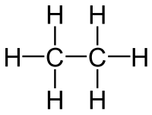
Molecule | Dominant IMF | Written Justification
C₂H₆
CH₃OH
PF₃
NH₃
H₂CO
CH₃F
Non-polar
Only option is London Dispersion Forces!

Slide 11
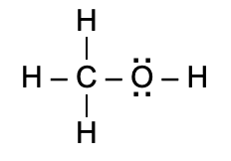
Molecule | Dominant IMF | Written Justification
C₂H₆
CH₃OH
PF₃
NH₃
H₂CO
CH₃F
Polar
Has “H-NOF Lone Pair”
So it is an H-Bond

Slide 12
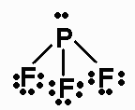
Molecule | Dominant IMF | Written Justification
C₂H₆
CH₃OH
PF₃
NH₃
H₂CO
CH₃F
Remember that lone pairs on the center atom bend the molecule!
Polar
NO “H-NOF Lone Pair”
So it is Dipole-Dipole

Slide 13
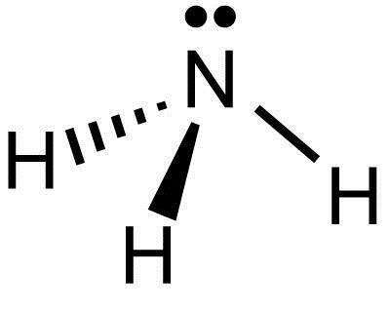
Molecule | Dominant IMF | Written Justification
C₂H₆
CH₃OH
PF₃
NH₃
H₂CO
CH₃F
Remember that lone pairs on the center atom bend the molecule!
Polar
Has “H-NOF Lone Pair”
So it is an H-Bond!

Slide 14
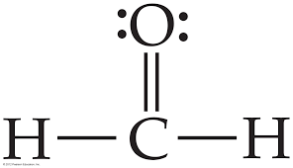
Molecule | Dominant IMF | Written Justification
C₂H₆
CH₃OH
PF₃
NH₃
H₂CO
CH₃F
Careful! The formula was “chunked” to try and give you a hint!
Polar
NO “H-NOF Lone Pair”
The H is not connected
to the oxygen!
So it is Dipole-Dipole!

Slide 15
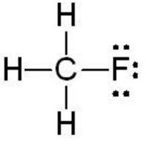
Molecule | Dominant IMF | Written Justification
C₂H₆
CH₃OH
PF₃
NH₃
H₂CO
CH₃F
Polar
NO “H-NOF Lone Pair”
The F is not connected
to the oxygen!
So it is Dipole-Dipole!

Slide 16
Crash Course – Liquids https://youtu.be/BqQJPCdmIp8

Slide 17
YouTube Link to Presentation https://youtu.be/NzUSb6QFaBk

