Slide 1
Special Examples of IMFs and Bulk Solids

Slide 2
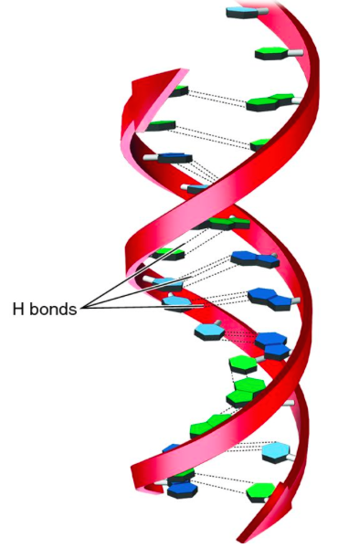
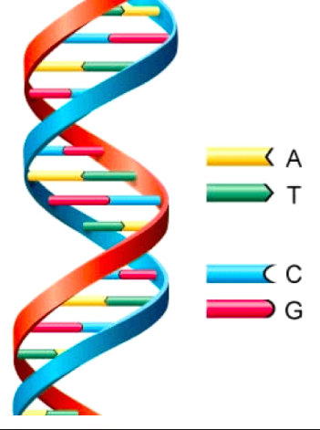
Important Example of H-Bonding
DNA Alpha helix shape-
Nucleic acids “bond” A to T and C to G
H bonds
Generic DNA picture

Slide 3
Please highlight the Hydrogen Bonds on your little Glue-In paper

Slide 4
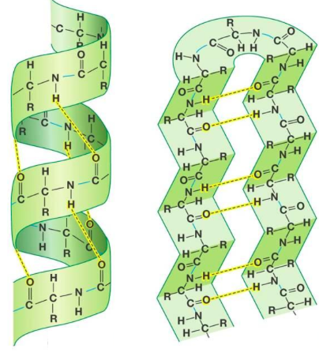
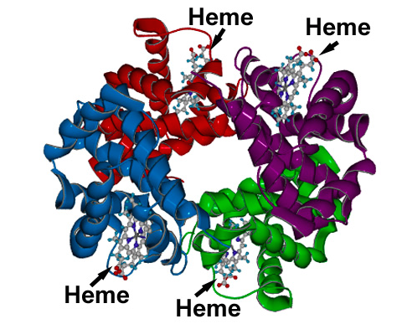
H bonding in protein shapes
Proteins – chain of amino acids
Secondary structures: beta sheets and alpha helix
Alpha helix
Beta sheets
Hemoglobin protein

Slide 5
Bulk Solids

Slide 6
Interactions in solids
COMBINATION OF: intramolecular AND intermolecular forces in a “large” or “bulk” scale
3 TYPES
Metallic (weakest) Ionic Lattice (middle)
Network covalent (strongest)
Bulk solids have very high melting/boiling points because there are SO MANY inter and intra molecular forces holding the atoms close together

Slide 7
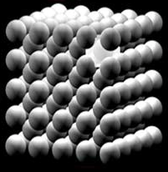
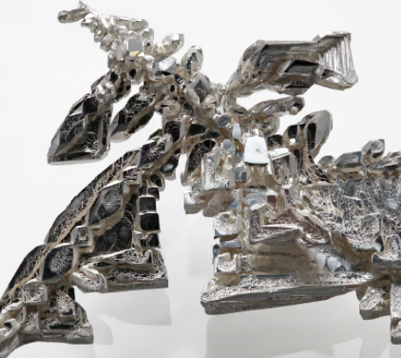
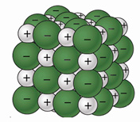
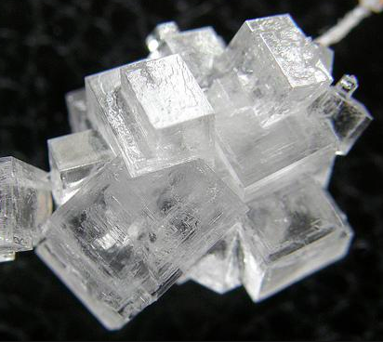
METALLIC
Metal ions stack in an
ordered fashion held together
by the “sea of electrons” and
the positive metal ions
Example: Fe
IONIC LATTICE ions stack in an ordered fashion to form crystals
Example: NaCl

Slide 8
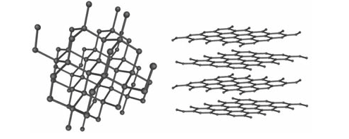
NETWORK COVALENT Examples: Diamond/Graphite = both C, Si, SiO₂ , W
covalently bonded atoms in a continuous network
Example: Carbon
DIAMONDS GRAPHITE

Slide 9
Overall Ranking
Nonpolar Covalent
LDF
Polar Covalent
DP-DP
Polar Covalent
H-Bond
Metallic Bond
Ionic Bond
Network Covalent
Weakest Strongest Least Most
IMFs IMFs

Slide 10
How to Rank Based on Properties
1st – Have to identify the TYPE of IMF present
2nd – Have to put them in order based on the general overall ranking from previous slide
3rd – Don’t forget things like:
If both are LDF then rank based on largest # of electrons
If both Dipole-dipole then rank based on largest electronegativity difference.

Slide 11
Example
H₂
SiO₂
Cu
CO
Br₂
H₂O
KF
- LDF
Rank the following substances from lowest boiling point to highest boiling point
- Network Covalent
- Metallic
- Dipole-Dipole
- LDF
- Hydrogen bond
- Ionic
H₂ <
Br₂ <
CO <
H₂O <
Cu <
KF <
SiO₂
LOWEST
HIGHEST

Slide 12
Geckos https://www.youtube.com/watch?v=YeSuQm7KfaE

Slide 13
Reading - It is a class copy – please don’t write on the paper directly - Divide your paper in half so you have a top half for notes and the bottom half for the next part. - Take notes in your notebook - Talk about what you are reading in your groups. This will make the next part easier!
Notes from reading
#1
#2
#3

Slide 14
Notes from reading
Pick three examples from your reading.
Write a small paragraph about each one. FULL SENTENCES! It should be several sentences each.
Must fill half the page!
#1
#2
#3

Slide 15
YouTube Link to Presentation
https://youtu.be/TbugACqGwyI

