Slide 1
Instructions for the day! DO NOT KEEP THIS HANDOUT! CLASS COPY
Jumpstart is written on the whiteboard. Complete it.
Set up KCQ notes on page __________ as shown on this handout
Target: I can describe and explain special examples of IMFs and Bulk Solids
Take your notes using this print out of the powerpoint
Complete your KCQ boxes
Show the sub and get your page stamped

Slide 2
Take the gold colored reading handout from the sub – it is a collection of things found from the internet, all about other examples of IMFs in the real world.
DO NOT KEEP THE GOLD READING HANDOUT!
Read the handout
On the top of page _______ list the examples that were mentioned in the handout
Pick three that were most interesting to you and summarize each of them in 3-5 FULL SENTENCES. Make sure you mention how they relate to IMFs!

Slide 3
Target: I can describe and explain special examples of IMFs and Bulk Solids
K C Q
List of examples from golden colored reading handout from the sub
Three top choices from the handout – summarize each one in 3-5 full sentences
Important examples of hydrogen bonding
DNA | Proteins
Bulk Solids
Definition | Ionic Lattice
Metallic | Network Covalent

Slide 4
Special examples of IMFs

Slide 5
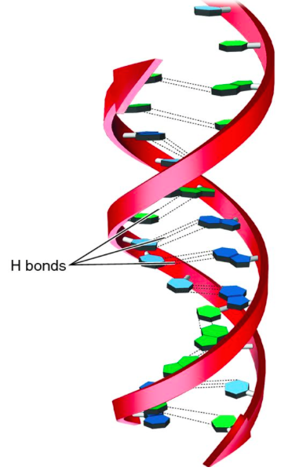
Important Example of H-Bonding
DNA Alpha helix shape-
Nucleic acids “bond” A to T and C to G
H bonds
Generic DNA picture

Slide 7
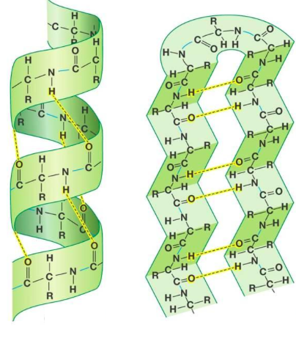
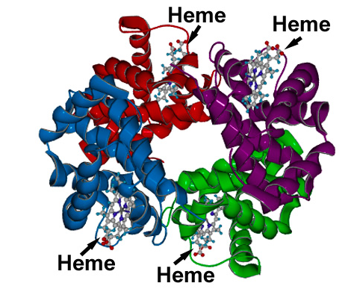
H bonding in protein shapes
Proteins – chain of amino acids
Secondary structures: beta sheets and alpha helix
Alpha helix
Beta sheets
Hemoglobin protein

Slide 8
Bulk Solids

Slide 9
Interactions in solids
Combination of:
intramolecular AND intermolecular forces
in a “large” or “bulk” scale
3 types
Ionic Lattice
Metallic
Network covalent

Slide 10
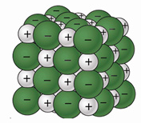
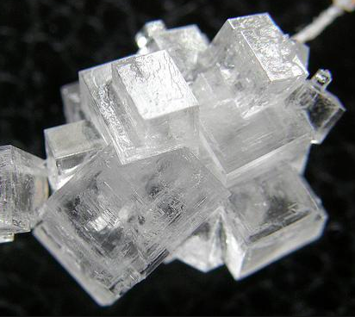
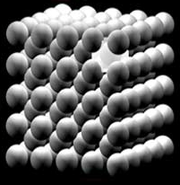
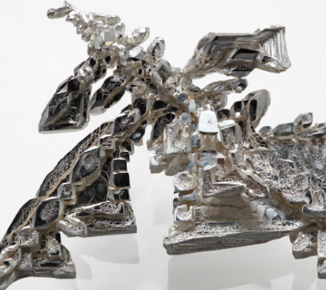
Ionic lattice - ions stack in an ordered fashion to form crystals
Example: NaCl
Metallic – Metal ions stack in an ordered fashion held together by the “sea of electrons” and the positive metal ions
Example: Fe

Slide 11
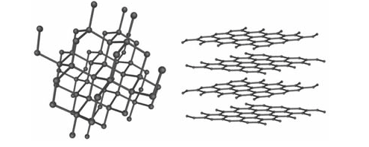
Network covalent – covalently bonded atoms in a continuous network
Example: Carbon
Diamonds graphite

Slide 12
Bulk solids have very high melting/boiling points because there are so many inter and intra molecular forces holding the atoms close together

