Slide 1
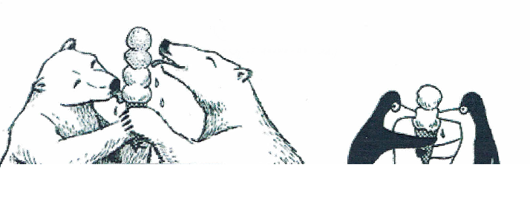
VERBAL Jumpstart
Welcome Back!
How do Picture 1 and 2 relate to what you have learned about atoms and how they bond? Guiding Questions:
What do the polar bears represent?
What do the penguins represent?
What does the ice cream represent?
What kind of bond is represented in Picture #1
In Picture #2?
Picture 1
Picture 2
Hope you had a great vacation!

Slide 2
Molecular Forces

Slide 3
Vocabulary
INTRAmolecular Forces
Forces holding together the atoms INSIDE a molecule or compound.
Types:Ionic forces, covalent forces, polarity
INTERmolecular Forces
Attractions or repulsions which act between neighboring molecules
Types: Hydrogen bonding, dipole-dipole forces, London forces

Slide 4
Intramolecular

Slide 5
Polarity (Intra)

Slide 6
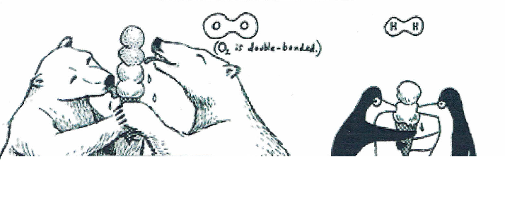
What’s happening inside covalent molecules like O₂ or H₂?
Electrons are shared equally

Slide 7
Molecules become POLAR when electrons are not equally
Example: HF
HF is covalent but electrons are not shared equally

Slide 8
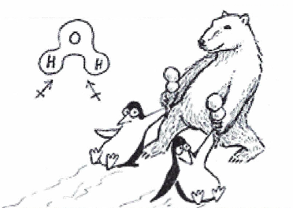
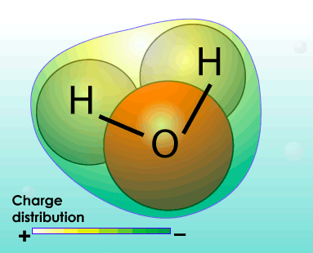
Polar molecules with more than 2 atoms
Water has:
2 H’s willing to almost give up electrons
1 electronegative O Ends up UNEQUAL

Slide 9
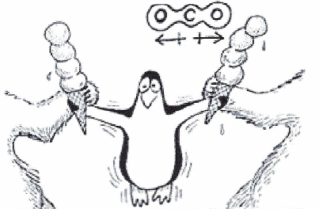
Symmetry…the pole destroyer!
CO₂
Has 1 carbon surrounded by 2 electronegative Oxygens, but is NOT polar?!?!
Symmetrically pulling electron density away from the center of a molecule EVENLY makes it non-polar

Slide 10
INTERmolecular Forces Research
Make smart choices….
Don’t make me take away the iPads ☺

Slide 11
Exit ticket discussion
1) Today’s lesson helped me to understand……..
2) One new thing I learned today was………
3) One thing that I was surprised by today was……..
4) One topic from today that I need more clarification on is……..

