Slide 1
Jumpstart #????
1) Draw the Lewis dot diagram of NH₃
2) Based on your drawing is NH₃ polar or non polar?

Slide 2
INTER molecular forces (forces between neighboring molecules)
London < Dipole-dipole < H-bonding
WEAKEST
STRONGEST

Slide 3
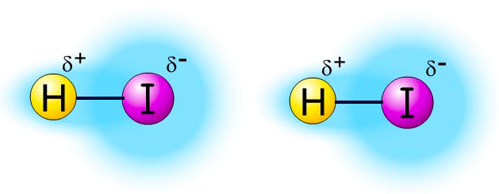
Dipole - Dipole
ONLY OCCURS IN POLAR MOLECULES
Partially negative portion of one polar molecule attracted to Partially positive portion of the second polar molecule
Example: 2 molecules of HI

Slide 4
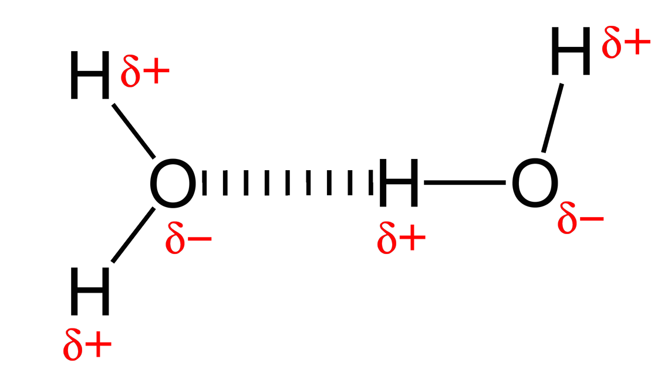
Hydrogen Bonding
A TYPE OF DIPOLE-DIPOLE! (Strongest Kind!)
Must have: “H-NOF”
ATTRACTION BETWEEN:
Hydrogen end of an O-H, N-H, or F-H bond
the partially negative part of a lone pair on an O, F, or N atom
-
+

Slide 5
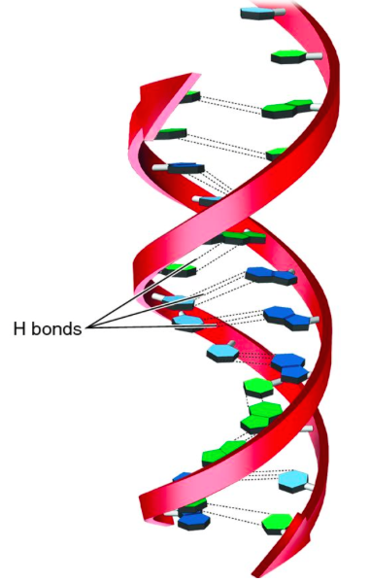
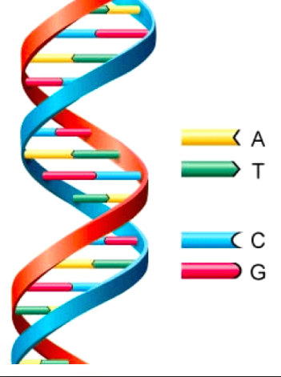
Important Example of H-Bonding
DNA Alpha helix shape-
Nucleic acids “bond” A to T and C to G
H bonds
Generic DNA picture

Slide 7
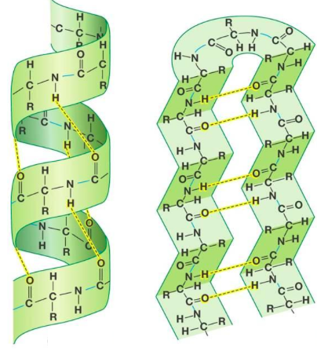
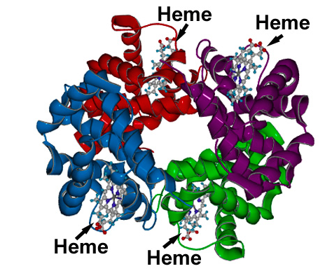
H bonding in protein shapes
Proteins – chain of amino acids
Secondary structures: beta sheets and alpha helix
Alpha helix
Beta sheets
Hemoglobin protein

Slide 8
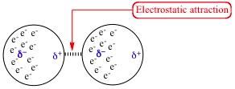
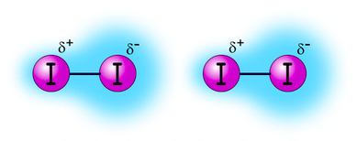
London Forces
VERY WEAK and TEMPORARY!!!!
Caused by temporary unequal electron distribution that makes weak and temporary dipoles.
Example I₂

Slide 9
Interactions in solids
Combination of:
intramolecular AND intermolecular forces
in a “large” or “bulk” scale
3 types
Ionic Lattice
Metallic
Network covalent

Slide 10
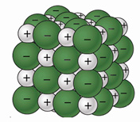
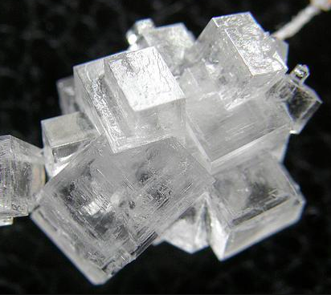
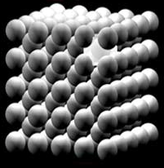
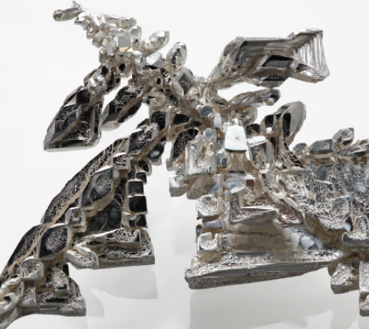
Ionic lattice - ions stack in an ordered fashion to form crystals
Example: NaCl
Metallic – Metal ions stack in an ordered fashion held together by the “sea of electrons” and the positive metal ions
Example: Fe

Slide 11
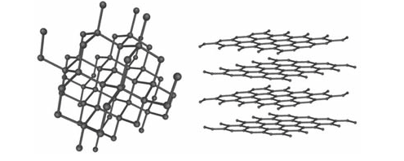
Network covalent – covalently bonded atoms in a continuous network
Example: Carbon
Diamonds graphite

