Slide 1
INTERMOLECULAR FORCES

Slide 2
WELCOME BACK! I hope you had a great winter break!
JUMPSTART
Get your notebook off the lab tables
Pick up the handouts from my lab bench and glue them in!

Slide 3
Page 137
TASK
METHODS
OBSERVATIONS AND RESULTS
EXPLANATION
DIAGRAM
PROCESSING QUESTIONS

Slide 4
GO TO YOUR WORKING LAB STATION
Compare and contrast the structures for each molecule.
Count how many drops of each compound you can get to fit on top of a penny.
Mrs. Farmer will tell you where to go

Slide 5
WHITE BOARD WORK
Design your whiteboard as if it were an informational poster
Include the following:
Task
Methods used
Results
Working explanation
Diagram that adds to your explanation
Questions you have that may change your explanation if you knew the answer to your questions

Slide 6
SHARING SESSION
One person (PRESENTER) stays at working lab bench
Other people divide up to other lab benches (RESEARCHER)
Presenter - share your whiteboard info with info gatherers. PRESENT it to them, don’t sit there while they silently read it.
Researcher – can you answer any of their whiteboard questions?

Slide 7
REPORT BACK
Researchers - return to working lab groups
Report what you saw/learned in other groups
Presenters – did anyone answer any of your whiteboard questions? Can you erase any from your list?

Slide 8
REVISION SESSION
Revise your whiteboard based on your new body of knowledge.

Slide 9
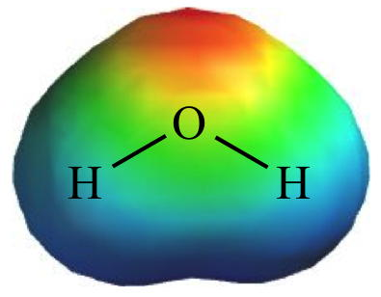
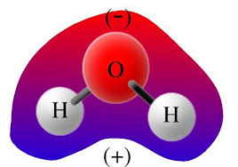
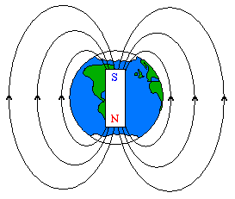
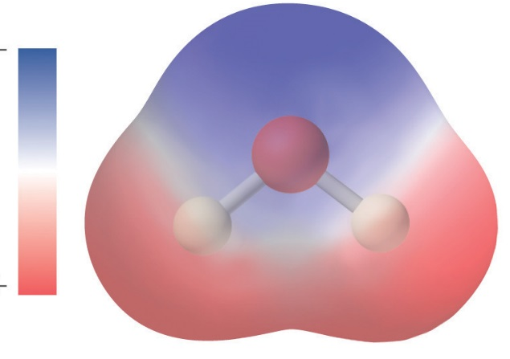
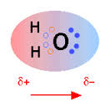
MRS. FARMER’S *HINT*
WATER IS A POLAR MOLECULE
NEGATIVE
POSITIVE

Slide 10
FINAL REVISION SESSION
Revise your whiteboard based on your new body of knowledge.
BE SURE TO INCORPORATE MRS. FARMER’S HINT AND VOCABULARY WORD INTO YOUR WHITEBOARD NOW!

Slide 11
PROCESSING QUESTIONS
Describe your explanation
Describe how your diagram connects to the explanation
How did your explanation change over time?
How did your diagram change over time?
Look around the room and find someone’s diagram that is different than yours – compare and contrast the diagrams
Which questions did you originally have on your whiteboard that you removed after the sharing session?
What questions do you still have on your whiteboard?
Describe an “Ah-ha!” moment that your group had – when did it happen? What prompted it? What did it change about your whiteboard and/or thinking?
Page 136

Slide 12
REPORT OUT
QUESTION NUMBER | LAB BENCH
1 | 8
2 | 7
3 | 6
4 | 5
5 | 4
6 | 3
7 | 2
8 | 1

Slide 13
FOLLOW UP QUESTIONS
What is the definition of polar and non-polar?
List and draw three examples of each.
Research and describe how polarity affects the properties of the molecules
List these in order from least to most polar: H₂O, H₂S, HF, H₂
Page 136

Slide 14
