Slide 1
Jump Start #1B
1) Rank the IMFs from weakest to strongest:
  H-Bond Dipole-Dipole London Dispersion
2) Fill in the blank with either
the word INCREASES or DECREASES:
Melting and Boiling point ________ with
increasing intermolecular forces.
3) Which molecule will have only LDF:
NaCl, CH₄, H₂O, HCl

Slide 2
Agenda
Jump Start
Connections to previous learning (Quick Review)
Sorting Activity
Group Discussion and IMF Handout
Exit Ticket

Slide 3
Connections to previous learning (Quick Review)

Slide 4
Target - I can categorize IMFs based on type, and rank them based on strength.
Do not copy! Not part of notes, just review!
Understand | Identify | Predict
The different types of IMFs.
The Dominant IMF present in the molecule.
How IMFs affect the properties.
Dipole-Dipole
H-Bonding
LDF.
1. Polar or Nonpolar?
2. Does it have
H-NOF:?
Rank the IMFs
1. From Lowest to highest
2. By Weak force to strong force.

Slide 5
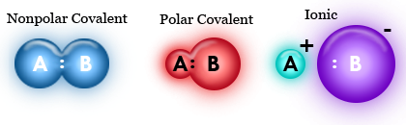
Non-Polar, Polar, & Ionic

Slide 6
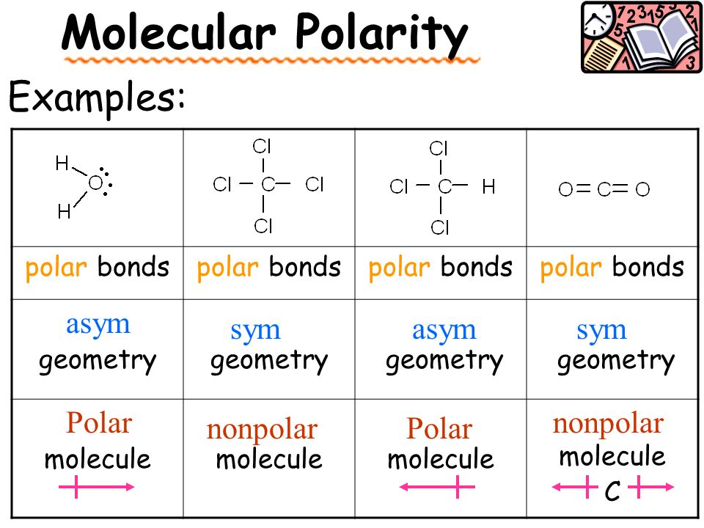
Polar/Non-polar
BOND versus MOLECULE!

Slide 7
IMF Sorting and Ranking Activity

Slide 8
IMF Sorting Activity
GOAL #1
To identify type of IMF present
Group molecule cards
into piles based on the
dominant IMF present.
Predict the boiling
point (high vs low) of
a molecule by first
identifying the
dominant IMF
present.
GOAL #2
To rank properties based on type of IMF present

Slide 9
Seating/Grouping For the Activity
Bench #1 | Red Even
Bench #2 | Red Odd
Bench #3 | Yellow Even
Bench #4 | Yellow Odd
Bench #5 | Green Even
Bench #6 | Green Odd
Bench #7 | Blue Even
Bench #8 | Blue Odd

Slide 10
Learning Check
Answer the question on a Post-It
Stick it on the chart next to the door on your way out
    Stick it on the box with your seat #
Notes:
Tip: Add your own speaker notes here.

Slide 11
Exit Ticket!
 | Polar or Non Polar | Dominant IMF
CO₂
NH₃
HBr

