Slide 1

Balancing Chemical Equations

Slide 2
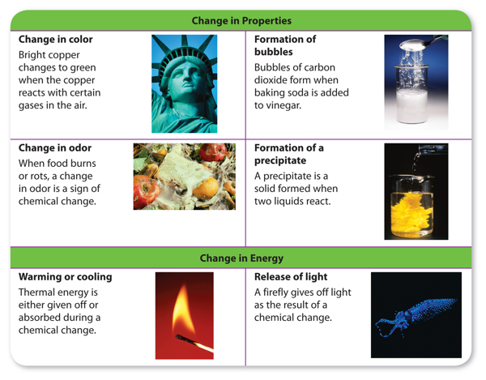
Reminder: Signs of a Chemical Rxn
Change in Properties
Color Change
Formation of a Gas
Odor Change
Formation of a Precipitate
Change in Energy
Absorbing/Releasing Heat
Releasing Light

Slide 3
Law of Conservation of Mass
In normal chemical reactions (not nuclear rxns),
  Total mass of reactants is equal to
  total mass of products
  Nothing can magically appear
  Nothing can magically disappear
  Science not Magic!

Slide 4
Ways to Write Equations
Word Equations
Written with the names of the compounds
hydrogen gas and chlorine gas
combine to form hydrogen chloride gas
Skeleton Equations
Written with formulas
H₂(g) + Cl₂(g) --> 2HCl (g)

Slide 5
Parts of Equations
A + B → C + D
Reactants Products
(starting materials) (ending materials)

Slide 6
Phases
A_{(g)} + B_{(s)} → C_{(l)} + D_{(aq)}
g = gas
s = solid
l = liquid
aq = “aqueous” – ions in water

Slide 7

Diatomic Gases
H₂
N₂
O₂
F₂
Cl₂
Br₂
I₂
Horses Need Oats For Clear Brown “Eyes”

Slide 8
Rules for Balancing
1) Write the skeleton equation
2) Count atoms on each side of arrow
(look at the subscripts & the coefficients!)
3) Change coefficients so the atoms are balanced; NEVER change subscripts!
4) Make sure coefficients are in lowest ratio possible
5) Check your work!
USE
PENCIL!!!

Slide 9
Tips for Balancing that (sometimes) Help!
Stuck? Erase and start over!
Try to balance atoms that appear in the fewest number of places first
Try to leave any diatomics until the end
Oxygens are often the hardest to balance
Try to balance polyatomic ions as a “chunk”
Combustion reactions – put a “2” in front of the hydrocarbon and THEN count & balance (may need to reduce your coefficients at the end, but it makes it easier!)

Slide 10
Practice Problems
Show your work in your notes the way I do!
Yes, eventually you should be able to do these mostly in your head.
BUT you need to be able to show your work when asked, or when you get a hard problem. SO PRACTICE
SHOWING YOUR
WORK!
USE
PENCIL!!!

Slide 11

USE PENCIL ! ! ! ! !

Slide 12
#1
______ ZnS (aq) + ______ O₂ (g) → ______ ZnO (aq) + _____ S (s)
Count each atom – BEFORE, DURING, and AFTER!
2
2
2
Zn:
S:
O:
Zn:
S:
O:
1
2
2
1
2
2
1
2
2
1
2
2
2
2
1
2
2

Slide 13
#2
______ Cu + ______ AgNO₃ → _____ Ag + ______ Cu(NO₃)₂
Count each atom – BEFORE, DURING, and AFTER!
2
2
Cu:
Ag:
N:
O:
Cu:
Ag:
N:
O:
1
1
1
1
1
2
2
1
2
2
1
2
2
2
2
3
6
6
6
6

Slide 14
#3
______ H₃PO₄ + ______ NaOH → _____ Na₃PO₄ + _____ H₂O
Count each atom – BEFORE, DURING, and AFTER!
3
3
H:
P:
Na:
O:
H:
P:
Na:
O:
4
6
2
6
6
6
1
1
1
1
1
3
3
3
3
5
7
7
5
7
7

Slide 15
#4
______ Ca₃(PO₄)₂ + ______ H₂SO₄ → ______ CaSO₄ + ______ H₃PO₄
Count each atom – BEFORE, DURING, and AFTER!
3
3
2
Ca:
P:
O:
H:
S:
Ca:
P:
O:
H:
S:
3
3
1
3
3
2
2
1
2
2
12
20
20
8
16
20
20
2
6
6
3
6
6
1
3
3
1
3
3

Slide 16
#5
______ O₂ + ______ CH₄ → ______ H₂O + ______ CO₂
Count each atom – BEFORE, DURING, and AFTER!
*Tip! Combustion reaction! Hydrocarbon reacting with oxygen to make carbon dioxide and water. Put a 2 in front of hydrocarbon and THEN count and start the problem
2
4
1
2
2
4
1
2
O:
C:
H:
O:
C:
H:
2
8
8
3
5
8
8
2
2
1
2
2
8
8
2
8
8
REDUCE!!!!!!!!!

Slide 17
#6
______ Cl₂ + ______ NaBr → ______ NaCl + ______ Br₂
Count each atom – BEFORE, DURING, and AFTER!
How to turn it into a multiple choice question?
1
2
2
1
Cl:
Na:
Br:
Cl:
Na:
Br:
2
2
1
2
2
1
2
2
1
2
2
1
2
2
2
2
What is the SUM of the coefficients?
6
List the coefficients:
1, 2, 2, 1
Can’t forget that there are 1’s when you don’t have a # for a coefficient!

Slide 18


Slide 19
Link to YouTube Presentation
https://youtu.be/xUY2iKdn7jw

