Slide 1
Writing Formulas for ionic compounds

Slide 2
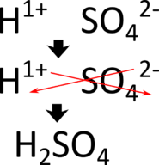
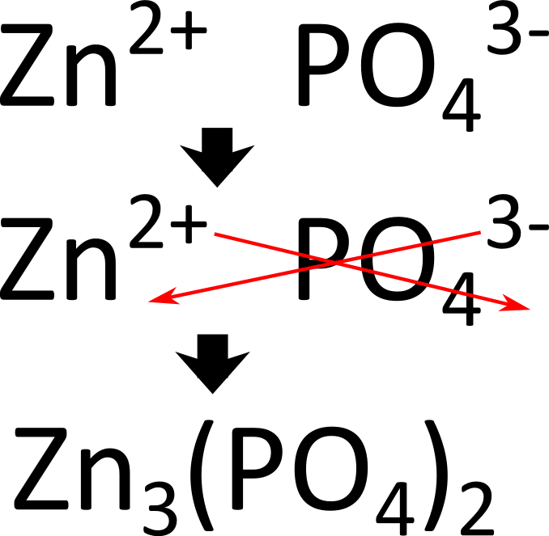

Slide 3
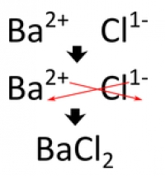
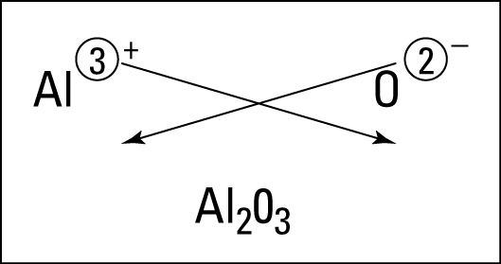
Al³⁺ O²⁻

Slide 4
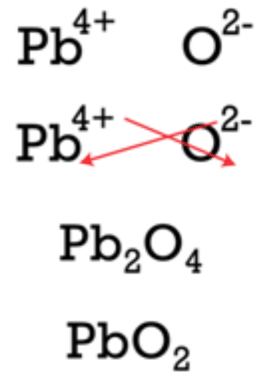
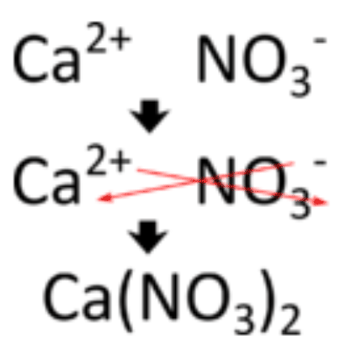

Slide 5
Practice #1
Potassium oxide…………………..K₂O
Calcium nitrate…………………….Ca(NO₃)₂
Chromium (III) hydroxide………..Cr(OH)₃
Ammonium carbonate……………(NH₄)₂CO₃
Zinc hydroxide……………………..Zn(OH)₂

Slide 6
Practice #2
Aluminum oxide…………….Al₂O₃
Iron (II) phosphate………….Fe₃(PO₄)₂
Ammonium acetate………...NH₄C₂H₃O₂
Magnesium bicarbonate…..Mg(HCO₃)₂
Calcium nitride……………...Ca₃N₂

