Slide 2
Spring Test #1 – Review – Chunk #1, 2, 3

Slide 3
LDF, Dipole-Dipole, Hydrogen “bond”
H2, O2, CO2 CO, H2S, HF H2O, NH3
DNA and proteins
HB, LDF, HB, HB, DP-DP, LDF, DP-DP
LDF, DP-DP, HB Ionic, Covalent
When the electrons are not evenly distributed around a molecule
See your notes!
P, P, NP, NP, NP, P, NP
If you don’t know it is bent you would think it is non-polar. Once you know it is bent you know it is polar

Slide 4
CH4 (LDF) < CH3OCH3 (DP-DP) < CH3OH (HB)
CH3CH2OH because it has H-bond, the other only has DP-DP
See your “argument from evidence!”
Any ionic substance like NaCl has ionic lattice, any metal like Fe has metallic bonds, and graphite and diamond have network covalent
Very very high!
Graphite and diamond
When you have the same substance at the end just a different form (ice and water)
When you make brand new subtances/molecules
A physical trait – big/small, color, etc
The way something behaves chemically – “it can burn” or “it can react with oxygen” etc

Slide 5
Melting, boiling, ripping, smashing, cutting
Melting, freezing, condensing, vaporizing, deposition, sublimation
color change, order change, precipitate forms, light is emitted, temperature change
MEMORIZE YOUR IONS!!!!

Slide 6
Melting, boiling, ripping, smashing, cutting
Melting, freezing, condensing, vaporizing, deposition, sublimation
color change, order change, precipitate forms, light is emitted, temperature change
MEMORIZE YOUR IONS!!!!

Slide 7
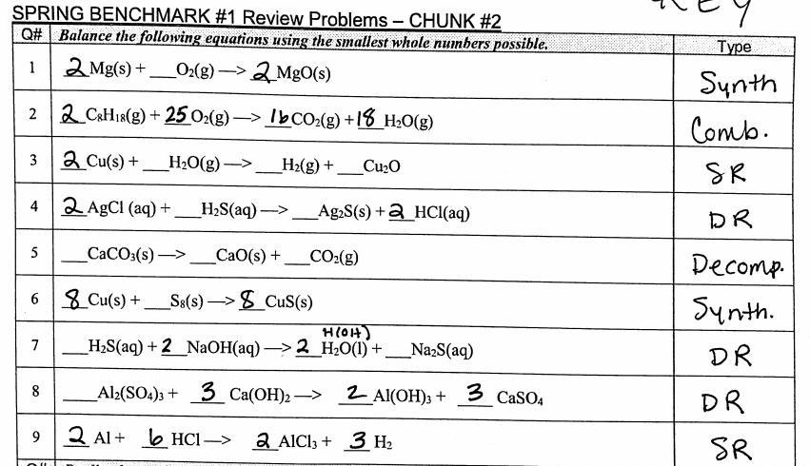

Slide 8
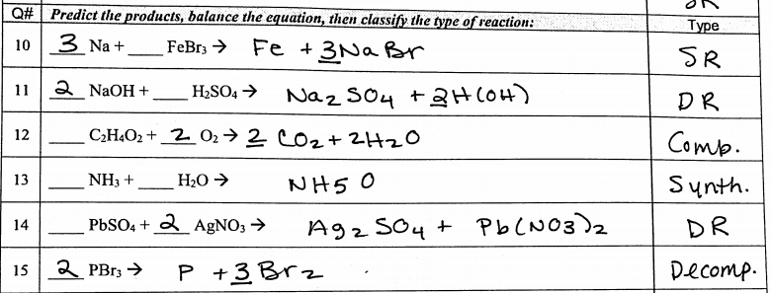
2

Slide 9
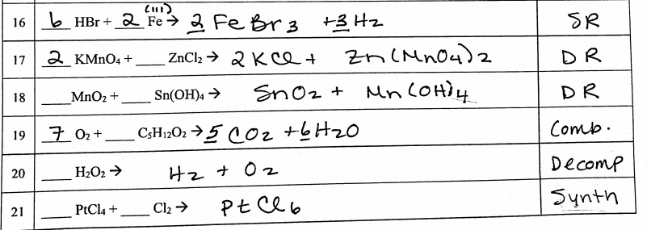

Slide 10
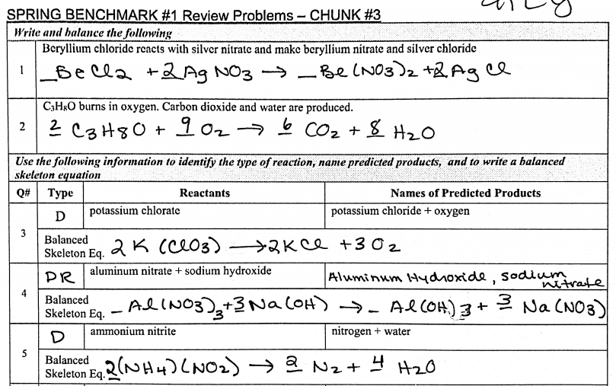
2

Slide 11
