Slide 1
Types of Reactions
Synthesis
Combustion
Decomposition
Double Replacement
Single Replacement

Slide 2
5 Main Categories
Helps us predict things about the reactions
Know the reactants?
You can predict the products
Know the products?
You can predict the reactants

Slide 3
Two things combining into one
Synthesis
Example:
X + Y → XY
O₂ + C → CO₂
What to look for:
More reactants than products

Slide 4
One thing falling apart into two
Decomposition
Example:
XY → X + Y
CaCO₃ → CaO + CO₂
What to look for:
More products than reactants

Slide 5
Burning
Combustion
Example:
Hydrocarbon + O₂ → CO₂ + H₂O
CH₄ + 2O₂ → CO₂ + 2H₂O
What to look for:
Reactants = Hydrocarbon and O₂
Products = CO₂ and H₂O

Slide 6
Swapping one element
Single Replacement
Example:
A + BC → AC + B
2Al + 3Pb(NO₃)₂ → 2Al(NO₃)₃ + 3Pb
What to look for:
Reactants =1 element and 1 compound
Products = 1 element and 1 compound, but different ones

Slide 7
Swapping two elements
Double Replacement
Example:
AB + CD → AD + CB
AgNO₃ + KCl → AgCl + KNO₃
What to look for:
Reactants = 2 Compounds
Products = 2 Compounds but different ones

Slide 8
For Replacement Rxns
If element is a cation, replace it with the other cation. If it is an anion, replace it with the other anion
All neutral compounds need to have a cation and anion when finished (IN THAT ORDER)
You need NEW subscripts – cross over FROM SCRATCH
Careful about diatomic elements in single replacements – they need to be diatomic!

Slide 9
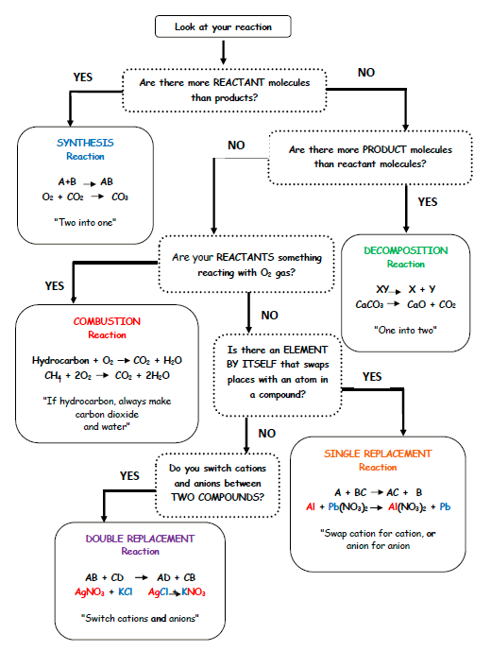

Slide 10
YouTube Link to Presentation:
https://youtu.be/RgKtc2vJ5cM

